Slide 1

Mapping Experiences of (Un)safety Amongst LGBTQ+ Newcomers
Thomas Tri (He/Him)
Bachelor of Social Work Student, Faculty of Social Work, University of Calgary
Supervisor: Dr. Ajwang’ Warria

Slide 2
Outline
01
BACKGROUND
02
INTRODUCTION: WHAT IS SAFETY?
03
LITERATURE
04
THEORETICAL FRAMEWORK
05
RESEARCH PROCESS
06
FINDINGS
07
IMPLICATIONS AND FUTURE RESEARCH

Slide 3
Background
The United Nations Declaration of Human Rights declares that “all human beings are born free and equal in dignity and rights.”
(United Nations, 1948).
12 impose the death penalty
65 countries criminalize private same-sex consensual activity
(Human Dignity Trust, 2023)
There is a lack of protection for LGBTQ+ people and a failure to repeal discriminatory anti-LGBTQ+ laws. The violation of international human rights law in numerous countries:
(Human Dignity Trust, 2023)
(Human Dignity Trust, 2023)

Slide 4
Safety
Physical
Emotional
Cultural

Slide 5
Literature
Safe Spaces
Physical or relational spaces that provide refuge and comfort for marginalized communities (Cisneros & Bracho, 2020; Goh, 2020).
LGBTQ+ Newcomer Experiences throughout the Migration Trajectory
Previous studies document ambivalent experiences. Many express feeling more free and authentic in their identity (Poon et al., 2017; Lee et al., 2021; Marshall, 2021) while others continue to experience discrimination within institutions and diasporic communities (Munro et al., 2013; Shaw & Verghese, 2022).

Slide 6
Theoretical Frameworks
Queer Geography
Affect Theory
  Examining sexuality and gender through power and space
  Interrogating how heteronormativity is embedded within space
  The personal is political
  Human emotions are socially active, reflecting systems of power
(Self & Hudson, 2015)
(Gorton, 2007)

Slide 7






Research Process
Research Tools
Recruitment
Consultations
Six Semi-Structured Interviews
Community Mapping
Reflexive Journalling
Centre for Newcomers, Community Partner
Participants
Data Analysis
  Ages 19-29
  Lesbian, Gay, Bisexual, Transgender, Queer, and Other Sexual and Gender Diverse Identities
  Immigrant, refugee, newcomer who has been in Calgary for 3-36 months
Thematic Analysis

Slide 8
“In Uganda, things are different as compared to how things are done here in Canada. There is a law that was passed by the government just recently and it was a ban to all LGBTQ people. Anyone identifying as part of the LGBTQ community, you were not allowed, to express, to show yourself to the public or else you're gonna face imprisonment.”
Findings
Acline, Uganda
“There's [no protection]. Like how it is in the Bahamas [is] if you're gay and you're beaten up like nearly half to death and you go to a police station to report it, either your file is going to get lost, or the cops are going to laugh at you. Your life isn't counted for and there are no protections afforded to you at all.”
  1. Experiences of Violence
Chase, Bahamas
  Many participants have reported adverse experiences of being LGBTQ+ in their countries of origin
  Some participants discuss experiences of structural violence in Canada
“As an immigrant, sometimes it gets so hard and frustrating, especially the work stuff or sometimes you just get tired…just getting tired and paying the bills up there to be paid and sometimes you feel, I feel like the the money is not enough and stuff.”
Rabbit, Kenya

Slide 9
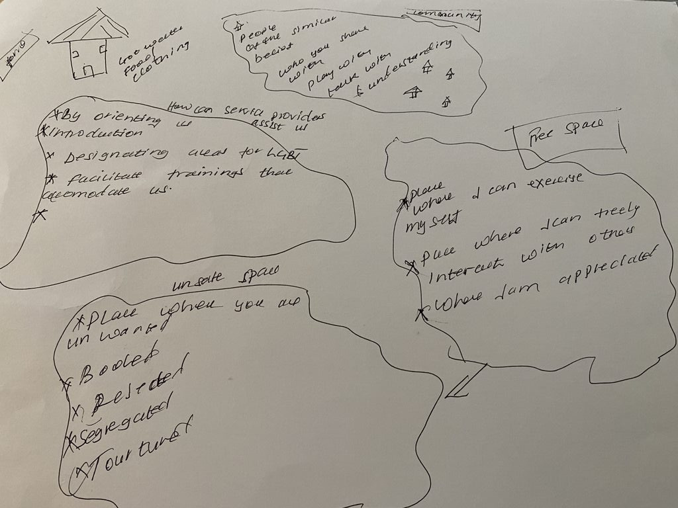
Findings
2. Experiences of Unsafety
  All participants recall experiences of unsafety in numerous spaces
  Participants describe experiences of unsafety as feeling excluded or ostracized
  Others describe it as a fear of being attacked and an ongoing sense that someone is watching them
Unsafe Space
  “Place where you are unwanted”
  “Booed”
  “Resented”
  “Segregated”
  “Tortured”
Courtney, Uganda

Slide 10
“I go with the environment and how I feel about the place of people around me… it’s a different approach in different places and with different people.”
Findings
Rabbit, Kenya
“If it's anywhere I'm by myself, then I don't think about my safety at all. But when I'm with my boyfriend because he can dress a little bit more ‘like out there’.”
3. Navigating (Un)safety
Chase, Bahamas
  All participants report ambivalent feelings as well as strategies to navigate safety in relation to their LGBTQ+ identity
  Strategies for navigating safety include assessing the environment, being conscious of what clothing to wear, and how to “act.”
  Some participants report navigating safety through racialized and LGBTQ+ identities
  Most participants express hesitation with expressing their LGBTQ+ identity in diasporic communities
“Everyone just get the feeling from people, like you just get the vibes”
Utahraptor, Ukraine

Slide 11
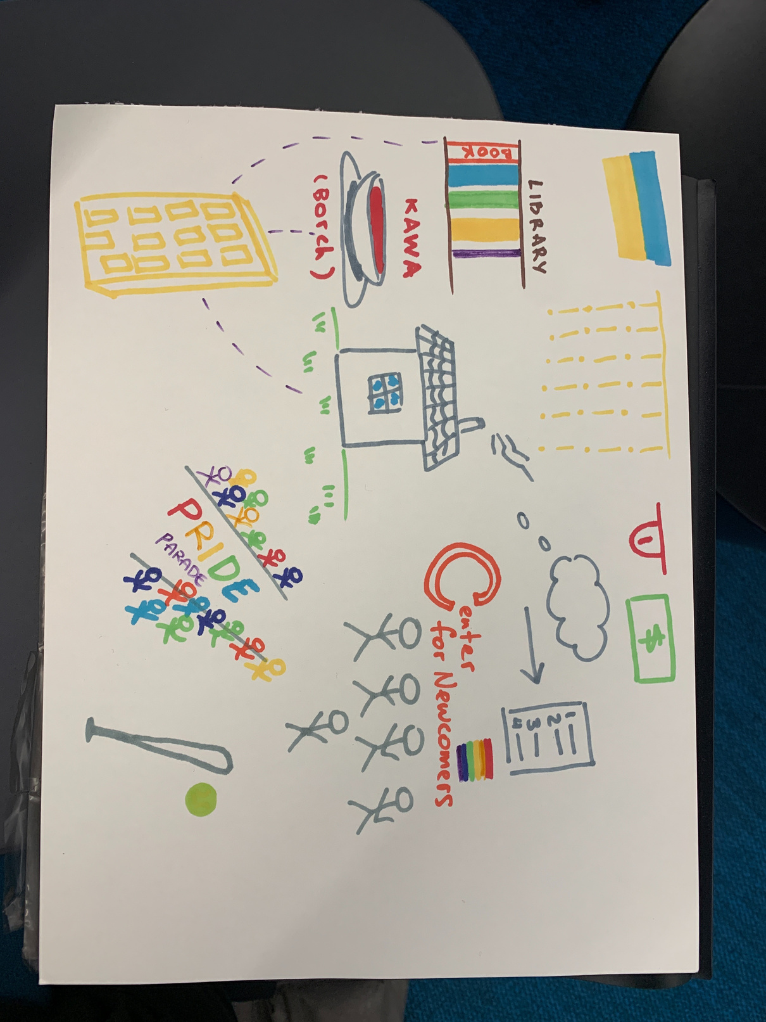
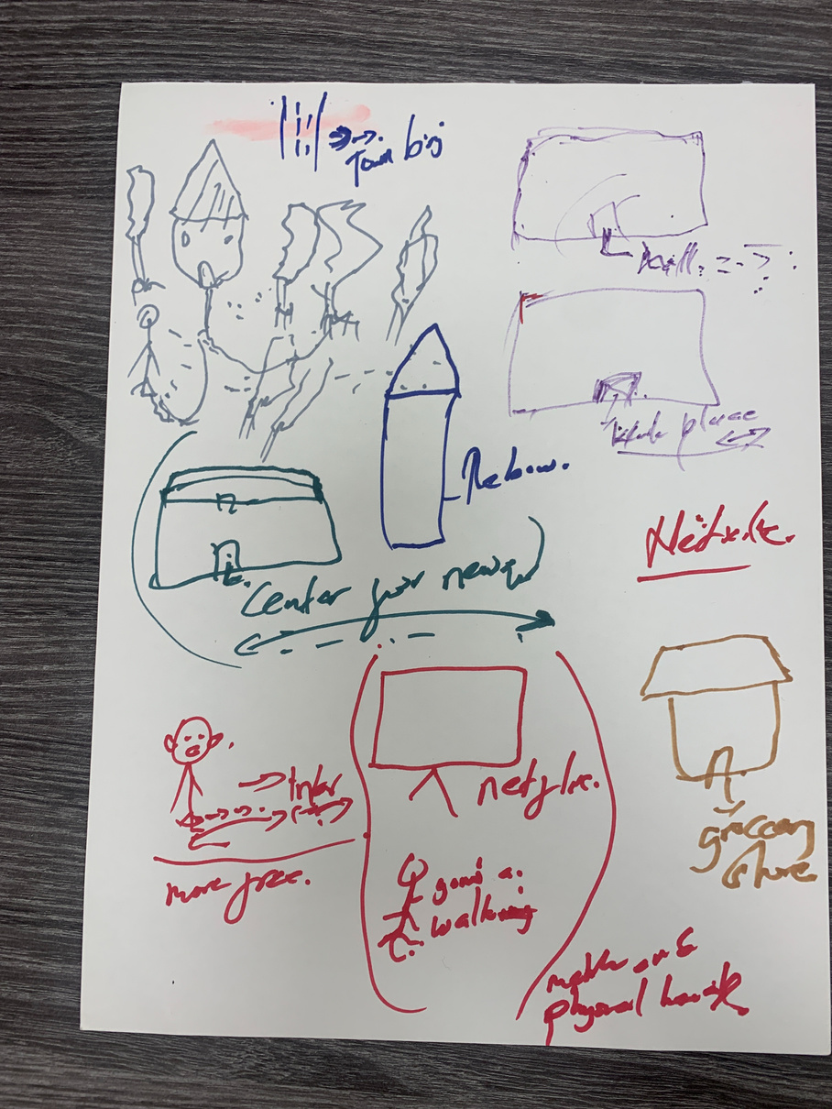
Findings
4. Experiences of Safety
Utahraptor, Ukraine
  All participants reported feeling safer in Canada, which starkly contrasts with their country of origin.
  Participants describe experiences of safety through the following:
    Affirmed in one’s identity
    Having a sense of community and belonging
    Legal protection against discrimination
    Having a sense of agency
Rabbit, Kenya

Slide 12
Implications
Future Research
  Co-creating safer spaces
    Ensures a sense of agency
    Prevent the homogenization of LGBTQ+ experiences
    Acknowledges that safety is a process not a state
  Recognition of Structural Barriers
    Structural violence
    Historical context of anti-LGBTQ+ laws (Lee et al., 2023).
    Prevalence of heteronormativity
  Trauma-Informed Practice
    Fundamental Ecological Threat (Alessi et al., 2017)
  Examining experiences through an intersectional lens
  How do urban environments differ from metropolitan ones?
  How can the community be involved all throughout the entire research process?

Slide 13
Thank you

Slide 14
References
Alessi, E. J., Kahn, S., & Van Der Horn, R. (2017). A Qualitative Exploration of the Premigration Victimization Experiences of Sexual and Gender Minority Refugees and Asylees in the United States and Canada. Journal of Sex Research, 54(7), 936–948. https://doi.org/10.1080/00224499.2016.1229738
Cisneros, J., & Bracho, C. (2020). Undocuqueer Stress: How Safe are “Safe” Spaces, and for Whom? Journal of Homosexuality, 67(11), 1491–1511. https://doi.org/10.1080/00918369.2019.1607684
Goh, K. (2018). Safe Cities and Queer Spaces: The Urban Politics of Radical LGBT Activism. Annals of the American Association of Geographers, 108(2), 463–477. https://doi.org/10.1080/24694452.2017.1392286
Gorton, K. (2007). Theorizing emotion and affect: Feminist engagements. Feminist theory, 8(3), 333-348
Human Dignity Trust. (2023). Map of countries that criminalise LGBT people. Retrieved March 7, 2023, from https://www.humandignitytrust.org/lgbt-the-law/map-of-criminalisation/.
Lee, E. O. J., Hamila, A., Koukoui, S., Zoldan, Y., Militzer, R., Chehaitly, S., Baillargeon, C., & Sansfaçon, A. P. (2023). Migration of LGBTQI+ People: Sexual and/or Gender Minority Migrants, Refugees, and Asylum-Seekers. In N. J. Murakami & M. Akilova (Eds.), Integrative Social Work Practice with Refugees, Asylum Seekers, and Other Forcibly Displaced Persons (pp. 405–428). Springer International Publishing. https://doi.org/10.1007/978-3-031-12600-0_17
Lee, E. O. J., Kamgain, O., Hafford-Letchfield, T., Gleeson, H., Pullen-Sansfaçon, A., & Luu, F. (2021). Knowledge and Policy About LGBTQI Migrants: A Scoping Review of the Canadian and Global Context. Journal of International Migration and Integration, 22(3), 831–848. https://doi.org/10.1007/s12134-020-00771-4
Marshall, N. (2021). QUEERING CYC PRAXIS: WHAT I LEARNED FROM LGBTQI+ NEWCOMER, REFUGEE, AND IMMIGRANT STUDENT EXPERIENCES IN CANADA. International Journal of Child, Youth and Family Studies, 12(3–4), 170–202. https://doi.org/10.18357/ijcyfs123-4202120344
Munro, L., Travers, R., St. John, A., Klein, K., Hunter, H., Brennan, D., & Brett, C. (2013). A bed of roses?: Exploring the experiences of LGBT newcomer youth who migrate to Toronto. Ethnicity and Inequalities in Health and Social Care, 6(4), 137–150. https://doi.org/10.1108/EIHSC-09-2013-0018
Poon, M. K.-L., Li, A. T.-W., Wong, J. P.-H., & Wong, C. (2017). Queer-friendly nation? The experience of Chinese gay immigrants in Canada. China Journal of Social Work, 10(1), 23–38. https://doi.org/10.1080/17525098.2017.1300354
Self, J. M., & Hudson, K. D. (2015). Dangerous Waters and Brave Space: A Critical Feminist Inquiry of Campus LGBTQ Centers. Journal of Gay & Lesbian Social Services, 27(2), 216–245. https://doi.org/10.1080/10538720.2015.1021985
Shaw, A., & Verghese, N. (2022). LGBTQI+ REFUGEES AND ASYLUM SEEKERS: A Review of Research and Data Needs. The Williams Institute at UCLA School of Law. https://www.jstor.org/stable/resrep42552
United Nations. (1948). Universal Declaration of Human Rights

