Slide 1
Disability Ethics of Newcomers
Muna Farah
October 6th, 2023

Slide 2
OBJECTIVES
OVERVIEW
Newcomers with intellectual disabilities in Canada face unique challenges as they navigate the country's healthcare, education, and social systems.
CHALLENGES
Limited Access to Services
Educational Barriers
Cultural Sensitivity
System Navigation
Employment Opportunities
Implementing these solutions with a focus on
cultural sensitivity and respect for religious
beliefs can help address the unique challenges
faced by newcomers with intellectual disabilities and promote their integration, well-being, and inclusion in Canadian society.
SOLUTIONS

Slide 3
OVERVIEW
Newcomers with intellectual disabilities in Canada face unique challenges as they navigate the country's healthcare, education, and social systems.
Caring for newcomer families who lack prior developmental screening can be challenging due to disruptions in education, decreased health literacy, traumatic experiences, and cultural barriers. Culturally sensitive surveillance and screening with evidence-based tools are essential for early intervention in developmental concerns among refugees and immigrants

Slide 4
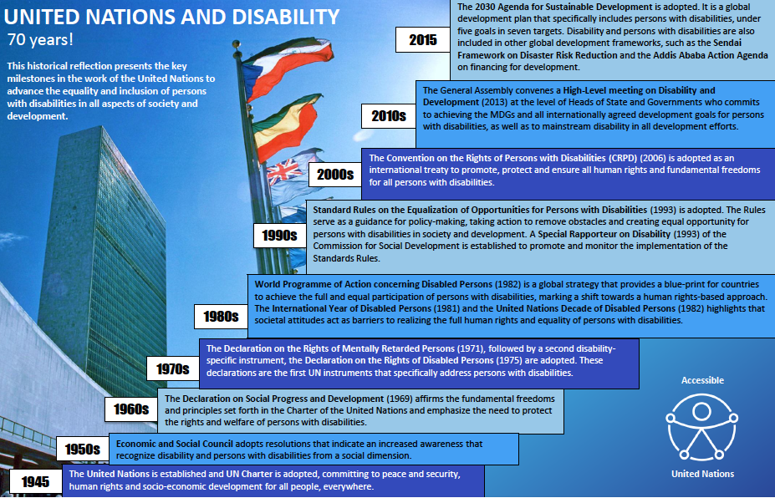

Slide 5
STATISTICS
According to Immigration, Refugees and Citizenship Canada (IRCC), Canada admitted over 400,000 new permanent residents in 2021.
The prevalence of intellectual disabilities among newcomers varies but is estimated to be in line with the general population, which is around 1-3%.
Specific statistics related to intellectual disabilities among newcomers may be challenging to ascertain due to a lack of comprehensive data collection and reporting.

Slide 6
CHALLENGES
Limited Access to Services:
                Newcomers often experience barriers in accessing healthcare and support services, particularly when language and cultural differences are involved.
Educational Barriers:
Children with intellectual disabilities may face challenges in integrating into the Canadian education system, requiring specialized support and accommodations.
Cultural Sensitivity:
Healthcare and educational professionals need to be culturally sensitive to the diverse backgrounds of newcomers, as beliefs and practices related to disability may vary significantly.

Slide 7
CHALLENGES
System Navigation:
Navigating the Canadian healthcare and social support systems can be complex and overwhelming for newcomers with intellectual disabilities and their families.
Employment Opportunities:
Finding suitable employment can be a significant challenge for adults with intellectual disabilities among newcomers.

Slide 8
SOLUTIONS
Culturally Competent Healthcare and Education:
  Training and education programs for healthcare professionals, educators, and service providers to enhance cultural competence.
  Develop and provide resources on common cultural beliefs and practices related to intellectual disabilities.
  Encourage open and respectful communication to bridge cultural gaps and build trust with newcomer families.
Community Engagement and Support:
  Establish community outreach programs to connect newcomers with intellectual disabilities and their families to support networks within their cultural and religious communities.
  Collaborate with religious and community leaders to raise awareness and provide guidance on supporting individuals with intellectual disabilities.

Slide 9
SOLUTIONS
Language Access:
  Ensure access to interpreters and translated materials in healthcare and education settings to facilitate communication with families who may have limited English or French proficiency.
  Create language-specific informational resources about intellectual disabilities and available services.
Culturally Sensitive Assessment and Diagnosis:
  Train diagnosticians and clinicians to approach assessments with cultural sensitivity, considering diverse family backgrounds and belief systems.
  Allow families to express their concerns and perspectives on their child's development and health.

Slide 10
SOLUTIONS
Tailored Educational Support:
  Develop Individualized Education Plans (IEPs) that account for cultural and religious practices and preferences, while still meeting educational goals.
  Collaborate with families to incorporate culturally appropriate teaching methods and materials.
Awareness and Advocacy:
  Conduct awareness campaigns to reduce stigma surrounding intellectual disabilities within culturally diverse communities.
  Encourage advocacy groups to include representatives from various cultural and religious backgrounds to address specific needs and challenges.

Slide 11
SOLUTIONS
Policy and Service Adaptation:
  Review and adapt government policies and service guidelines to accommodate the unique needs of newcomers with intellectual disabilities.
  Allocate resources to fund culturally sensitive programs and services.
Research and Data Collection:
  Collect data on the experiences and outcomes of newcomers with intellectual disabilities, with a focus on cultural and religious aspects.
  Use research findings to inform policies and strategies for improved support.

Slide 12
SOLUTIONS
Collaboration and Partnerships:
  Foster collaboration between government agencies, cultural organizations, religious institutions, and disability advocacy groups to coordinate efforts in supporting newcomers with intellectual disabilities.
Accessible Information and Resources:
  Create easily accessible online and offline resources in multiple languages and formats, covering topics such as disability rights, available services, and cultural considerations.

Slide 13
CONCLUSION
Addressing the needs of newcomers with intellectual disabilities in Canada while considering their religious and cultural backgrounds is a multifaceted endeavor that requires a holistic approach.
By fostering cultural competence, creating supportive communities, and encouraging collaboration between stakeholders, we can pave the way for a more inclusive and respectful society where these individuals can thrive and access the services and opportunities they deserve.
Embracing diversity and promoting cultural sensitivity will not only enhance the well-being of newcomers with intellectual disabilities but also enrich the fabric of Canadian society as a whole.

