Slide 1
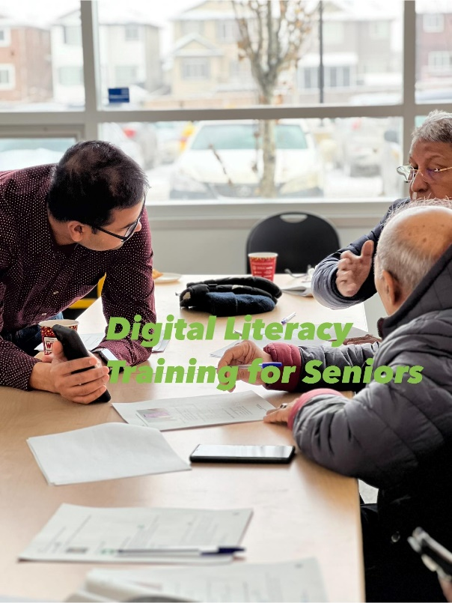


Digital Literacy for South Asian Seniors: Experience with Bangladeshi Community
Ruksana Rashid MBBS, MPH, MSc.
Executive Director, VOICE
Foundation for the Voice of Immigrants in Canada for Empowerment (VOICE)

Slide 2

Who we are?
Organization: Foundation for the Voice of Immigrants in Canada for Empowerment (VOICE)
A non-profit organization established in 2019
Primary Goal: Empower immigrants to reach their full potential and become active members of the society
Activities:
  Knowledge translation on important issues to better inform the immigrant communities
  Support immigrants to build networks with diverse communities and professional bodies, e.g., career mapping
  Offer culturally relevant services to improve health and wellness of vulnerable immigrants
  Engage in community-based research to better understand immigrant communities and their needs

Slide 3


Digital Literacy for South Asian Seniors: Experience with Bangladeshi Community
Funded by
Foundation for the Voice of Immigrants in Canada for Empowerment (VOICE)

Slide 4

Setting the Context
The world is becoming increasingly dependent on digital technology
Digital technology skill can be an empowering tool for seniors
Millions of seniors struggle to navigate the internet
Digital literacy can enable them participate fully in the society and gain access to valuable opportunities available through the internet

Slide 5

Primary Objectives
Support South Asian (SA) seniors build their basic digital skills
Help them improve and maintain their social connections
Increase their online access to resources and services
South Asian seniors are those who were born in any South Asian countries, 60 years or older living in Calgary or surrounding areas, who are Canadian citizens, permanent residents, visitors or with super visa. and speak either Bengali, Hindi, Urdu or Punjabi.

Slide 6
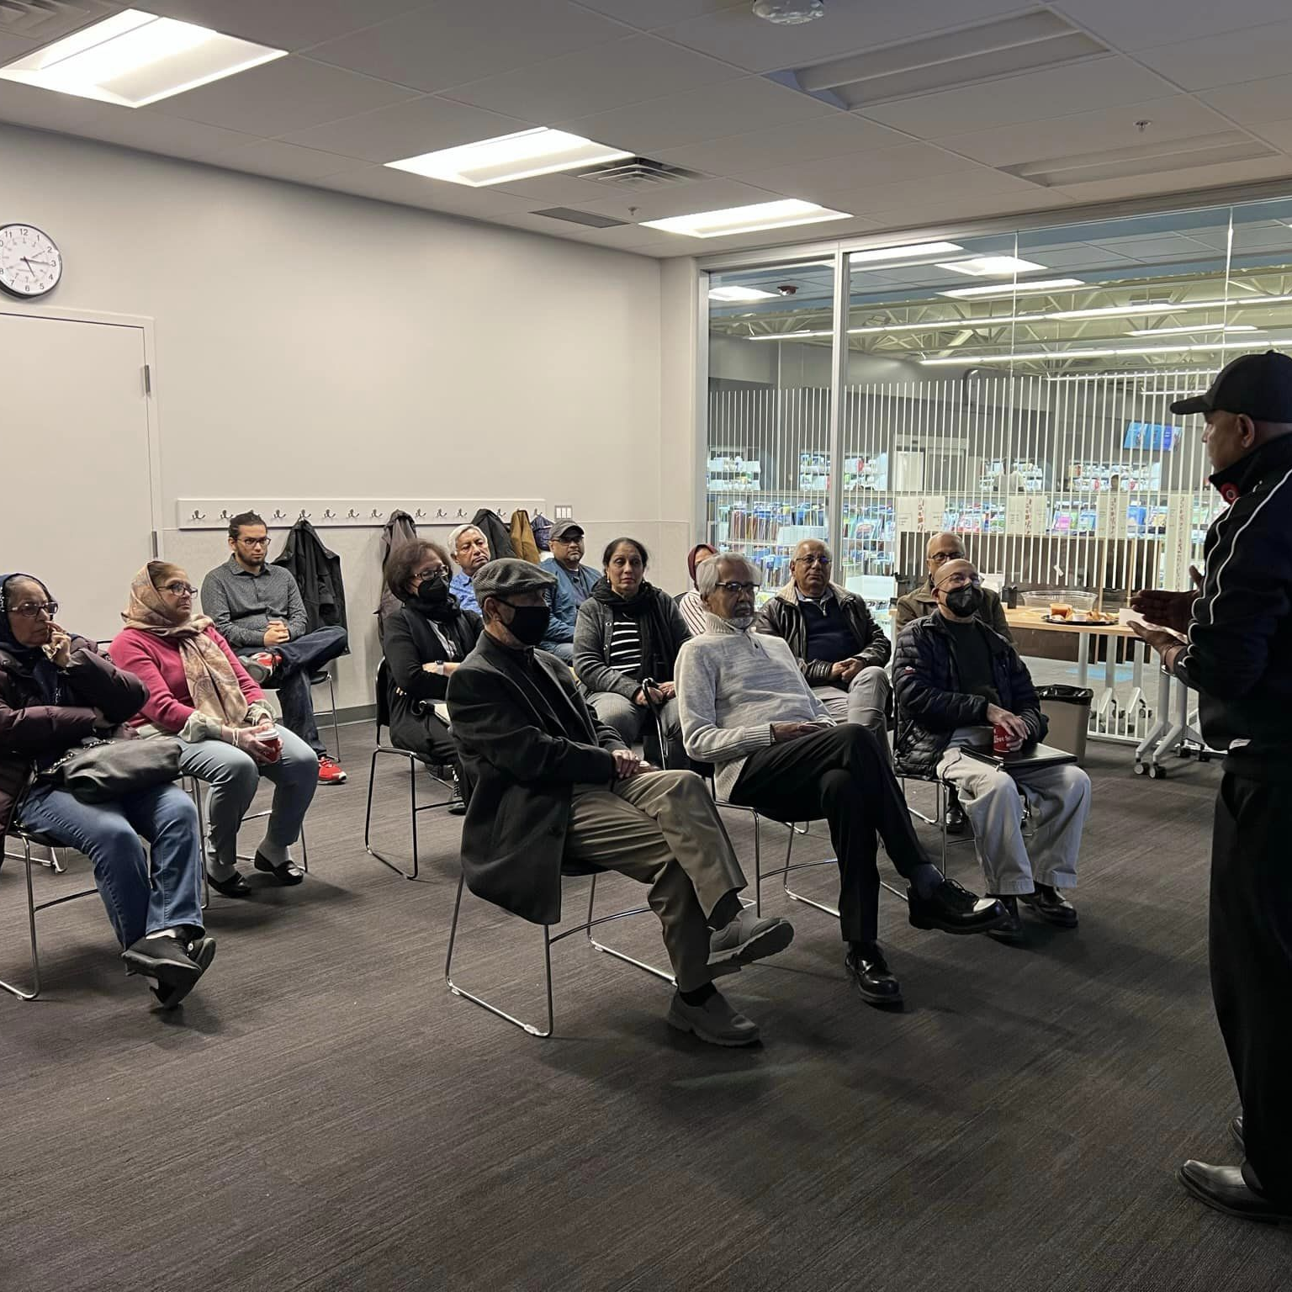

Outreach Strategies
Snowball Strategies
  Through existing network
Social Media Campaign
  Facebook, WhatsApp, Messengers & Website
Small group meetings with seniors

Slide 7

Collaborators
VOICE (Lead Organization)
Other Collaborators
Plan, design, implement, and monitor the project
Prepare curriculum for digital technology training
Offer digital technology training to the Bangladeshi seniors
Uturn Project Inc.
  Hindi & Urdu spoken seniors
Guru Nanak Peace Foundation
  Punjabi spoken seniors
Bangladesh Medical Society of Alberta
  Conduct webinars
University of Calgary

Slide 8

Project Outlines
Digital Literacy Training
Pre, mid and post surveys
Bi-weekly Online Group Chat
Monthly Webinar

Slide 9
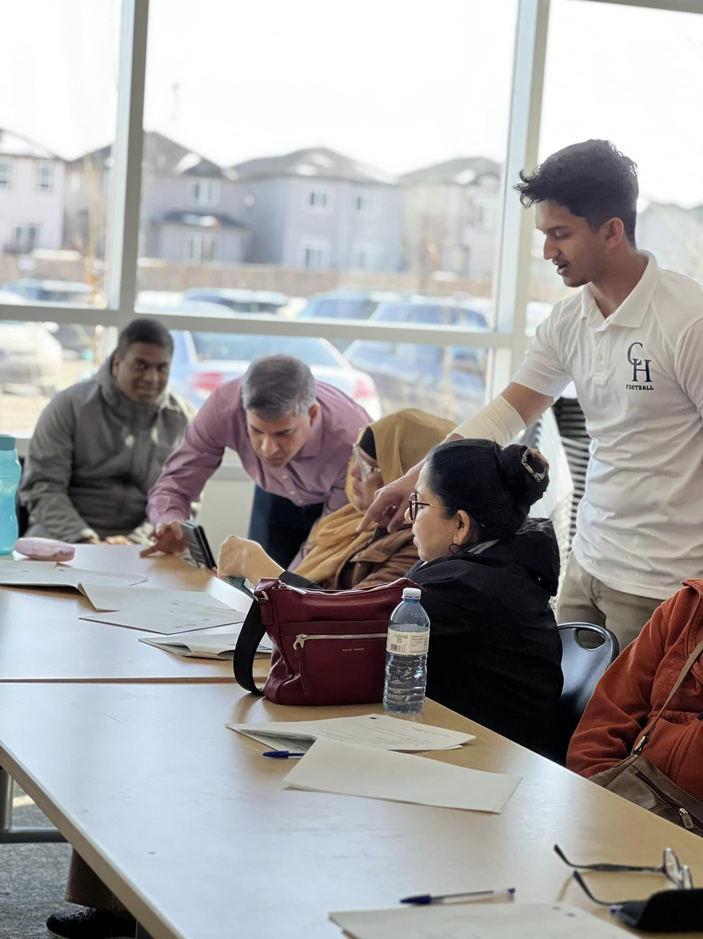

Digital Literacy Training (in-person)
  Performed need assessment while recruiting participants
  Developed a curriculum for baseline digital literacy training
    The topics included how to use smart phones, video chat, Facebook/YouTube and other social media basics, how to access online resources, online shopping, banking and how to be safe on internet.
  Free in-person bi-weekly group training for 2 hours for 4 months starting from March to June 2023

Slide 10

Online Group Chats
  Online group chats for 3 months starting from July 2023
  Group chats are conducted in four languages (Bengali, Hindi, Urdu, & Punjabi)
  Each group consists of 7-8 participants.
  VOICE (Bengali), UTurn (Hindi & Urdu) and Guru Nanak (Punjabi)

Slide 11

Surveys
Four surveys
  Baseline, mid-point, and two post-intervention surveys (at the end and 6 months after the project ends)
  Dr. Turin Chowdhury helped the VOICE team to develop the survey questionnaires
  The surveys are conducted in English
  The goal is to understand the impact in their day-to-day life of the training and to see whether the seniors continue using it

Slide 12
Surveys Timeline
 | Feb 2023 | Jun 2023 | Oct 2023 | April 2024
Baseline | Baseline
Mid-point |  | Mid-point
Post-intervention |  |  | Post-intervention
6 months post-intervention |  |  |  | 6 months post-intervention

Slide 13

Expected Outcomes
SA seniors will be more confident in using digital technology
They will be able to keep online social connection
Can navigate online resources and services

Slide 14

Experiences with the Bangladeshi Seniors
We completed 20 in person training sessions- 10 in Northeast and 10 in Northwest of Calgary
A total of 23 senior members of Bangladesh community participated
We selected Genesis Centre library at Northeast Calgary and Nose Hill library at Northwest Calgary as the workshop locations
We invited guest speakers from multiple disciplines to offer important information to the seniors.

Slide 15
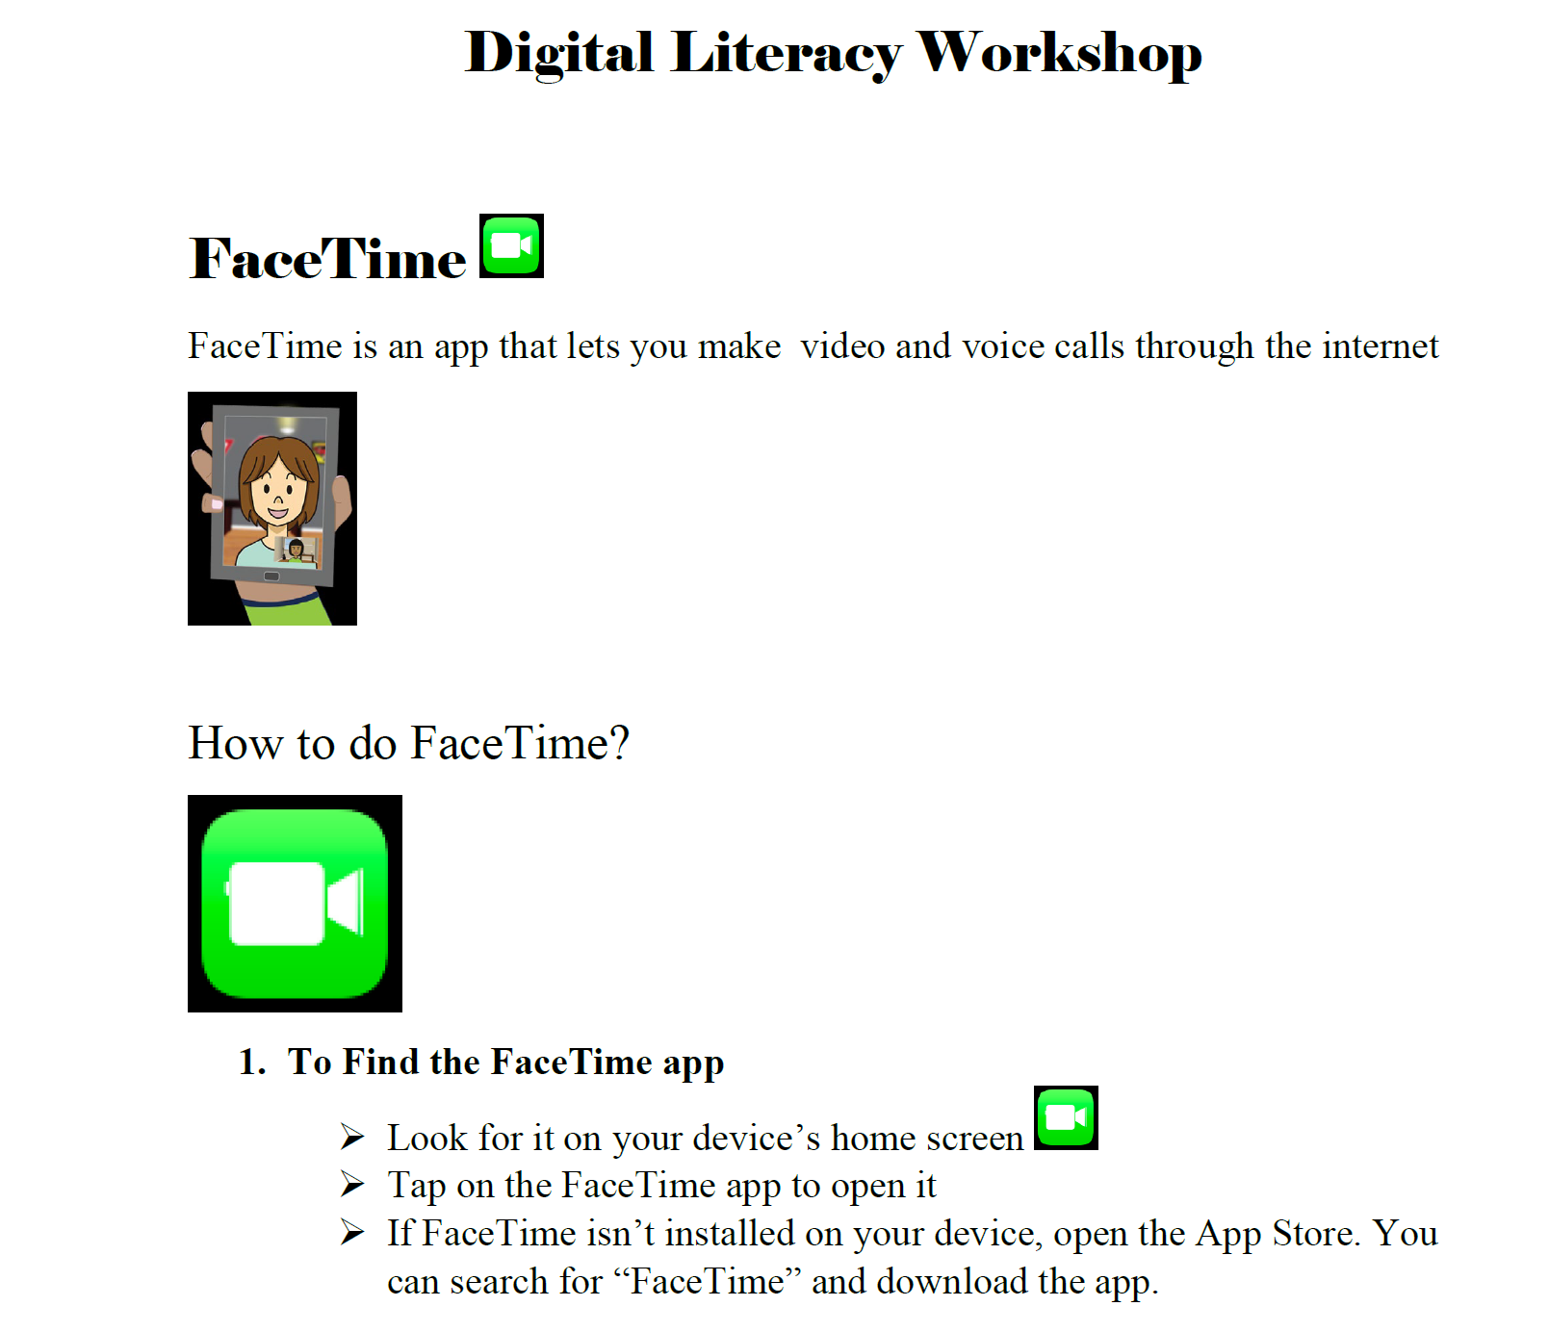

Experiences with the Bangladeshi Seniors
We designed the curriculum appropriate to older adults
Used printed handouts
Volunteers as teaching assistants
Slow paced teaching session and in Bengali
Repeated reminders and reviews

Slide 16
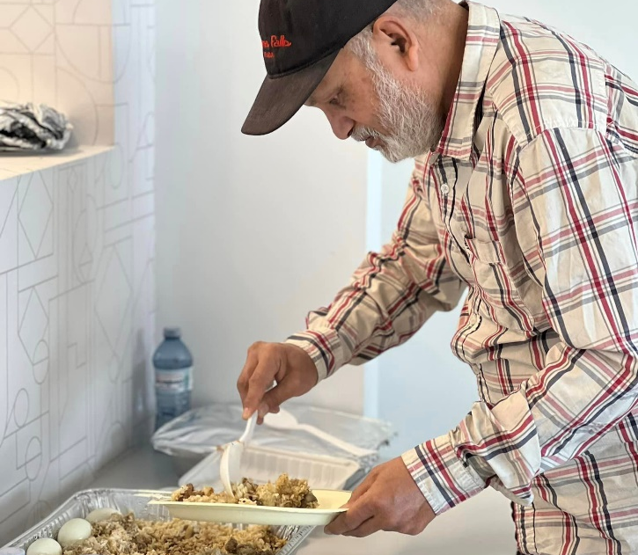
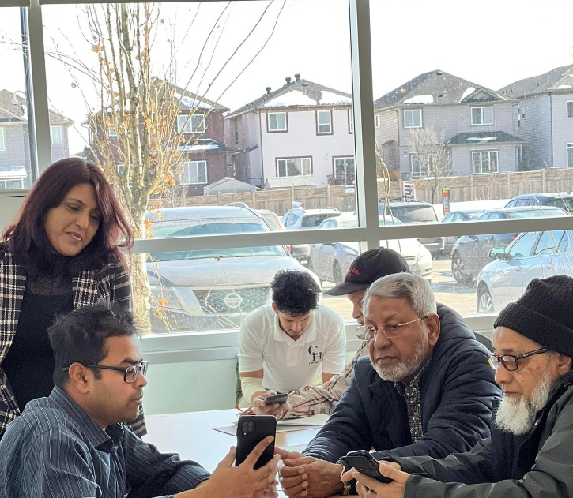
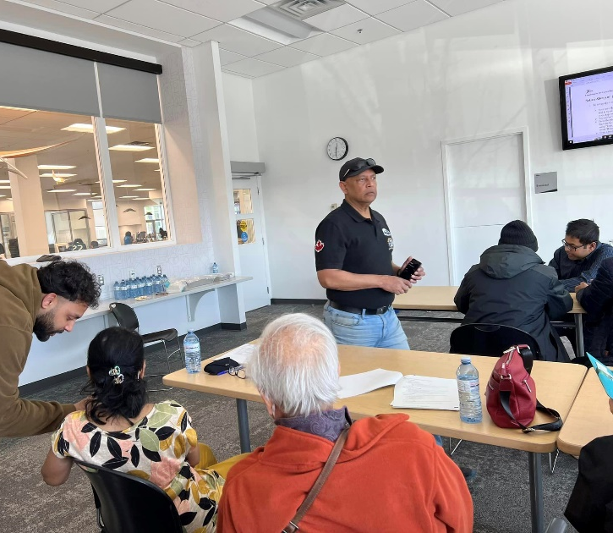
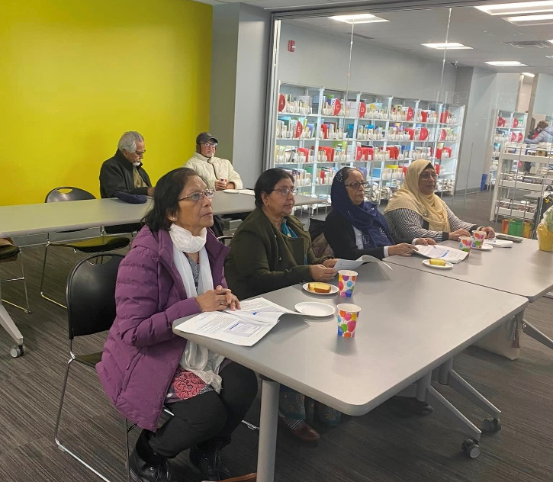
Experiences with the Bangladeshi Seniors
Participants were very willing to join
Socializing with fellow friends were important
Enjoyed potlucks or ethnic foods served

Slide 17

Challenges and Limitations
Lack of transportation
Many do not possess any computer/laptop/iPad/smart phones
A few do not have internet at home ( specifically those who live independently)
Physical disabilities (e.g., short of hearing, declined psychomotor performances etc.)

Slide 18

Conclusion
Building digital competencies of seniors is crucial
Developing a suitable course and creating a quality learning environment is important to enhance digital literacy among seniors
Training workshops need to be as accessible as possible

Slide 19

Acknowledgement
VOICE team
  Shaminder Singh
  Mohammad Rahman
  Md. Habibur Rahman
  Fatema Azim
  Khondoker Morshed
Volunteers
Dr. Turin Chowdhury, University of Calgary

Slide 20
Thank you!

