Slide 1
The Journey of Immigrant Seniors

Slide 2
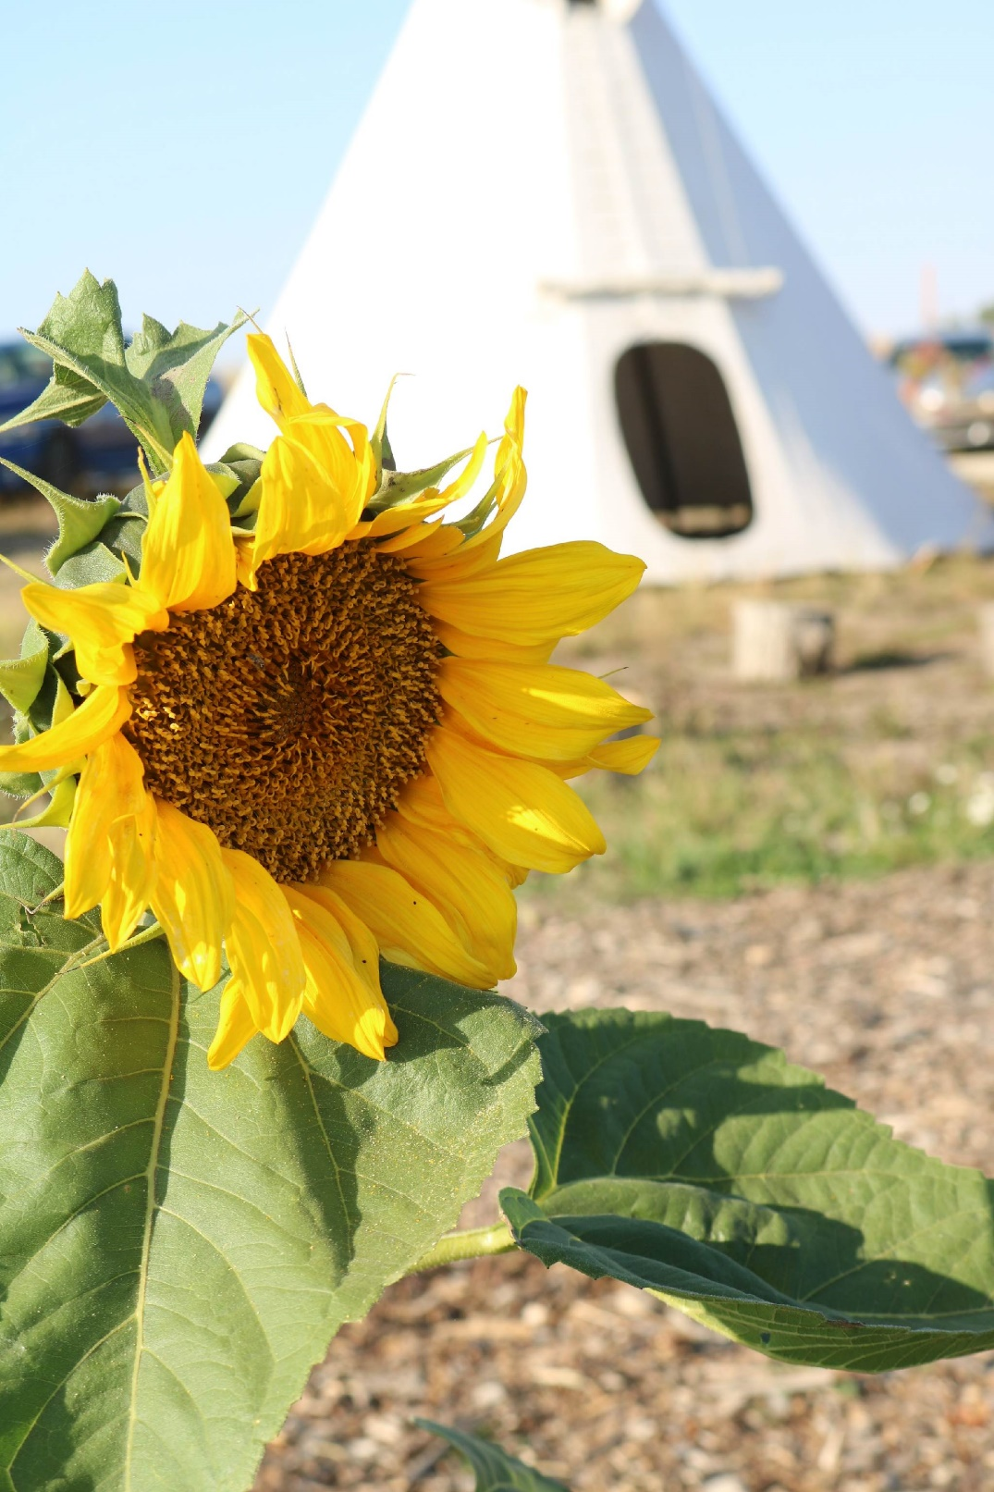
In the spirit of respect, reciprocity and truth, we honour and acknowledge Moh’kinsstis and the traditional Treaty 7 territory and oral practices of the Blackfoot confederacy: Siksika, Kainai, Piikani, as well as the Stoney Nakoda and Tsuut’ina nations.
We acknowledge that this territory is home to the Métis Nation of Alberta, Region 3 within the historical Northwest Métis homeland.
Finally, we acknowledge all Nations, indigenous and non, who live, work and play and help us steward this land, honour and celebrate this territory, as we recognize we are all treaty people.

Slide 3
Background
CCIS has been working with seniors since 1996 and there are many experiences that we can learn from
Immigrant Seniors Services and Seniors Connection

Slide 4
Objectives
To document those lived experiences which can make significant contribution to the community
To develop a book with stories and commentary of seniors for future generation

Slide 5
Methods
Participatory action method
10 individual interviews
5 focus groups
Data collection
Open ended questions
Guided discussions

Slide 6
Methods
Interviews were made in their first language: Cantonese, Hindi, Filipino, Vietnamese, Hispanic, Farsi, Korean, English
With interpreters during focus group discussions: Cantonese, Hindi, Filipino
Consents were taken

Slide 7
Discussion
Identified common themes from the narratives
Journeys to Canada
The Meaning of Home
Home may be described or defined differently,
yet it is closely and almost always associated with a sense of meaning. But leaving that place called home by force or circumstances beyond volition can be traumatizing.
Connecting the Loop

Slide 8
Discussion
challenges of survival
multi-layered discrimination
conflicting identities
adjustment with new culture

Slide 9
The Book
In A Place, I Now Call Home
Immigrant Seniors in Canada: Stories and Commentary
Based on thematic analysis

Slide 10
Results
Lessons learned from these narratives will be beneficial to service providers and seniors.
Participants who shared their stories are now sharing the book with their family and friends.
Effects of COVID 19 pandemic:
A combination of in-person and virtual interviews and focus groups.
Pandemic also restricted the volunteers to go back and forth to the seniors to check the contents of the interpretation/translation made by volunteers.
Masking and distancing were practiced by volunteers and participants.

Slide 11
Thank You
Sherrisa Celis – scelis@ccisab.ca
403 290 5755
Rashmi Dhaubhadel – rdhaubhadel@ccisab.ca
403 290 5754
Sabita Basnet –sbasnet@ccisab.ca
403 290 5756

Slide 12
