Slide 1

Developing a Toolkit for Hybrid Instruction for Adult Newcomer Literacy Learners
A Participatory Research Approach
Marianne Barker, Ph.D. & Paula Sampang, MA
November 9, 2023
Funded by: Immigration, Refugees and Citizenship Canada
Notes:
Marianne: Welcome to our presentation called, “Developing a Toolkit for Hybrid Instruction for Adult Newcomer Literacy Learners”
My name is Marianne Barker. (and I’m Paula Sampang). And we are part of a broader research team at an immigrant-serving organization here in Calgary called The Immigrant Education Society, or TIES.
The purpose of our presentation today is to share about our process of developing a toolkit to support language teachers involved in educating literacy learners.

Slide 2
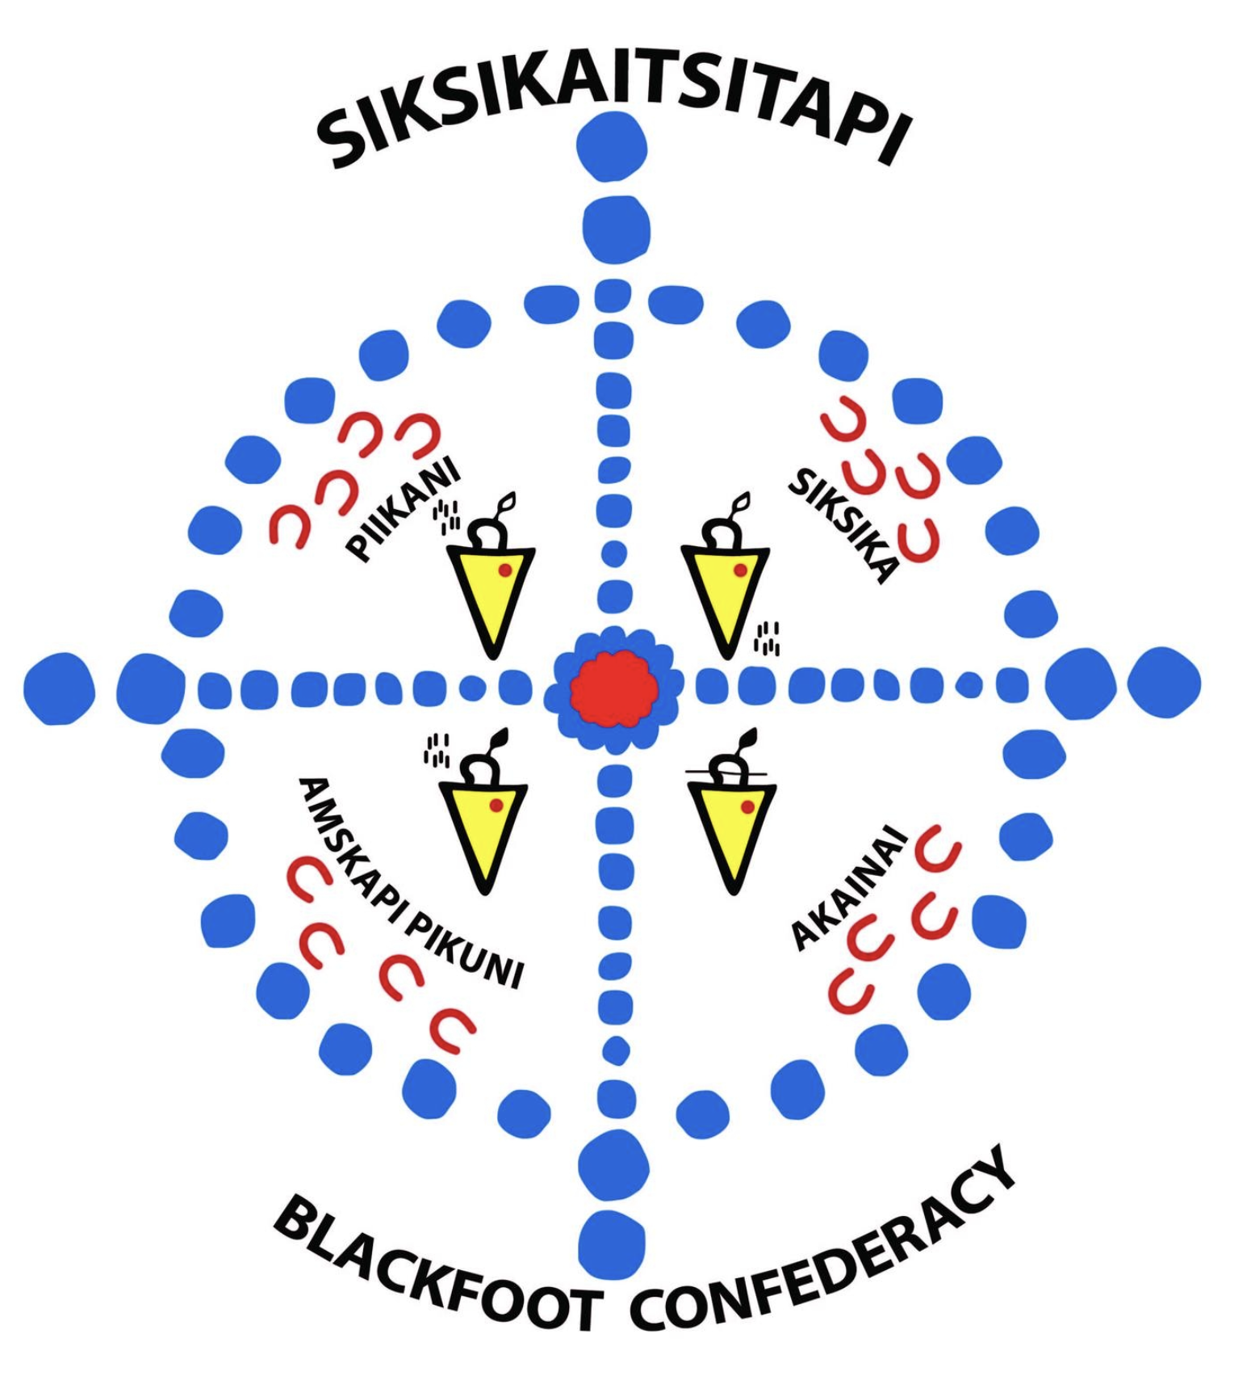


Land Acknowledgement
Notes:
Marianne: Before we get into it, I want to acknowledge the traditional territories of the peoples of Treaty 7, which include the Blackfoot Confederacy, the Tsuut’ina First Nation, and the Stoney Nakoda.
In doing research with immigrants, it’s important to remember that we are all settlers on this land, and we have a role to play in recognize and reconcile the systemic injustices faced by Indigenous communities in Canada.

Slide 3

Current Research Team
The Immigrant Education Society
University of Michigan
University of British Columbia
Katerina Palova
(Co-investigator)
Fatemeh Kazemi
(Senior Researcher)
Marianne Barker
(Research Associate)
Geneca Henry
(Research Coordinator)
Paula Sampang
(Research Assistant)
Dr. Odessa Gonzalez-Benson
(Co-investigator)
Dr. Elena Godin
(Service Developer)
Dr. Anusha Kassan
(Co-investigator)
In partnership with:
LINC Literacy at Edmonton Catholic District School Board
Notes:
Marianne: As I mentioned, Paula and I are part of a broader research group working on a 3 year project. You see our TIES contributors on the left (all of us are in the room today). Our organization partnered with researchers at the University of Michigan and UBC, and our research was conducted in the context of both TIES and the Edmonton Catholic District School Board.

Slide 4

Background: Online Learning for ESL
COVID-19 catalyzed online learning
Increases accessibility for learners with barriers to attending in-person.
Supports access to increasingly digital world.
(Moriarty, 2011; Haleem et al., 2022)
Notes:
Marianne: Our project focuses on online learning formats for Eng language learners.
The Covid-19 pandemic pushed teachers and learners to online spaces with little warning.
Although abrupt, educators adapted and we have come to see benefits of online learning for ESL students, especially immigrants.
Online learning increases accessibility to language classrooms for students who have barriers to attending in person, such as childcare needs or health issues.
Beyond that, learning how to navigate technology in our increasingly digital world has become a necessity.

Slide 5
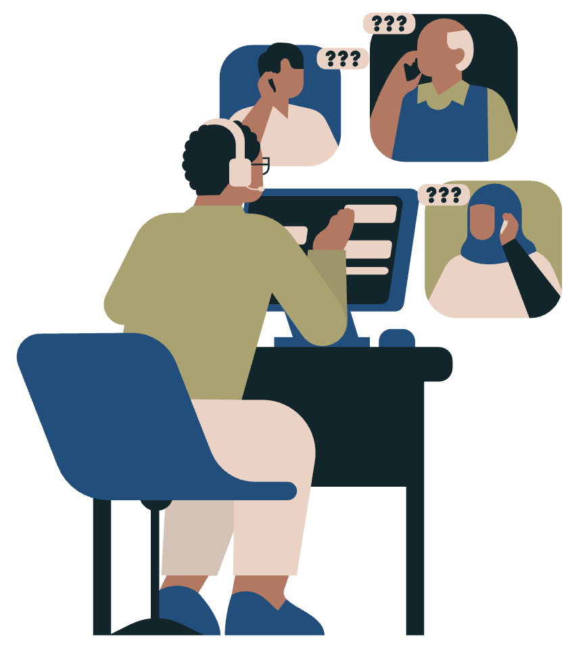
But There’s a Gap: Literacy Learners
Limited formal education
Limited literacy skills in their first language, numeracy, digital literacy.
Unfamiliar with technology and navigating digital spaces.
Few practitioner resources exist to support educators in helping literacy learners gain access and familiarity to remote and hybrid classes.
Notes:
Marianne: However, there is a particular group of learners who have faced the most challenges in moving to online learning formats, and that is Literacy Learners.
Literacy learners have limited formal education, limited literacy skills in their first language, as well as limited numeracy and digital literacy skills.
They also tend to be unfamiliar with technology and struggle to navigate digital spaces.
On top of that, few practitioner resources exist to support educators in helping literacy learners to gain access and familiarity to remote and hybrid classes.

Slide 6
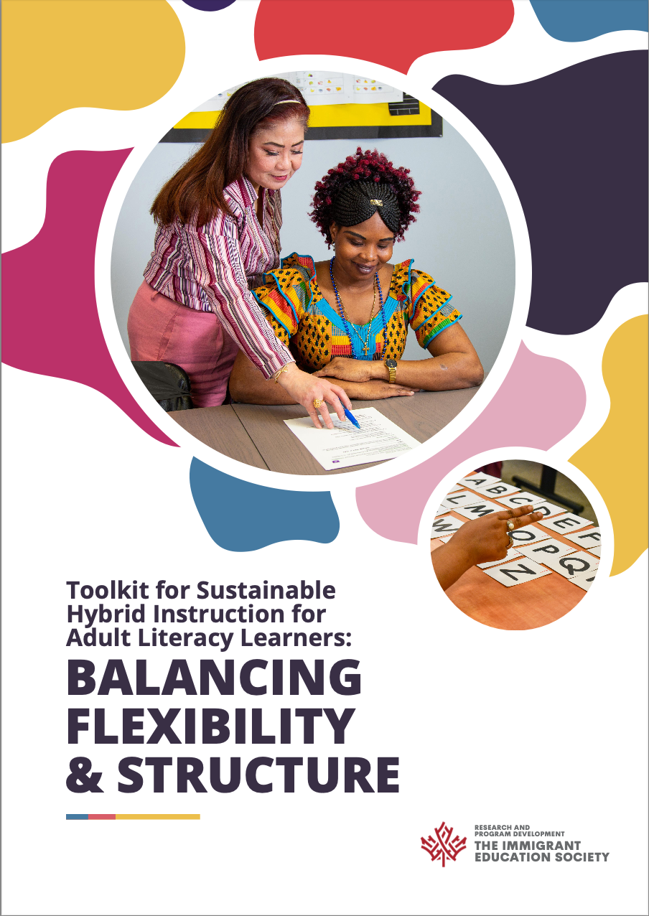
Creating Solutions: A Toolkit
This research addressed this gap using a qualitative participatory research design to collaborate with language teachers to develop a toolkit to support literacy learners in online spaces.
Notes:
Paula: To address this gap, our research used a qualitative participatory research design that collaborated with language teachers to develop a toolkit to support literacy learners in online spaces
The purpose of this presentation is to explain our process in creating this toolkit.

Slide 7

Participatory Approach
Collaboration between researchers and stakeholders
Action oriented – seeking practical solutions
Reflective and iterative process
(Hall, 1984; Kemmis et al., 2014; Lewin, 1946)
Notes:
Paula: A Participatory approach is….In our case, the stakeholders we partnered with were LINC teachers and admins in our organization whom we had existing partnerships with.
This study is participatory in the way the problem was voiced by teachers within our organization.
A Participatory approach is action oriented, it seeks practical, participant-led solutions. in our research, our practical solution was to develop a toolkit of resources, information, and ideas that could be used in literacy classes.
A Participatory approach is also reflective and iterative which is demonstrated in our research design

Slide 8
Research Design:
Advisory Group (7 instructors + 2 researchers; 25 remote meetings (Oct 2022–Apr 2023)
Classroom Observations (2 researchers in blended and hybrid format classes)
Stage 1: Knowledge Building
Integration of Stage 1 Data
Toolkit Development
Stage 2: Toolkit Development
Local Scale Piloting and Refining (12 educators in AB; 2-month pilot in classes; FGs)
National Scale Piloting and Refining (10 educators across CAN; Online survey)
Stage 3: Piloting and Refining the Toolkit
Notes:
Paula:
consists of 25 meetings with an advisory group to discuss literacy students needs.

Slide 9
Stage 1 - 2:
Knowledge Building & Toolkit Development
Notes:
Marianne: So, as Paula mentioned, in stages 1-2, we listened to literacy educators to determine their needs, and then we developed the toolkit accordingly.
I would like to share a couple examples of how the data we gathered in stage 1 led to the development of the toolkit.

Slide 10
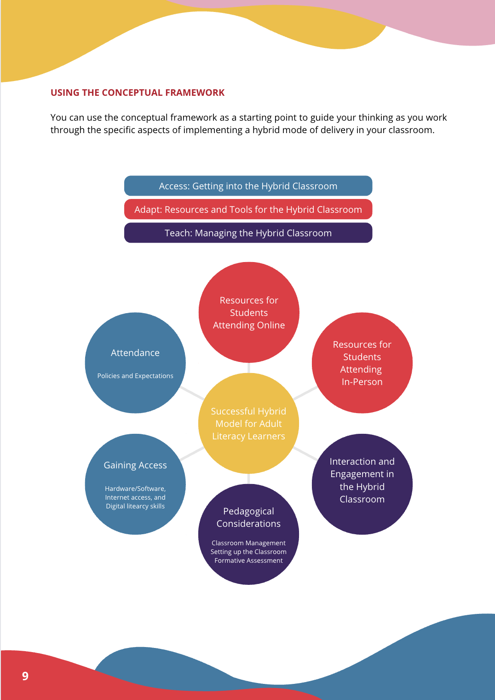
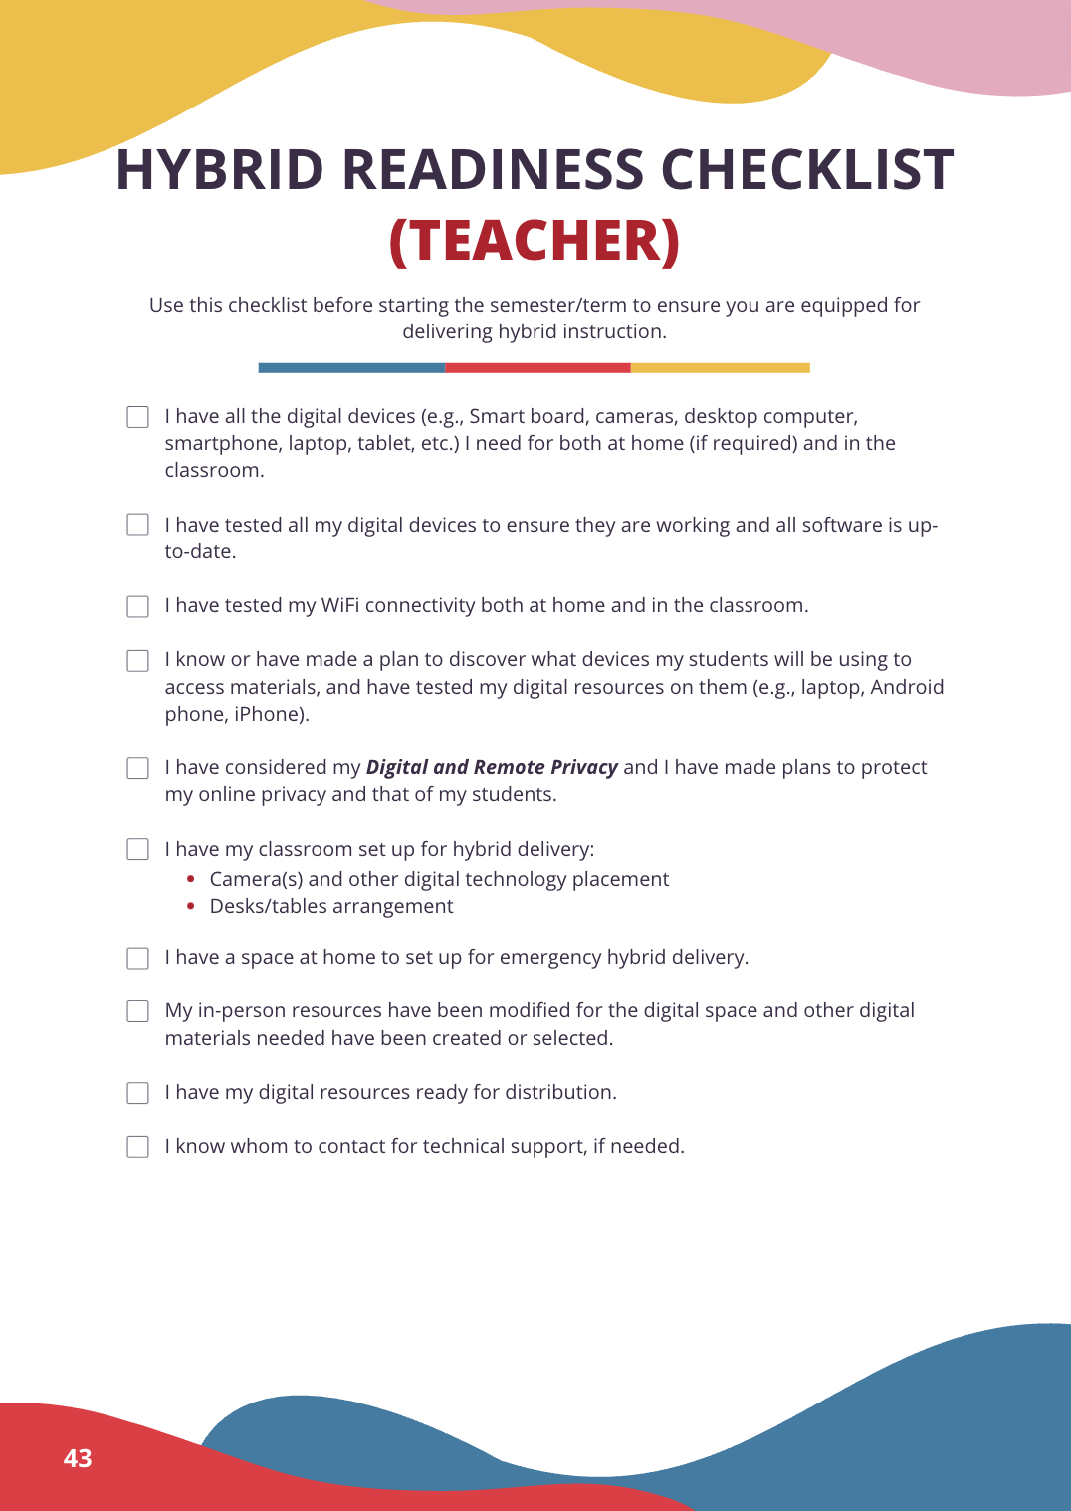
Stage 1: Knowledge
Building
Stage 2: Toolkit Development
Theme
Emerging goal: To support teachers in navigating hybrid teaching and learning.
Quote
“Digital access comes down to the teacher’s ability to maneuver the computer during class at the same time as addressing the students.” - Instructor
Notes:
Marianne: The first example is that a clear goal emerged from the knowledge building stage, which was to support teachers in navigating hybrid teaching and learning.
One instructor said… [QUOTE]. Other quotes pointed to the need for teachers to manage tech and test new pedagogical approaches.
From these conversations, the advisory group fleshed out key considerations that led to the development of a conceptual framework, which you can see in the first screen shot. This conceptual framework is included near the start of the toolkit to give teachers an overview of considerations regarding access, resources, and pedagogy for successful online learning.
And as you can see in screenshot 2, we included resources like teacher checklists to further support teachers as they move to online spaces.

Slide 11
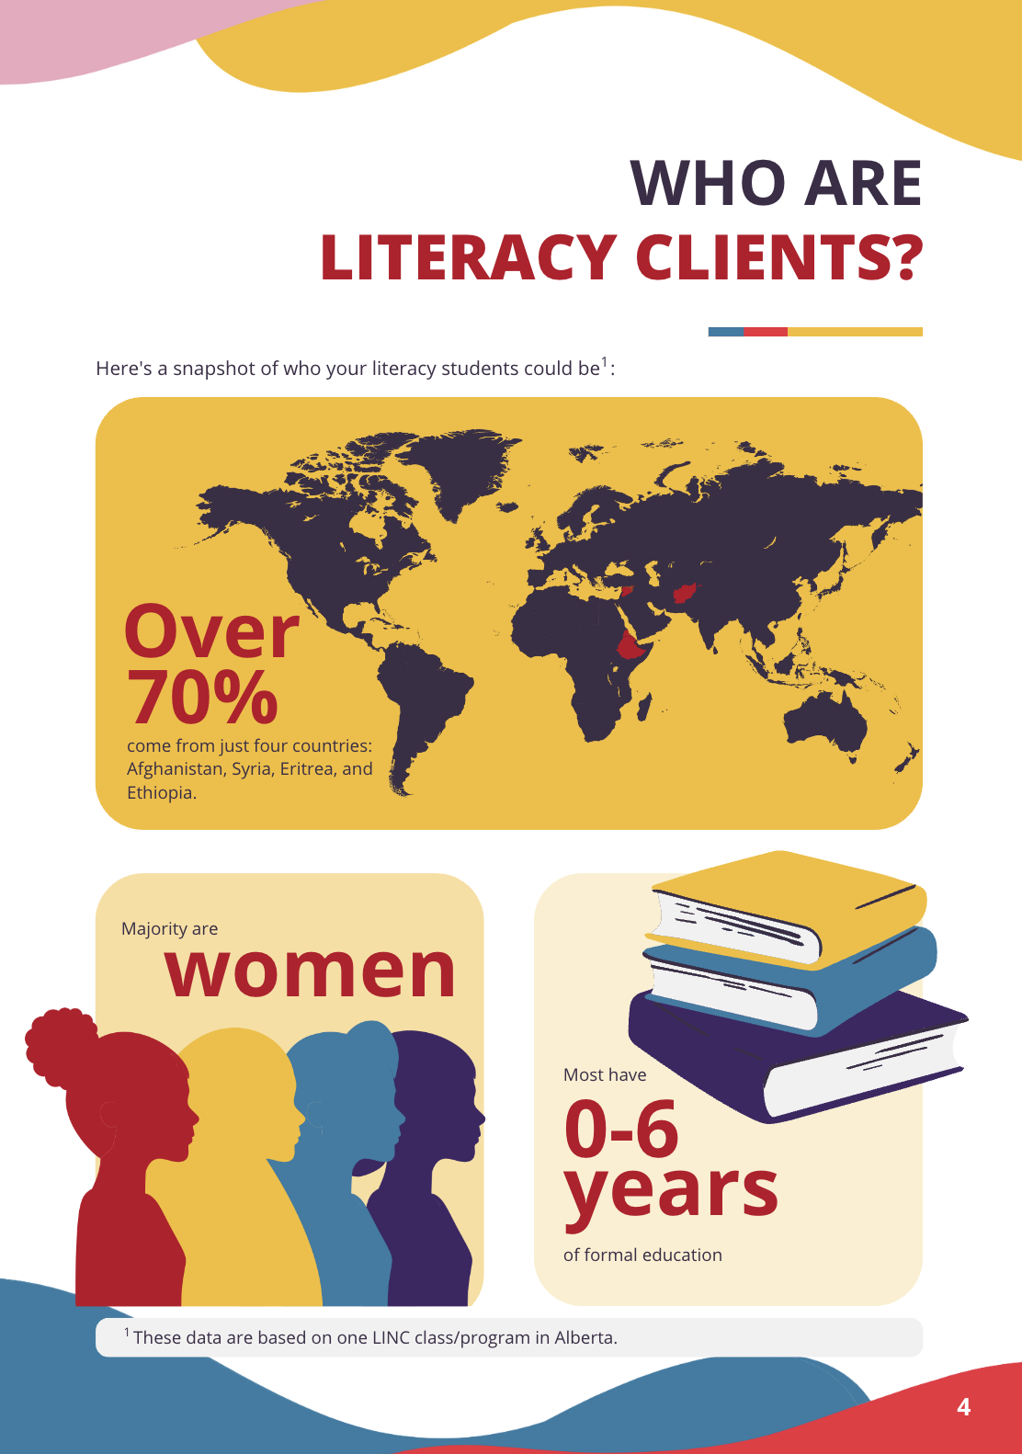
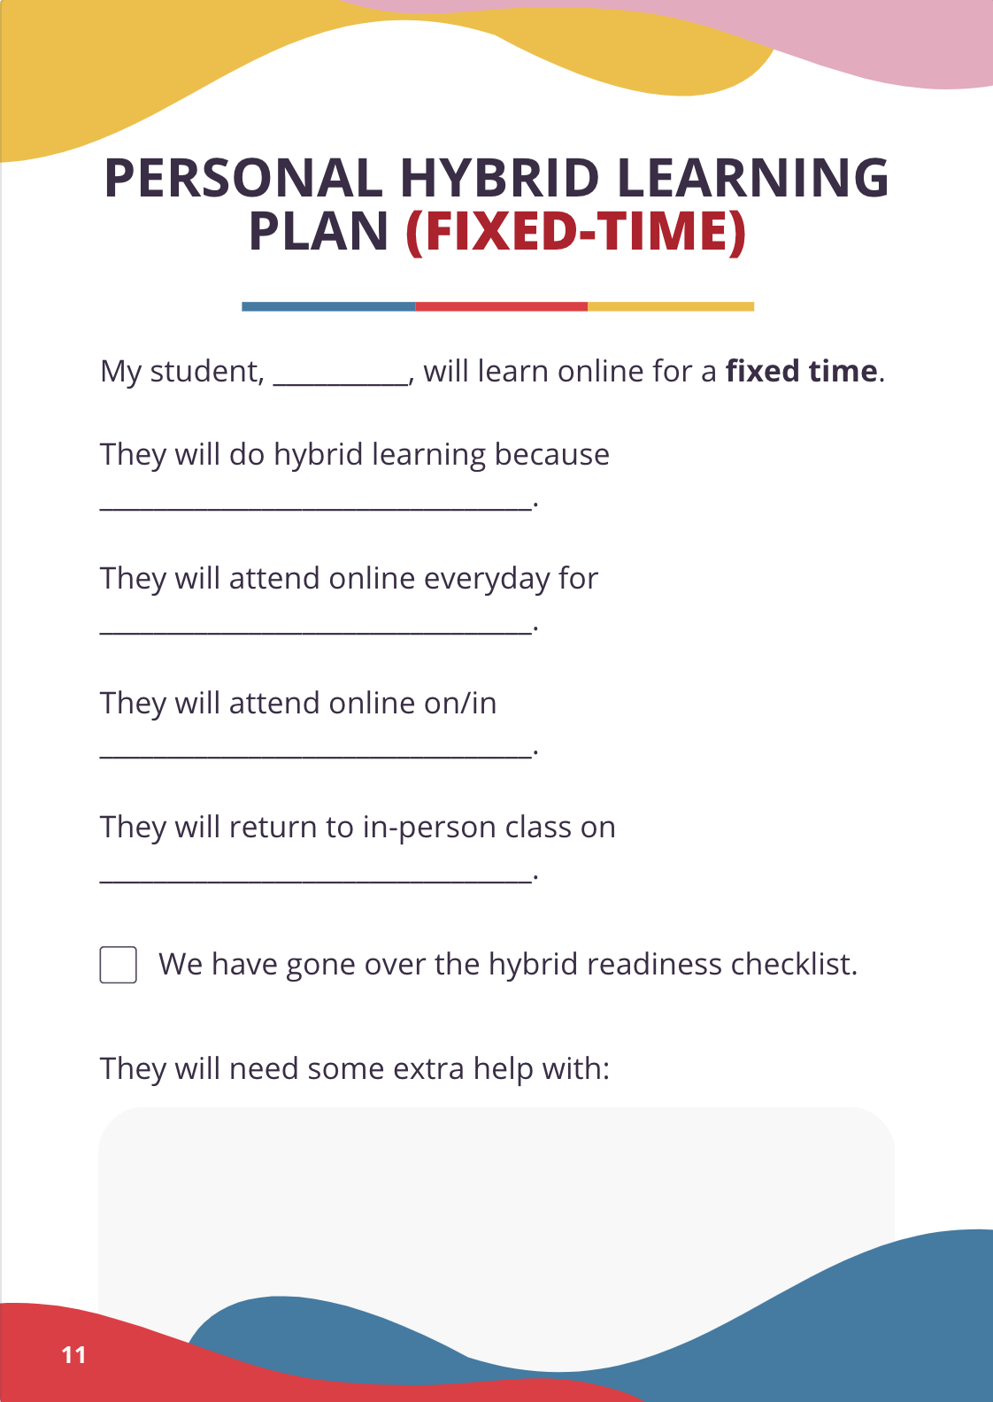
Stage 1: Knowledge
Building
Stage 2: Toolkit Development
Theme
Literacy learner needs are poorly understood.
Quotes
“Teachers of non-literacy students have literacy students, and they don’t know what to do with them.” - Instructor
“Literacy students have different needs compared to other students.” - Instructor
Notes:
Marianne: Another example of a theme emerging from the advisory group meetings was that the needs of Literacy Learners are poorly understood.
Instructors said [QUOTE] and [QUOTE]
As this was unpacked in the advisory group, teachers discussed how literacy learners are often unfamiliar with classroom norms, need routine, lack study skills, lack digital literacy skills.
To address these concerns, in our toolkit development, you can see that in screenshot 1, we included some information about who literacy learners are, and in screenshot 2, you see a resource we developed called the Personal Hybrid Learning Plan to help teachers build students’ study habits and increase their familiarity with classroom routines and expectations.

Slide 12
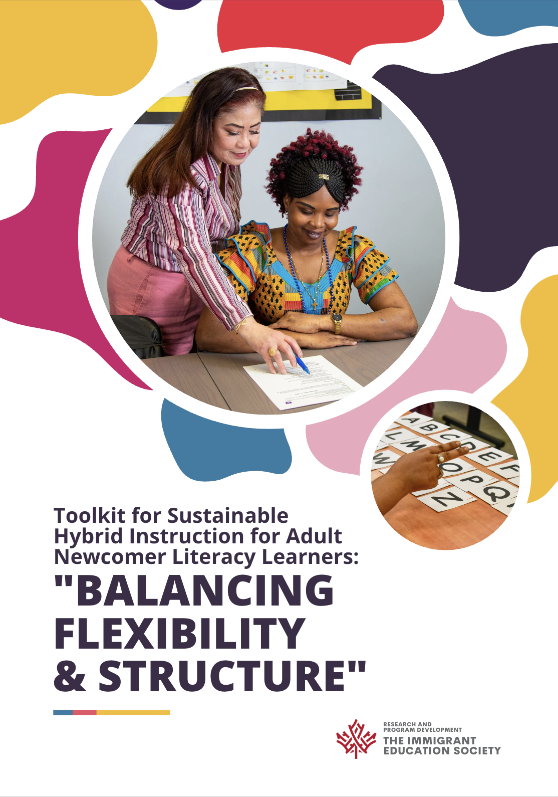
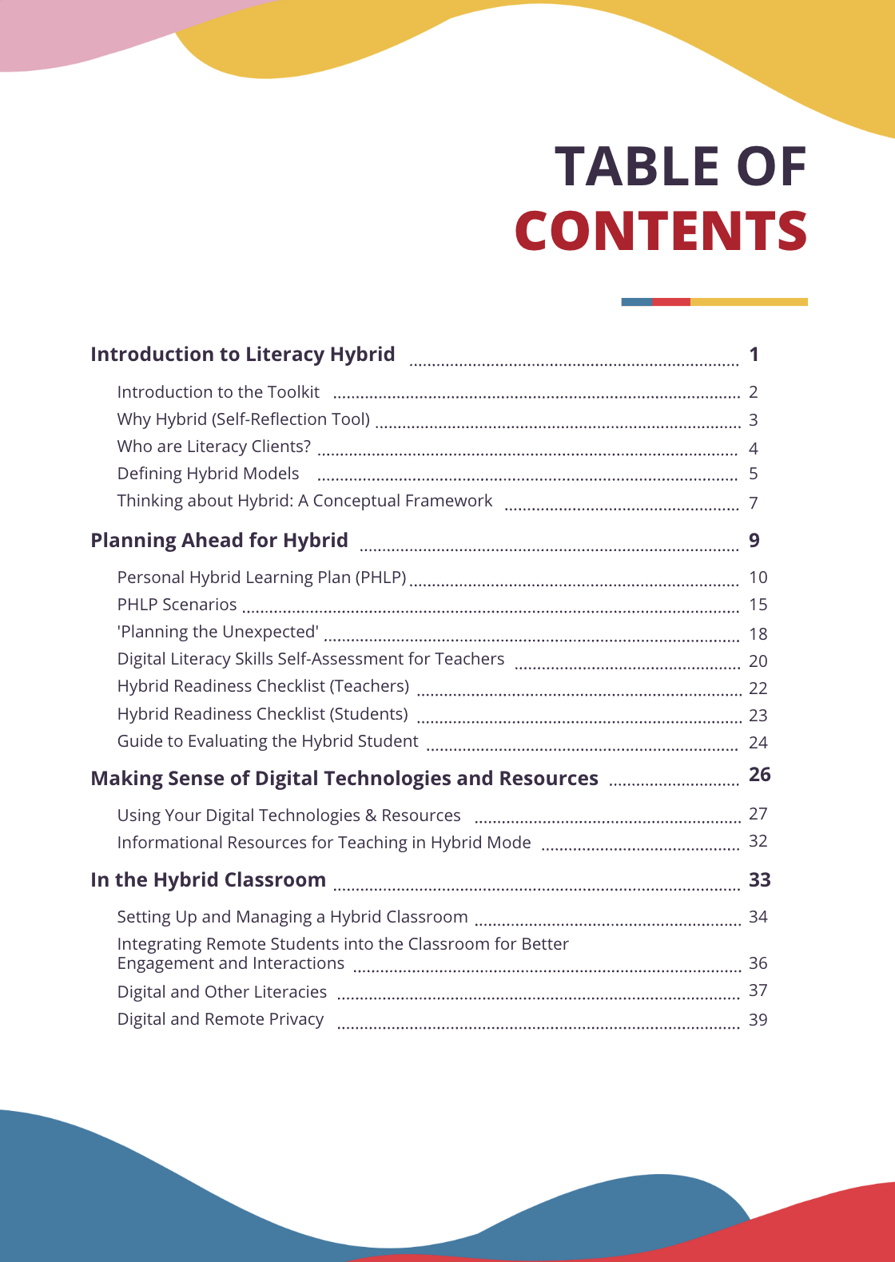
Stage 2: Toolkit Development
Notes:
Marianne: A number of other topics were discussed, including: privacy, setting up the classroom for hybrid learners, challenges of hybrid learning, digital needs of literacy students, and fostering interaction in digital spaces.
These discussions informed our creation of our first version of the toolkit, and you can see here our front cover and ToC.
Once we had developed our first version of the toolkit, we moved on to piloting the toolkit.

Slide 13
Stage 3: Piloting & Refining the Toolkit
Notes:
Paula: Once again stage 3 included piloting the toolkit among local and national educators and then refining the toolkit based on their feedback
We received a lot of positive feedback, but the following slides are examples of how we incorporated their constructive feedback into the toolkit

Slide 14
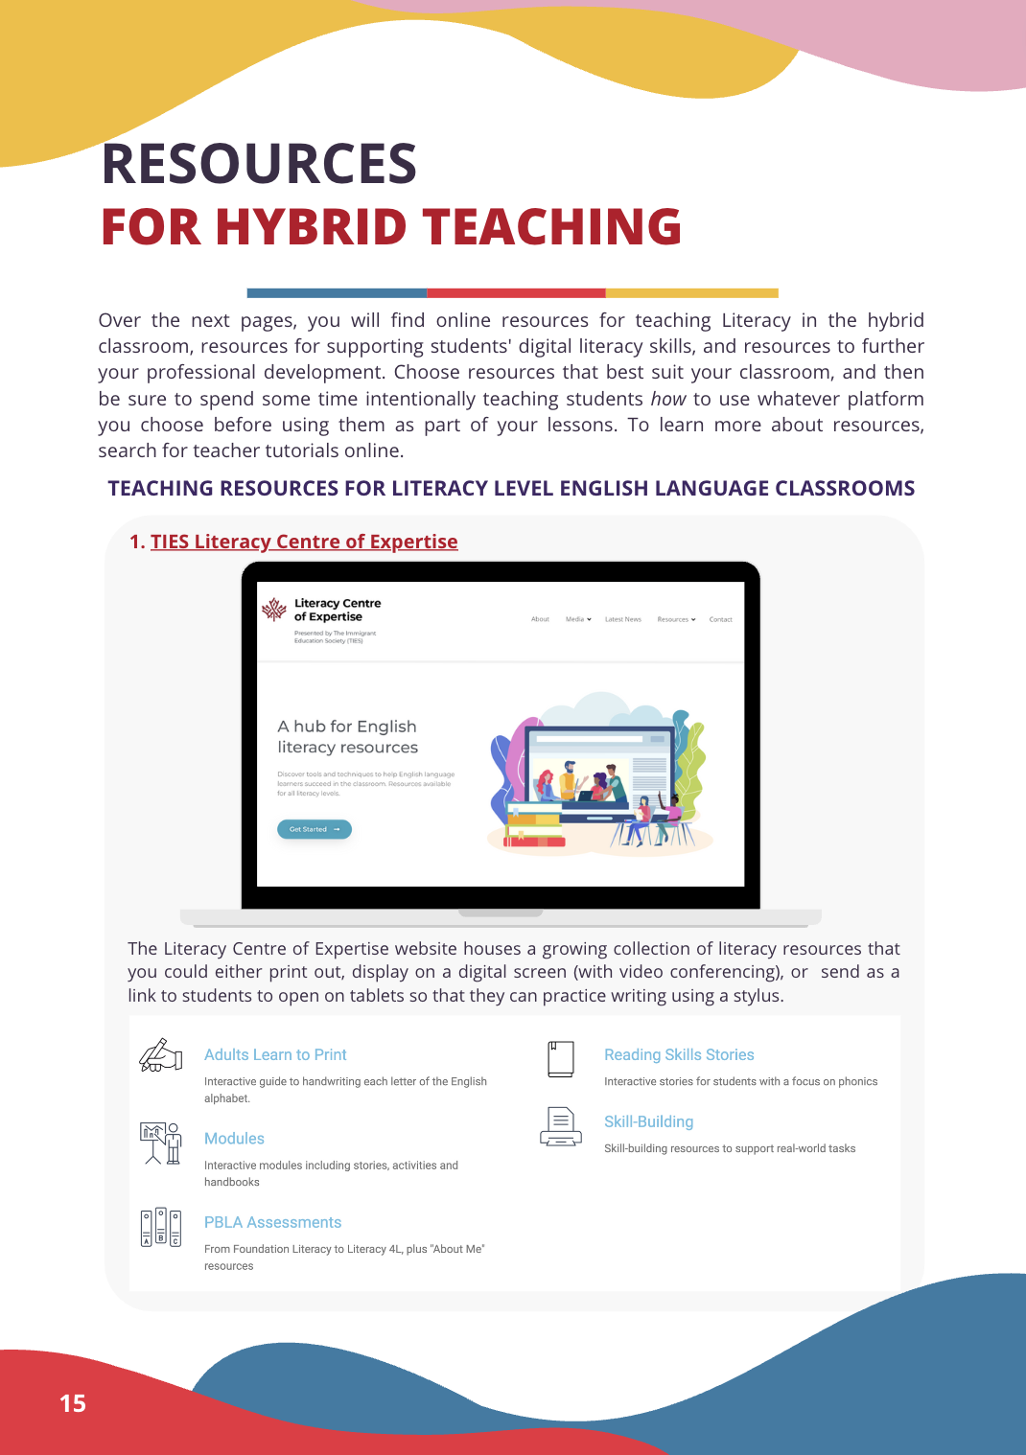
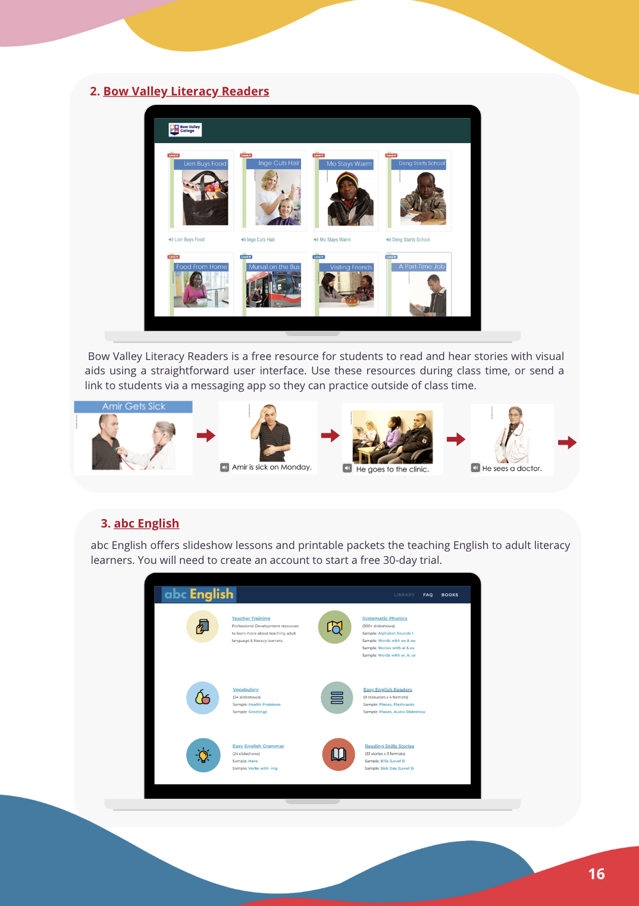
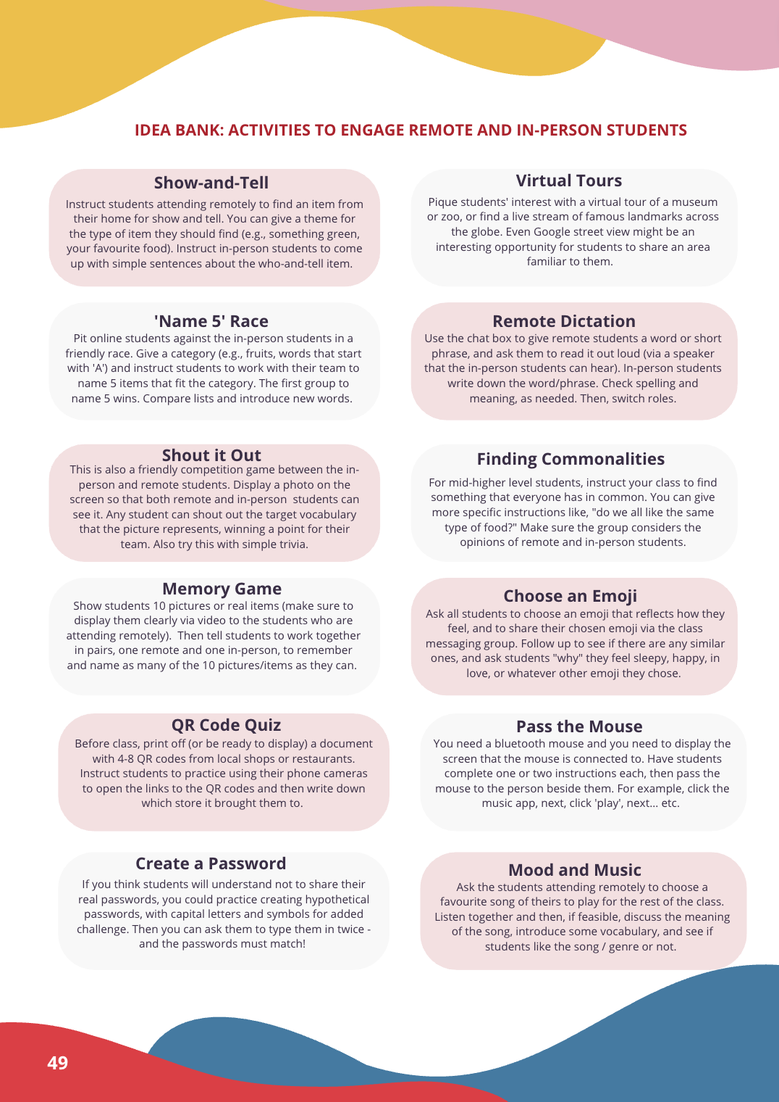
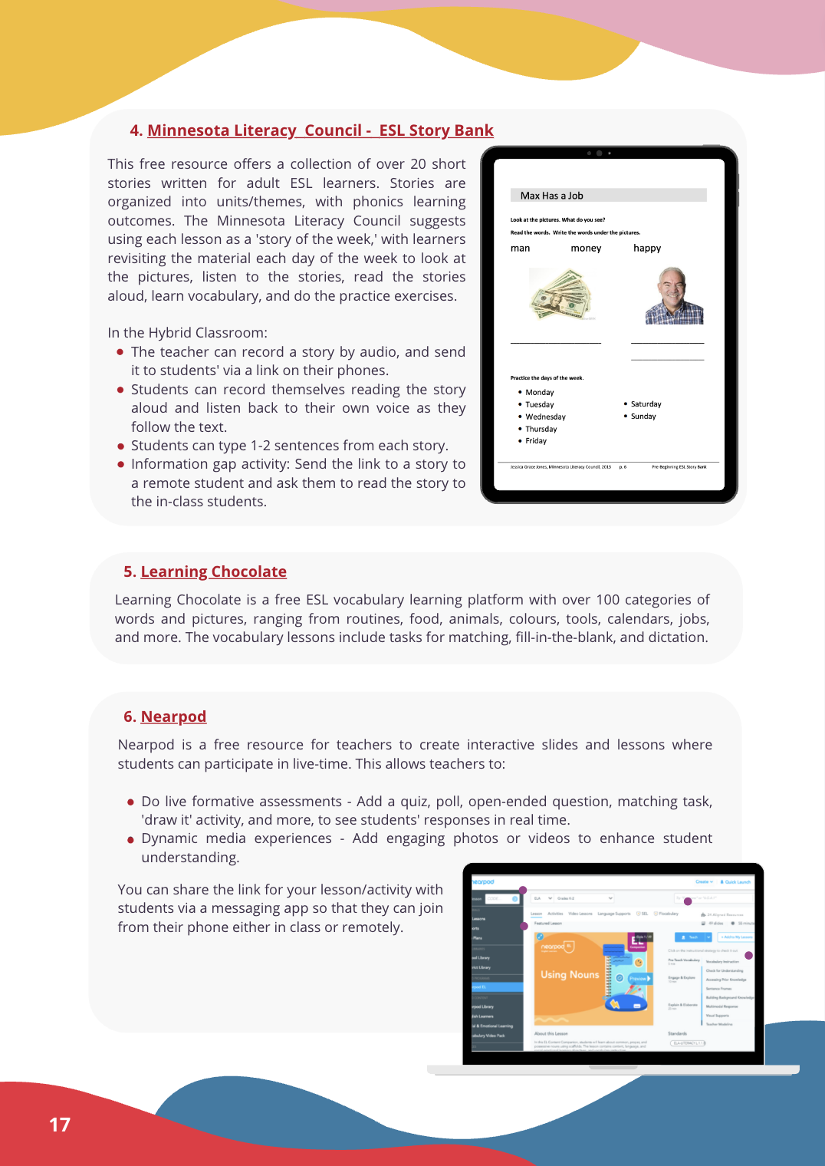
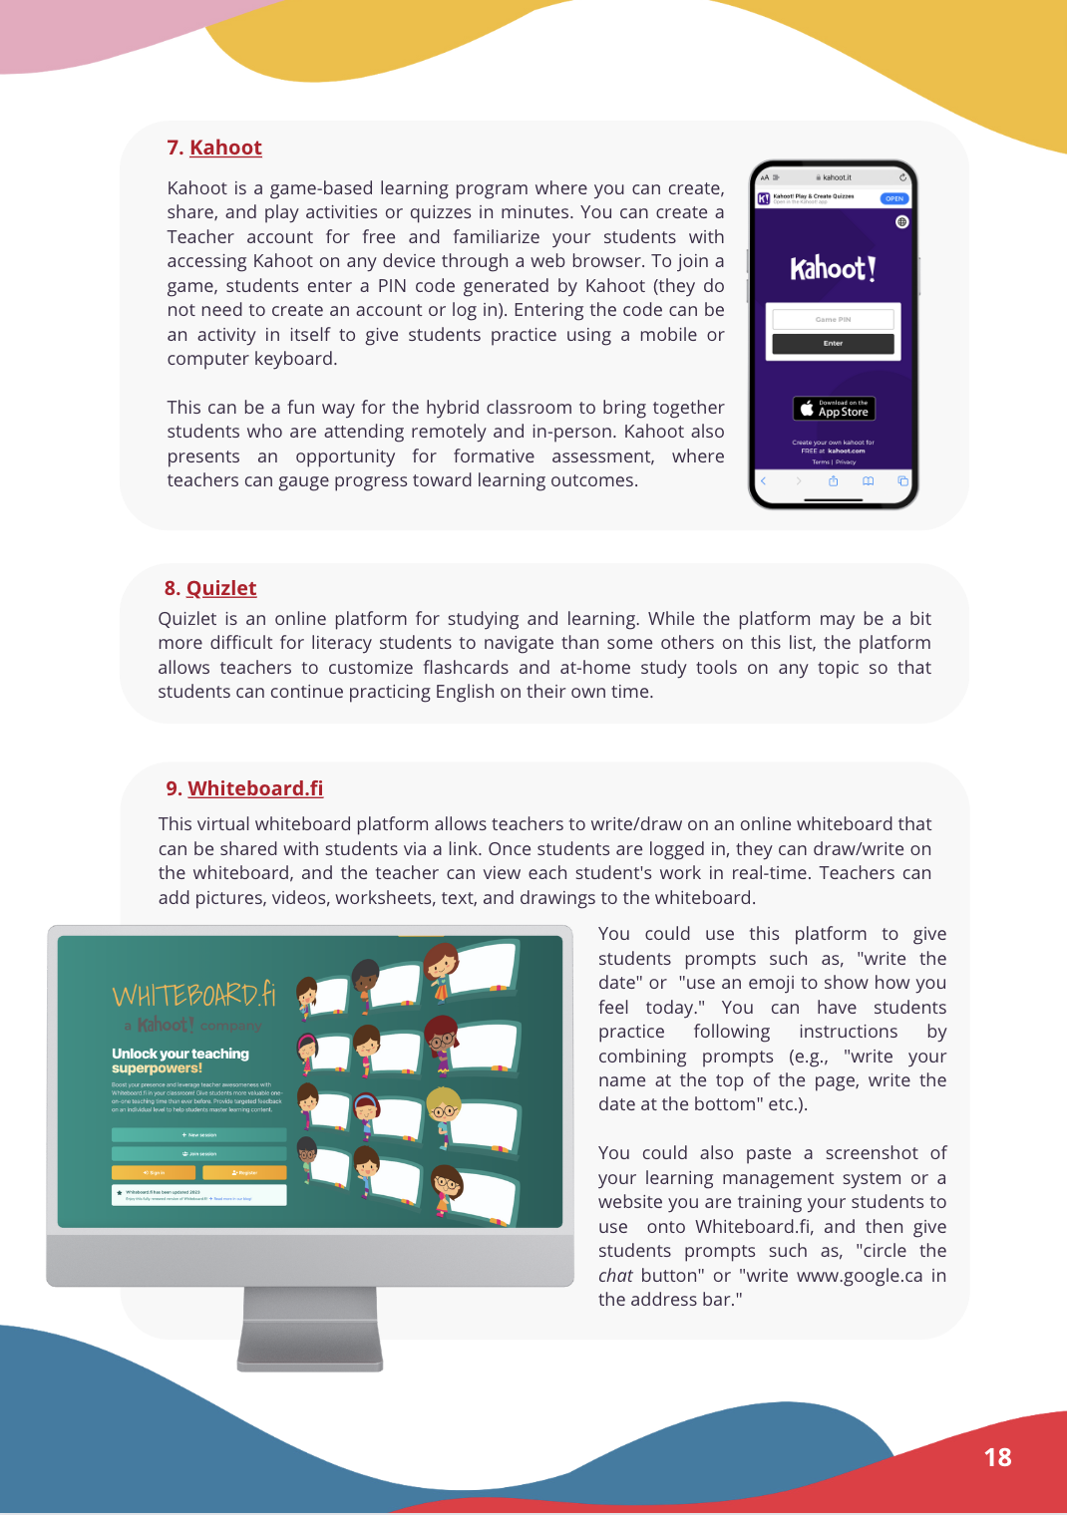
Stage 3: Piloting & Refining the Toolkit
Theme
Need to include more practical activities and resources
Quotes
“I wouldn’t pull it out of my bag and take it to my classroom every day, because … to me, it feels like it’s information.” - Instructor
Expanded from 1 to 7 pages
Notes:
Paula: The first theme that emerged from the feedback was the need to include more practical activities and resources
Regarding the toolkit, one instructor said…, for some teachers, the toolkit was just not practical enough.
To address this we added 6 more pages of practical resources for hybrid teaching including an Idea bank to engage remote and in-person students

Slide 15
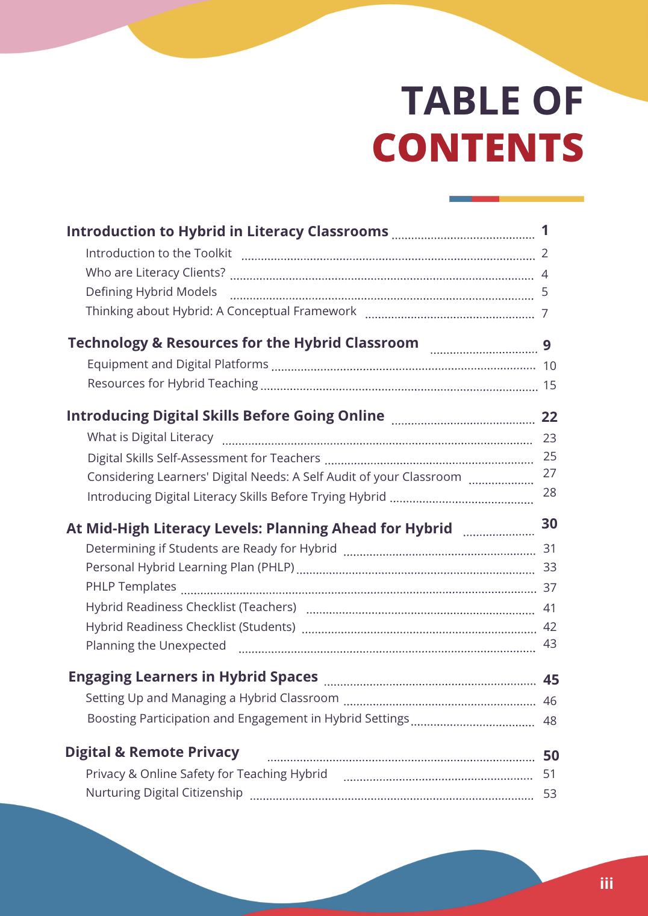
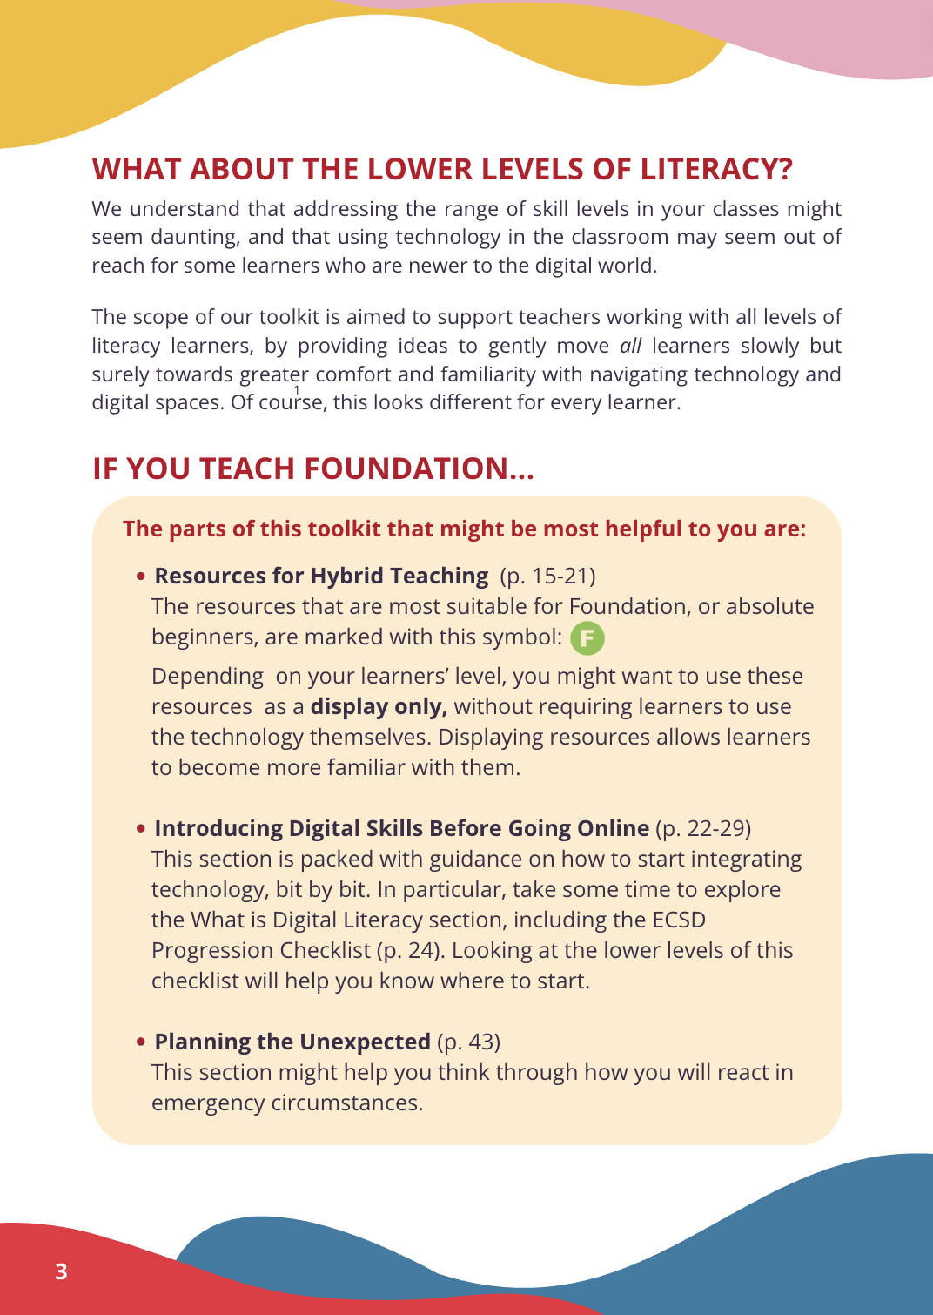
Stage 3: Piloting & Refining the Toolkit
Theme
Need to reframe the scope: Who is this toolkit for?
Quote
“Is this toolkit for low literacy learners? … If you follow this like the Bible, it’s not going to make your literacy foundation class any more viable.” - Instructor
Notes:
Paula: The second theme that emerged was the need to reframe the scope: who is this toolkit for?
Read quote
we contemplated removing the focus on lower levels altogether and just focusing on higher levels of literacy who are ‘ready’ to go to hybrid formats... but another discussion that surfaced through our piloting focus groups centered on EQUITY. Providing hybrid learning is providing equitable access to education. So we decided to include lower literacy learners in our toolkit as much as possible.
Screenshot 1: shows how we restructured the content of our toolkit to reflect our growing understanding of the differences between literacy levels.
Screenshot 2: shows a page we added to help foundation teachers find content in the toolkit thats dedicated to them.

Slide 16
Outcomes & Next Steps
Development of Toolkit - 57 pages, etc.
So far: Teachers are satisfied with the toolkit
Piloters deem resources suitable for literacy learners
Piloters said they would use this toolkit in their future classes
Quotes
“The resource list is very useful – I am wanting to use more online resources for my class.” - Instructor
“The toolkit is well organized. It provides useful information and material. It is going to be helpful for the teachers working with literacy students.” - Instructor
Notes:
Marianne: Before we close, I’ll take brief moment to point out the outcomes and next steps for our project, which is in its final year.
In summary, we have developed a 57 page toolkit with a dynamic and infographic design, containing teacher-informed resources, ideas, and strategies for supporting literacy students in online spaces.
So far, teachers are satisfied with the toolkit, and all of our piloters have deemed…
As far as next steps go, we will be disseminating the final version of our toolkit widely across Canada.

Slide 17
Resources
Hall, B. (1984). Research, commitment and action: The role of participatory research. International Review of Education, 289-299.
Haleem, A., Javaid, M., Qadri, M. A., & Suman, R. (2022). Understanding the role of digital technologies in education: A review. Sustainable operations and computers, 3, 275-285.
Lewin, K. (1946). Action research and minority problems. Journal of social issues, 2(4), 34-46.
Moriarty, M. (2011). Finding our way: Digital technologies for adult literacy students, edcuators and programs literature scan: 2005-2011. Alphaplus.
Kemmis, S., McTaggart, R., & Nixon, R. (2014). The action research planner: Doing critical participatory action research. Springer.

Slide 18
Thank you

