Slide 1
Patient Engagement: How it can help immigrant women navigate their healthcare in Canada.
Farzana Ali
October 06, 2023

Slide 2
Land recognition
As we gather here today, I acknowledge we are on the traditional territories of the people of the Treaty 7 region in Southern Alberta. The City of Calgary is also home to the Métis Nation of Alberta, Region 3.

Slide 3
Overview
z
Patient engagement
What?
Why?
How?
Patient engagement for Immigrant women
What?
Why?
How?

Slide 4
Research Team
Farzana Ali Anne Leis
Jebunnessa Chapola Ayla Raazi Mahli Brindamour
Tina Abellera Sarah Tut

Slide 5
z
Patient Engagement

Slide 6
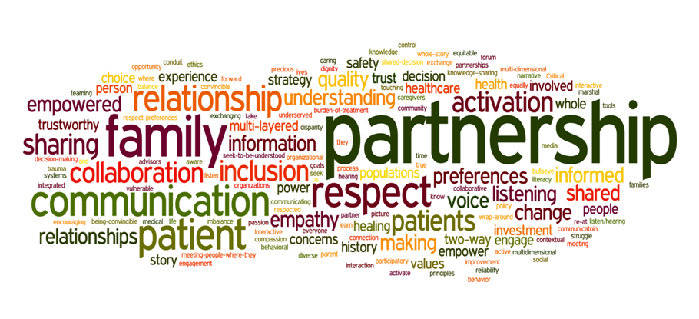
Source: Dahlborg Healthcare Leadership Group

Slide 7
“An approach to involve patients, families, and/or patient partners in:
Their own healthcare
The design, delivery, evaluation of health services
A way that fits their circumstances.”
- Engaging Patients in Patient Safety: A Canadian Guide, 2018

Slide 8
Continuum of patient engagement
Inform
Consult
Involve
Collaborate
Empower
Domain of engagement
Individual
Organizational
Policy
Healthcare System
Policy & practice
Culture
Patients
Health literacy
Health beliefs
Societal factors
Resource availability
Social norms
Factors influencing patient engagement

Slide 9
Fig: Spectrum of patient and stakeholder engagement in research. Adapted from IAP2’s (International Association for Public Participation) Public Participation Spectrum and Carman et. al.’s Multidimensional Framework For Patient And Family Engagement.

Slide 10
Continuum of patient engagement
 | Inform | Consult | Involve | Collaborate | Empower
Individual | Patient informed of diagnosis and treatment plan | Patient is asked about their preferences | Patient self manages | Shared decision making | Patient decides
Organizational (e.g. programs/ services) | Patients and the public are informed about decision | Patients and the public are asked about their input | Co-developing options and alternatives | Co-deciding on programs and services | Ultimate decision belongs to patient and public
Policy (System) | Patients and the public are informed about decision | Patients and the public are asked about their input | Co-developing options and alternatives | Co-deciding on programs and services | Patient and the public decide
Domain of Engagement

Slide 11
Scenario 1:
An oncologist meets with the parents of a child who is a cancer patient and discuss treatment options including risks and benefits associated with each option. In the end, it’s the patient’s parents who decides whether and which procedure will be used.
Source: The Strategy for Patient-Oriented Research (SPOR) modules
Notes:
Individual and empower

Slide 12
Continuum of patient engagement
 | Inform | Consult | Involve | Collaborate | Empower
Individual
Organizational
Policy
Domain of Engagement

Slide 13
Scenario 2:
A Gastroenterologist who also does clinical research for a pharmaceutical companies meets with a patient to reveal the results of some recent diagnostic testing and to advise the patient that she needs surgery.
Source: The Strategy for Patient-Oriented Research (SPOR) modules
Notes:
Individual and Inform

Slide 14
Continuum of patient engagement
 | Inform | Consult | Involve | Collaborate | Empower
Individual
Organizational
Policy
Domain of Engagement

Slide 15
Patient engagement
for
Immigrant women
z

Slide 16
”Immigrant women" are any women who migrated from a different country of origin to Canada and staying here with any status except refugee status.
Any first generation immigrant women or International female student/worker with study permit, work permit, permanent residency and/or citizenship.

Slide 17
N=25
Demographics | Total Count
Age group 18-25 26-35 36-45 | 7 8 10
Status in Canada Temporary residence Permanent residence Citizen Not available/ missing | 8 5 9 3
Time in Canada 1-2 years >2-<5 years >5-10 years >10 years | 9 2 8 6
Demographics | Total Count
Education Highschool/diploma Undergraduate Postgraduate Not available/ missing | 3 4 16 2
Ethnicity Black Caucasian East Asian South Asian Middle- Eastern Latin American | 4 1 3 7 3 6

Slide 18
Challenges
to
Patient engagement
for
Immigrant women
z

Slide 19
Barriers Identified | Individuals affected | Nature of the problem
Limitations mandated by regulations | Newly arrived immigrants and returning Canadian citizens | Lack of information and navigation Affordability Loop-holes in private coverage plans
Limitations on coverage on particular classes | Live-in care givers, temporary work visas, travellers’ visa | Often don’t get coverage Limited accessibility option
Limitations due to administrative barriers | Individuals with expired travel visa, work and/or study permit | Experience difficulties re-entering the system
Notes:
Gender role and preferences

Slide 20
Barriers Identified | Individuals affected | Nature of the problem
Limitations related to patient disempowerment | All categories of immigrants | Refusal or delaying seeking care because of fear or misunderstanding Language barriers
Limitations stem from cultural differences and family dynamics | All categories of immigrants | Providers with lack of cultural competency Disconnection and miscommunication Gender role and kinship network
Limitations from systemic barriers, stereotypes and racisms | All categories of immigrants | “Second class citizen” Stereotypical assumptions and mistreatment

Slide 21
Benefits
of
Patient engagement
for
Immigrant women
z

Slide 22
“Care, Share, Aware”
Paradigmatic shift from determining "what is the matter?" to discovering "what matters to you?"
Accountability for health-improving behaviours that correlate with better outcomes
Peer support, e.g., Immigrant Women’s Peer Support Program (IWPSP)

Slide 23
“Nothing about me without me”
- Valerie Billingham, 1998

Slide 24
Source: DU Beat
Email:
farzana.ali@usask.ca
fali@ccsa.ca

Slide 25
REFERENCES
Patient Engagement Action Team. 2017. Engaging Patients in Patient Safety – a Canadian Guide. Canadian Patient Safety Institute. Last modified February 2018. Available at: www.patientsafetyinstitute.ca/engagingpatients
Nelson G, Ochocka J, Griffin K, Lord J. “Nothing about me, without me”: Participatory action research with self-help/mutual aid organizations for psychiatric consumer/survivors. American journal of community psychology. 1998 Dec 1;26(6):881-912.
Dahlborg T. Systems level improvements begins with individual relationships [Internet]. [cited 26 September 2019]. Available from: https://tdahlborg.wordpress.com/2015/08/20/systems-level-improvements-begins-with-individual-relationships
Gallivan J, Kovacs Burns K, Bellows M, Eigenseher C. The many faces of patient engagement. J Particip Med. 2012 Dec;4:e32.
Carman KL, Dardess P, Maurer M, Sofaer S, Adams K, Bechtel C, Sweeney J. Patient and family engagement: a framework for understanding the elements and developing interventions and policies. Health Affairs. 2013 Feb 1;32(2):223-31.
Iap2canada.ca. (2014). IAP2 spectrum. [online] Available at: https://iap2canada.ca/Resources/Documents/0702-Foundations-Spectrum-MW-rev2%20(1).pdf [Accessed 2 Jul. 2019].
SCPOR Patient-Oriented Research: Level of Engagement Tool [Internet]. Saskatchewan Centre for Patient-Oriented Research (SCPOR). [cited 26 September 2019]. Available from: https://www.scpor.ca/scpor-patientoriented-research-level-of-engagement-tool
Kuile S, Rousseau C, Munoz M, Nadeau L, Ouimet M. The universality of the Canadian health care system in question: Barriers to services for immigrants and refugees. International Journal of Migration, Health and Social Care. 2007 Jul 1;3(1):15-26.
Of Perusing Languages [Internet]. 2017 [cited 26 September 2019]. Available from: http://dubeat.com/2017/02/of-perusing-languages/

