Slide 1

Development of Professional Relationships in RISE for Health and Wellness
Aria Ahadzadeh Ardebili
Inioluwa Adeboye
Karam Senjar
Didem Erman
Tanvir Turin Chowdhury

Slide 2

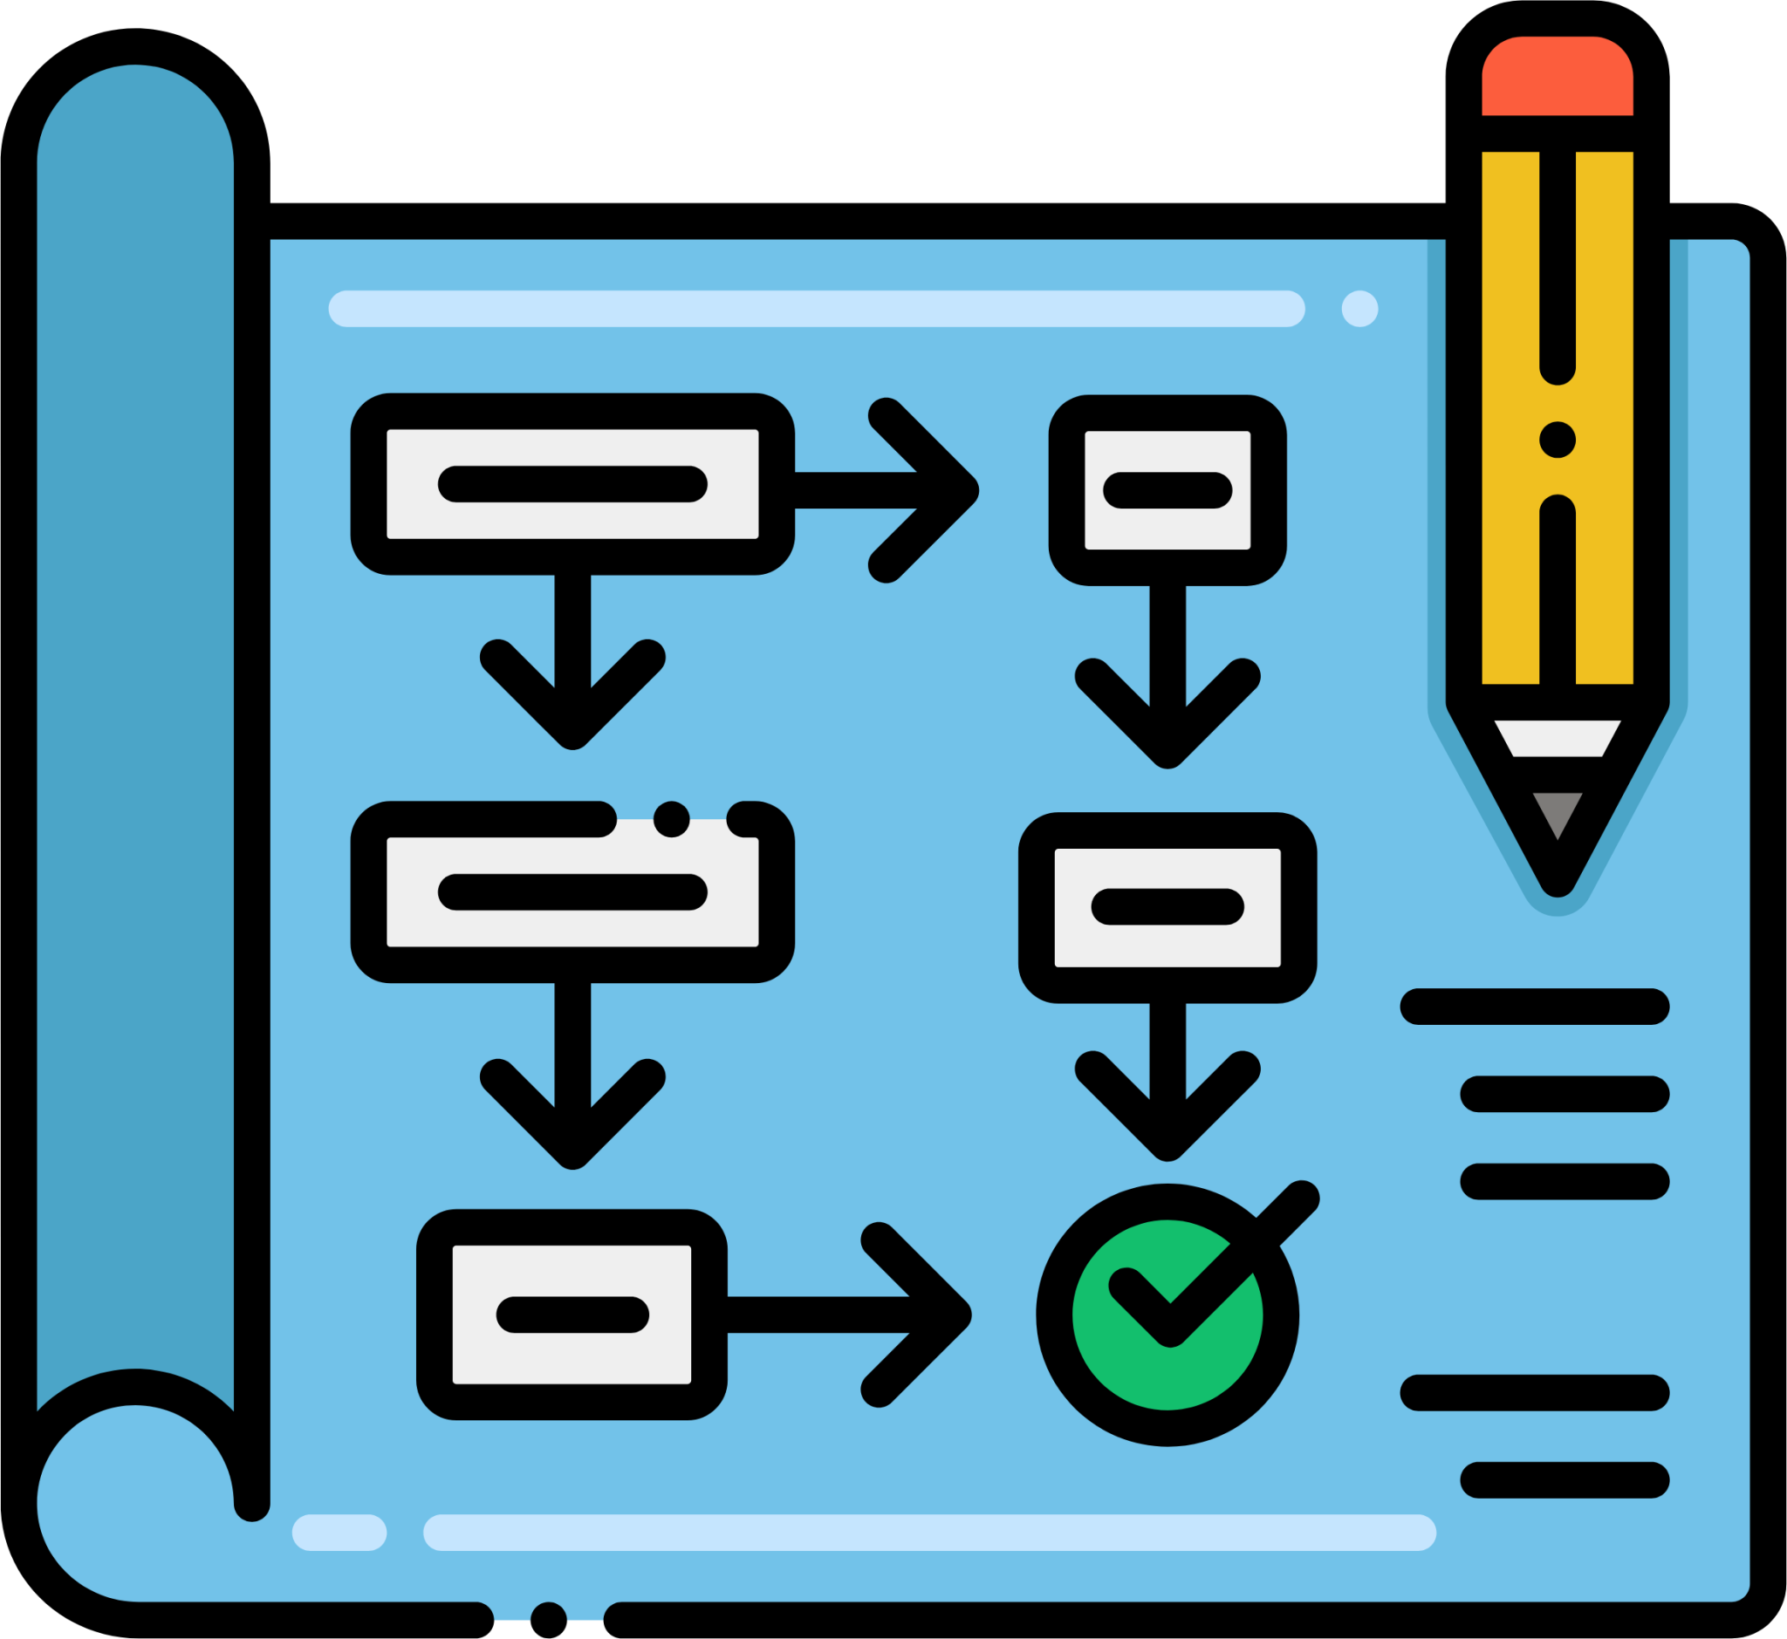


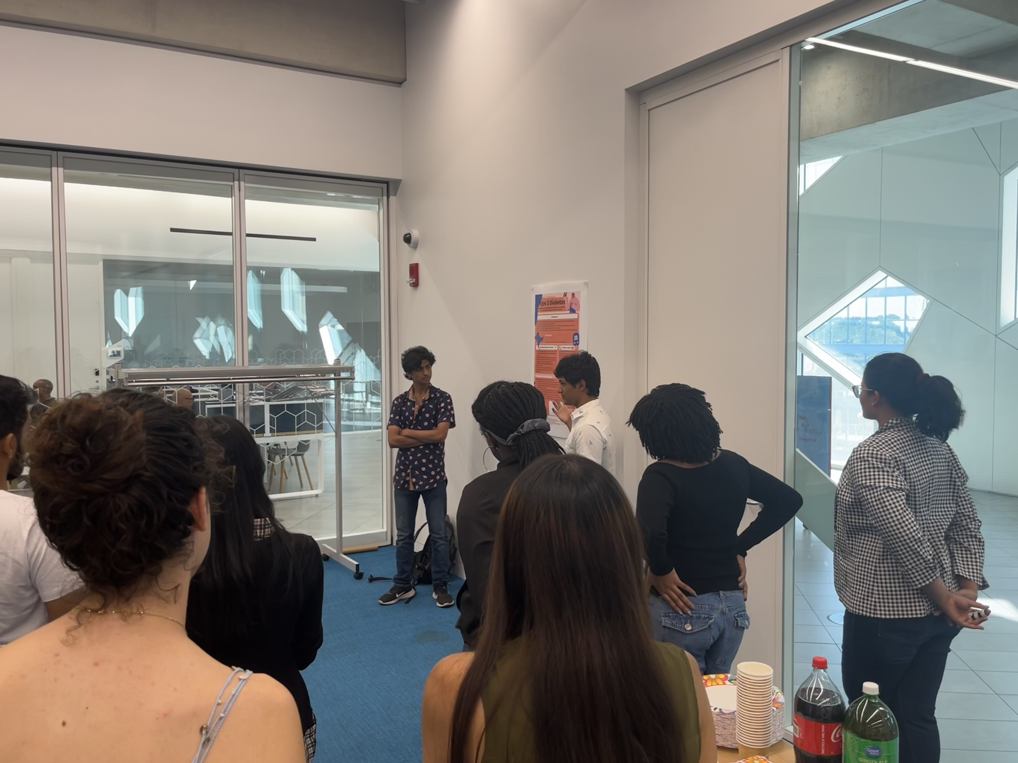


RISE for Health and Wellness
The Health Literacy Program designed for Community by Community
Reflections + Focus Groups
Program Planning
Curriculum Delivery
Knowledge Dissemination
Professional Engagement
Notes:
- RISE is a summer program aimed to improving the health literacy of youth
- Prior to starting, we collect an understanding of the students for each session and after each session collect reflections on what they learnt and what we can improve
- At the end of each year, we conduct focus groups to best understand where we can improve (from previous students) as well as what topics are most relevant for current immigrants (from non-participants)
- Furthermore we invite youth to return following completion of the program to assist us in planning the program for the following year.
- During planning, we invite professionals related to the topic to attend our session and provide expert knowledge
- The ultimate goal of the program is for youth to leave the program and disseminate knowledge within their communities
- Following the first year, we encourage students to come back and help us build the curriculum in future years → More inclusivity and much more dynamic

Slide 3



The Importance of Professional Relationships
Although through different roles and different modes, it is all about engagement
Sharing and promoting effective health-based information, skills and practices
Encouraging two-way communication and dialogue
Fostering novel relationships within and outside of the program
People and communities participate, take informed decisions and actions, foster social change and enhance resiliency
Notes:
-During our sessions, we noticed that we would often develop professional relationships with a wide variety of individuals for various purposes
- All of these were aimed towards improving the health literacy of youth, engaging them more effectively
- The ultimate outcome for us is to encourage participation, informed decision and action making capabilities

Slide 4



Community Relationships
Teachers, Youth-Oriented Organizations and Working Professionals
Our students loved the presentation! We hope to see you again next year!
The students’ writing and reading have really improved.
I would love to come and work with the students again next year!
Notes:
- one category of professional relationships we have developed is our community relationships with teachers, youth-oriented organizations and working professionals
- These are to increase our engagement and to improve the overall outcomes of our work through the advice of professionals
- Other professionals are often met as a result of them deciding to participate with RISE
- We have done informal interviews with our community partners and speakers and have done surveys and focus groups with volunteers and previous participants. Through these methods, we have obtained a wealth of knowledge on how to improve our program and have been able to extract key factors which are capable of indicating success and by fostering these factors within our relationships we are able to better improve our sessions

Slide 5
Community Relationships - Professionals
The Key Factors for Long-Lasting Relationships
Expertise in their field
Flexibility
Participant’s Retained Knowledge
  “I worked with them to develop a session plan”
  “Talked about the goals of the session and what we wanted him to discuss”
  “We asked them to return since they always made sessions digestible for students”
  “Someone who was engaging and knowledgeable”
  “Had personal connections as an immigrant”
  “His experience and expertise is invaluable”
Notes:
- We work with a number of individuals who teach students and have noticed various factors that affect the development of long-lasting relationships
Expertise in their field
Flexibility in developing more comprehensive and appropriate presentations for youth
The knowledge that is being retained by our speakers
- Overall, these 3 factors are essential in determining whether this partnership is mutually beneficial for us, the students and themselves

Slide 6
The Growth of Speakers
Direct Quotes from Students over the Years
Phase I
Phase II
Phase III
Phase IV (?)
Unattainable Information
Areas of Improvement
Digestible Presentations
“It was hard to understand things that were only presented orally rather than on the slides”
“Knowing that there were language barriers, the content could have been communicated in a simpler way”
“I felt that things had gone really quickly and the information came at us too quickly”
“I would have appreciated longer time spent explaining”
“Using more engaging activities and interactive discussion to create personal interest”
“It would have been nice to get to speak to others for a second opinion”
“The analogies were helpful in understanding new information”
“[The speaker] was so relatable, kind and inspirational”
“Making presentations feel more like conversations helped to learn and stay attentive”
Notes:
With individuals who have been with us for extended periods of time, we often see their progression through the following steps, albeit they are often entering at either Phase I or II. We are often capable of developing Phase I into Phase II through a few sessions with speakers prior to their actual date which is also a large indicator of their flexibility as individuals
Phase I: Participants are unable to grasp the concepts
Phase II: Participants understand the material but they would like to go further indepth
Phase III: Participants find that the material provided is incredibly beneficial for their overall growth and success
Phase IV: Perfection (Unattainable but we strive for it at all times)
- Please find quotes from the reflections that can be inserted into these portions, it would be very useful if they could be from the same speakers/sessions in each row (I.E these ones I tried to get from Social determinants of health)

Slide 7



Mentorship Relationships
The Flow of Knowledge
Peer to Peer Assistance
Direction & Organization from Leaders
Volunteer to Youth Mentorship
Notes:
- Although we develop many speaker and professional style relationships, we often observe mentoring relationships throughout our program
- 3 different mentorships
Direction of Organization from Leaders
From Peer to Peer
From Volunteers to Youth

Slide 8
Dynamic Progress
2021
2022
2023
2024
…
…
Feedback drives annual improvements
Notes:
The reason we are able to maintain these relationships and continuously develop them is due to the dynamic progress we establish within our organization
- Focus groups with students
- two directional discussions with healthcare and research professionals
- Consistent feedback from previous years and building upon each year

Slide 9
Cultural Sensitivity
The Answer is in the Design
Dynamic Session Design
Incorporating participants in future development
Adding new programs and adjusting our flaws
Bi-directional learning with our community
Constantly renewing our understanding of contemporary issues
Obtaining feedback at every point on improving our delivery
Our Diverse Team Development
Incorporating Immigrants and Canadians
Recognizing the plethora of cultures
Notes:
- Immigrants working with Immigrants → Diverse Team Development → Incorporating Individuals from all cultures + Allyship Spirit
- Team
-Session Design → Working with Immigrants to understand their issues + Annual updates from RISE and non-RISE participants
----- Relatability
- Working with the Community → Learning from the Community & Growing with Them → Bidirectional Learning

Slide 10
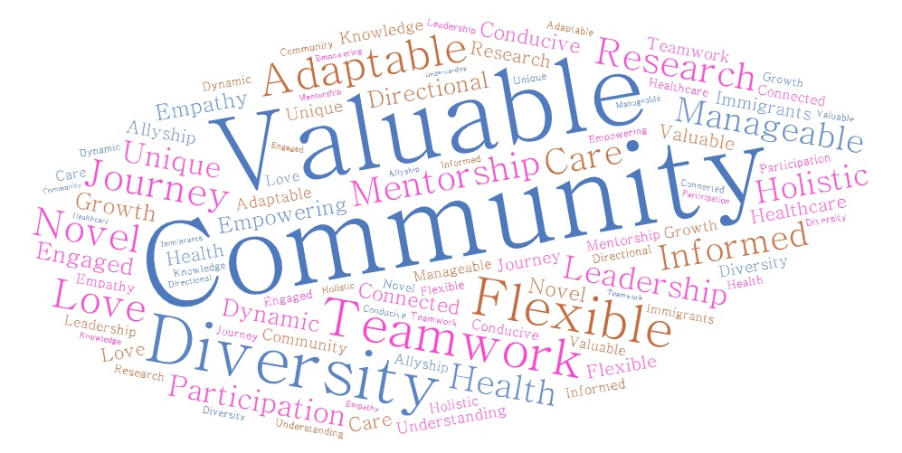
What makes us stand out?
Notes:
We have an amazing program and saw the relationships we were able to develop over the years and wanted to share our findings in what is successful and to share it with other grassroot organizations but to also find new ideas which could potentially expedite our (and everyones) development of educational grassroot community engagement organizations. We often find that … factors really improve out outstanding work and the students are capable of recognizing the months of work that go into their sessions every year
- Word map of all the unique things about RISE
AKA
- our goal of improving at all times
- Our diverse team comprised of immigrants and individuals within the majority (Aka allyship in constant action)

Slide 11




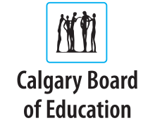
Thank You ☺
The Entire RISE Team
  Didem Erman
  Dr. Tanvir Turin Chowdhury
  Our Session, Youth and Past Volunteers
Our Supporters
Notes:
Final Thank you and Questions ☺

