Slide 1
Vibrational Circular Dichroism It's easier than it looks
Arvi Rauk
Professor Emeritus and Faculty Professor
Department of Chemistry, University of Calgary
rauk@ucalgary.ca
http://www.chem.ucalgary.ca/research/groups/rauk/

Slide 2
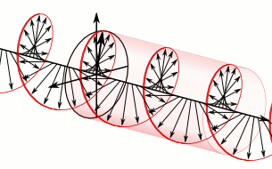
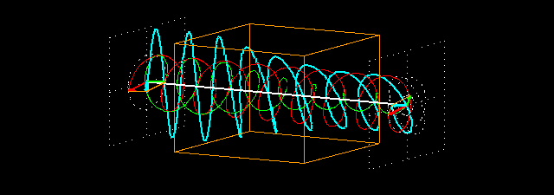
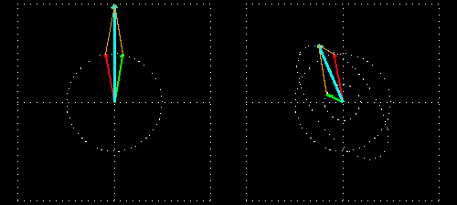
Plane and Circularly Polarized Light
n_{L} ≠ n_{R}
→ ORD
In
Out
ε_{L} ≠ ε_{R}
→ CD
András Szilágyi

Slide 3
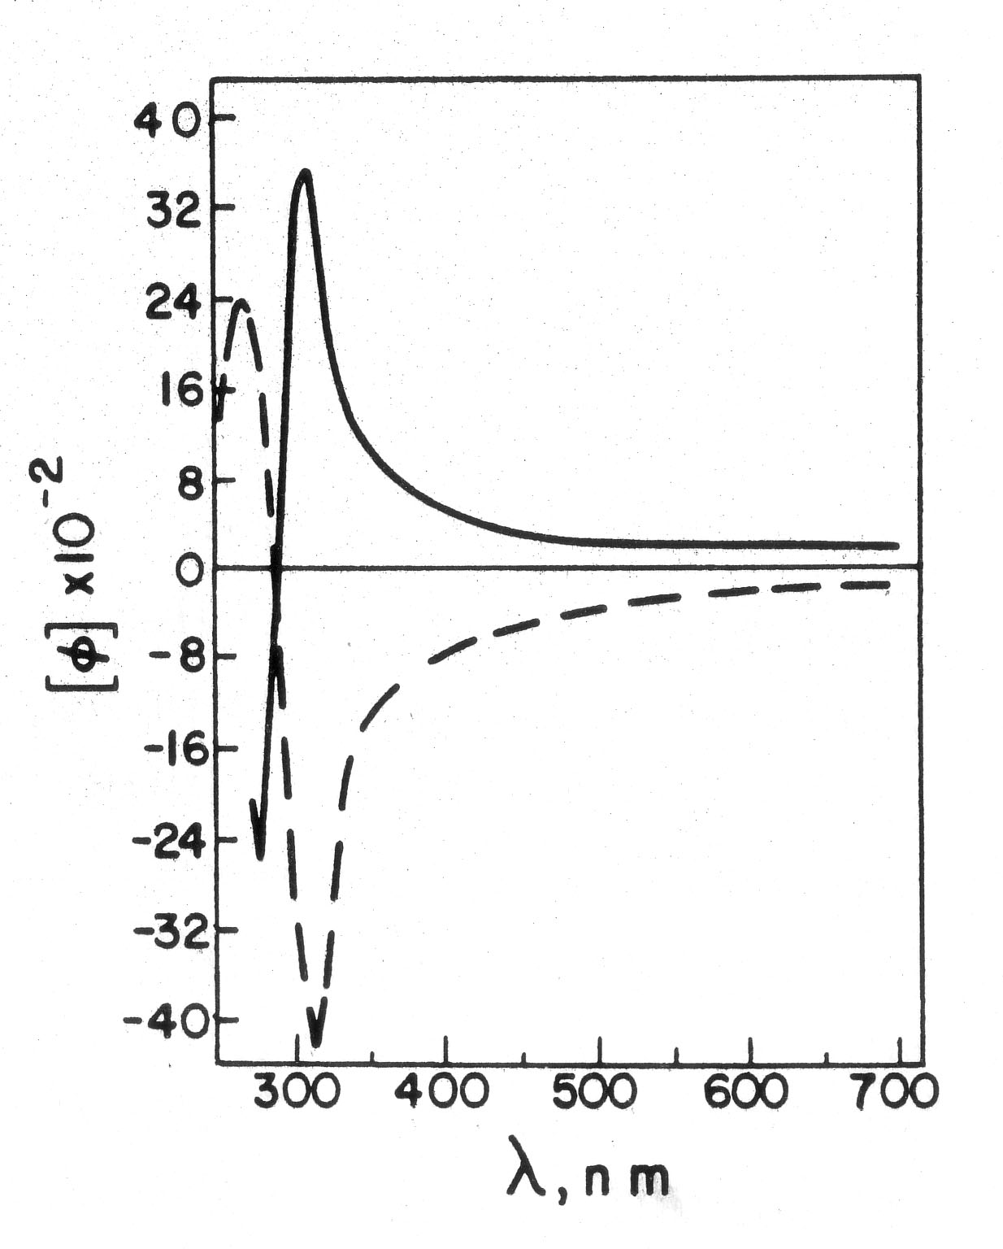
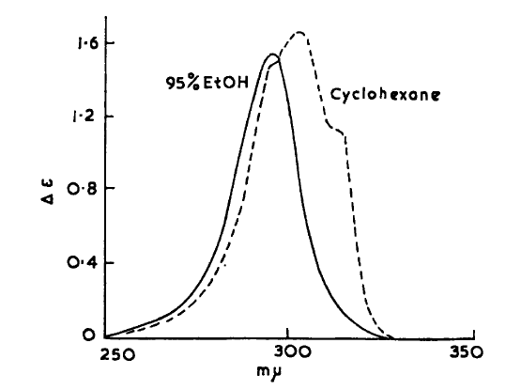
ORD
“D” 589 nm
CD
ε_{L} ≠ ε_{R}
n_{L} ≠ n_{R}
How to describe this behaviour theoretically?

Slide 4
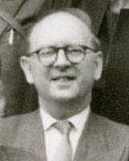
Optical Rotatory Dispersion (ORD)
β = -4πc/3h Σ_{n}[R_{0n}]/(ω_{0n}² – ω²)
where
[R_{0n}]^{r} = -i <Ψ₀|μ|Ψ_{n}><Ψ_{n}|m|Ψ₀>
Léon Rosenfeld
(1904 – 1974)
L. Rosenfeld, Z. Physik 52, 161 (1928)
Ψ₀, Ψ_{n} are ground and excited state wavefunctions
μ, m are electric and magnetic dipole transition moment operators
μ = μ^{e} + μ^{N} = - Σ_{i}er_{i} + Σ_{I}Z_{I}eR_{I}
m = m^{e} + m^{N} = - Σ_{i}(e/2mc) r_{i} × p_{i} + Σ_{I}(Z_{i}e/2M_{I}c)R_{I} × P_{I}
p_{i} = -iħ∇_{i}

Slide 5
ORD
“D” 589 nm
CD
Major disadvantages of electronic CD (ECD):
Too few transitions, often in far UV
Necessity to obtain accurate description of excited states (possible now with TD methods)

Slide 6
The answer? VCD
Vibrational Circular Dichroism
It's easier than it looks?
Advantages:
3n – 6 transitions in easily accessible IR region
electronic ground state - routinely optimized by all codes
Disadvantages:
CD signals extremely weak in IR region – instrumental difficulties
Too many transitions in larger molecules – overlapping bands difficult to interpret
Electronic ground state in BO approximation does not contribute to [R]

Slide 7
Vibrational Circular Dichroism
[R_{0n}]^{r} = -i <Ψ₀|μ|Ψ_{n}><Ψ_{n}|m|Ψ₀>
μ = μ^{e} + μ^{N} = - Σ_{i}er_{i} + Σ_{I}Z_{I}eR_{I}
m = m^{e} + m^{N} = - Σ_{i}(e/2mc) r_{i} × p_{i} + Σ_{I}(Z_{i}e/2M_{I}c)R_{I} × P_{I}
p_{i} = -iħ _{i}
Ψ₀ = Ψ(r,Q)_{0,0} ≈ ψ(r,Q)₀Φ(Q)_{0,0}
Q = {Q₁,Q₂,Q₃,...Q_{3N-6}}
Ψ_{n} = Ψ(r,Q)_{0,1} ≈ ψ(r,Q)₀Φ(Q)_{0,1}
Electric dipole transition moment
<ψ₀Φ_{0,0}|μ|ψ₀Φ_{0,1}> = <Φ_{0,0}| <ψ₀|μ^{e}|ψ₀> + μ^{n}|Φ_{0,1}>
<ψ₀|μ^{e}|ψ₀> + μ^{n} = μ⁰
...the adiabatic electric dipole moment of the ground state

Slide 8
Magnetic dipole transition moment
For the magnetic dipole operator, m, with adiabatic BO wavefunctions
<ψ₀Φ_{0,0}|m|ψ₀Φ_{0,1}> =
<Φ_{0,0}| <ψ₀|m^{e}|ψ₀> + m^{n}|Φ_{0,1}> = <Φ_{0,0}|m^{n}|Φ_{0,1}>
Vanishes since ψ₀ is real and m^{e} is purely imaginary
➔ Requires non-BO treatment
Expand in terms of adiabatic BO wave functions
Let Ψ(r,Q)_{0n} ≈ ψ(r,Q)₀Φ_{0n} – Σ_{e≠0}a(Q)_{0n,em}ψ(r,Q)_{e}Φ(Q)_{em}
From RSPT, with T as the perturbation
a(Q)_{0n,em} = <ψ(r,Q)_{e}Φ(Q)_{em}|T|ψ(r,Q)₀Φ(Q)_{0n}> / (E(Q)_{em} – E(Q)_{0n})
where T is the part of the nuclear kinetic energy operator neglected in the BO approximation, neglecting the second order term
T = -ħ² (∂/∂Q)_{elec}(∂/∂Q)_{nucl}
From a Taylor expansion to first order, ψ(Q)₀ = (ψ₀)₀ + (∂ψ₀/∂Q)₀ Q
Φ(Q) are harmonic oscillator wave functions

Slide 9
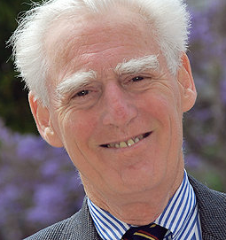
After some algebra...
<ψ₀Φ_{0,0}|m|ψ₀Φ_{0,1}>
= <Φ_{0,0}| m^{n}|Φ_{0,1}> + 2ħ²<(∂ψ₀/∂B)|∂ψ₀/∂Q>₀<Φ₀₀|(∂Φ₀₁/ ∂Q)>
B is the magnetic field
Evaluated by:
coupled perturbed HF theory
(magnetic field perturbation) - Stephens
or
sum over states
(vibronic coupling theory) – Nafie and Freedman
P. J. Stephens
(1941-2012)
Teresa B. Freedman
(tbfreedm@syr.edu)
Laurence. A. Nafie
(lnafie@syr.edu)

Slide 10
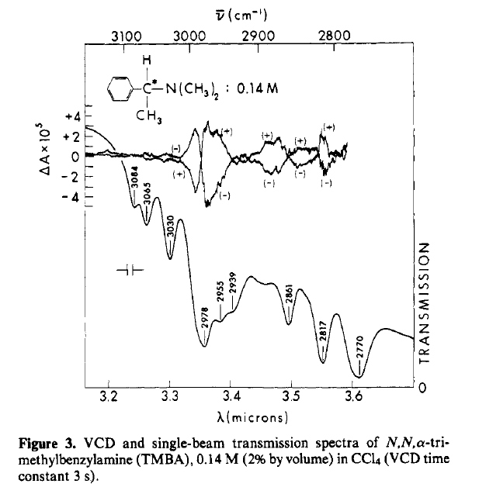
First Experimental VCD Spectra
P. J. Stephens
(1941-2012)
Timothy A. Keiderling
(tak@uic.edu)
Laurence. A. Nafie
(lnafie@syr.edu)
JACS 1976, 98, 2715 - 2723

Slide 11
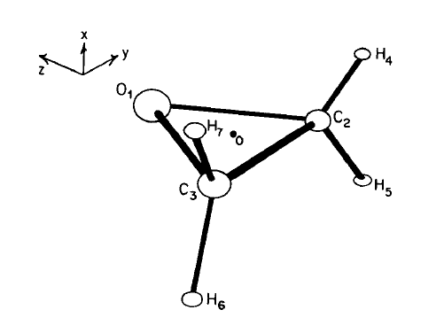
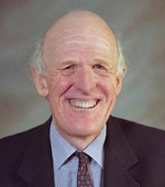
1987, 133, 21-26
➔ NO VCD!
Nicholas C. Handy
(1941 – 2012)

Slide 12
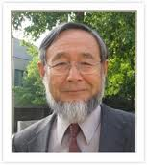
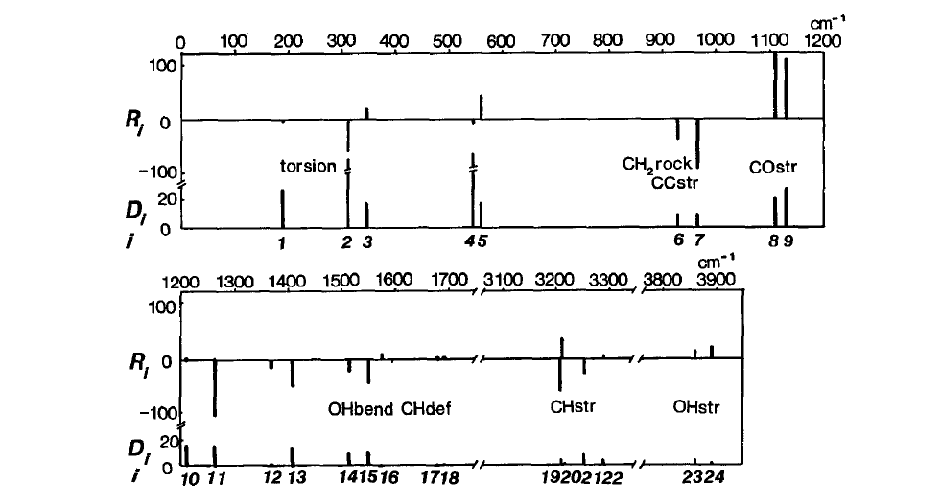
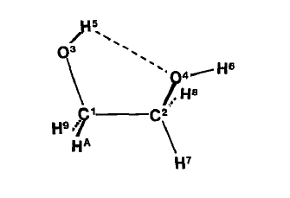
1987, 134, 23-26 ➔ FIRST VCD?
morokuma@euch4e.chem.emory.edu

Slide 13
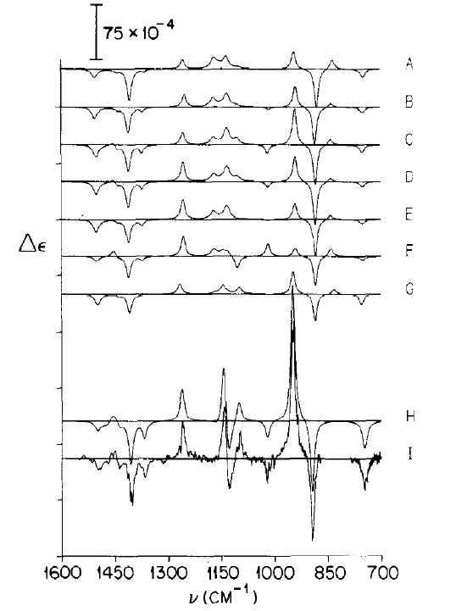
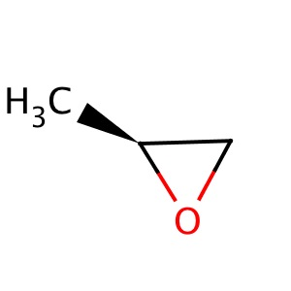
1988, 145, 411-417
expt
(S)-(-)-propylene oxide

Slide 14
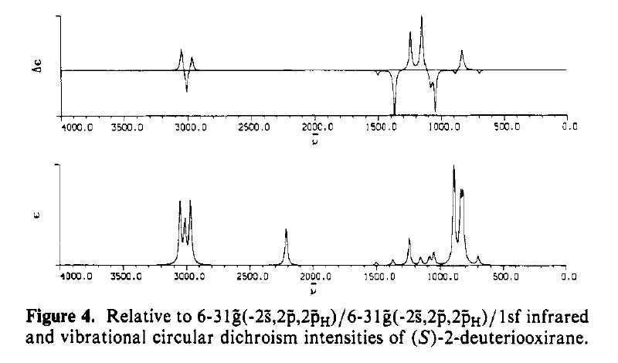
Remo Dutler
D

Slide 15
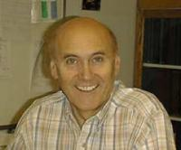
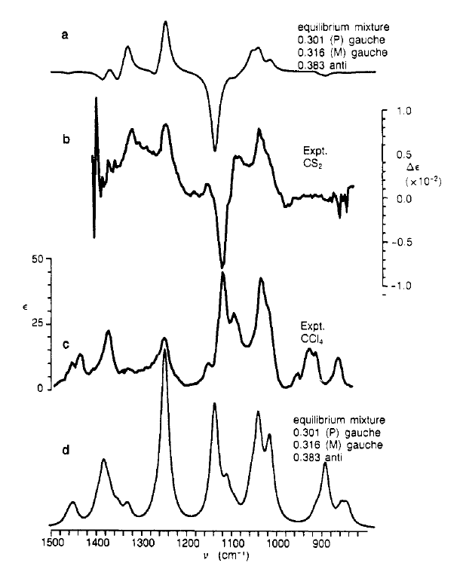
Helmut Wieser

Slide 16
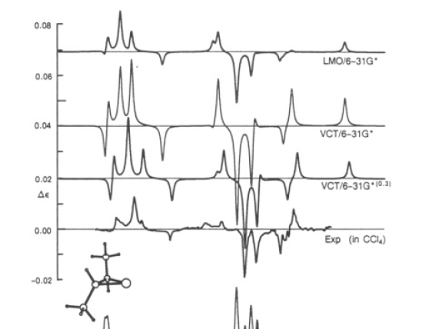
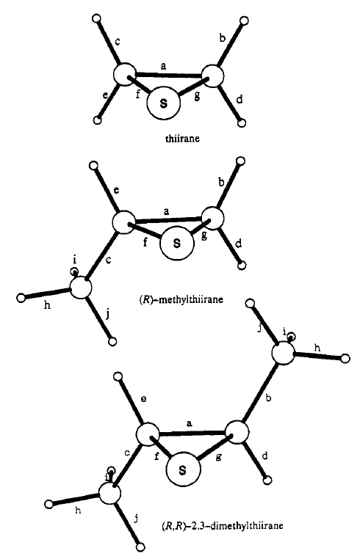
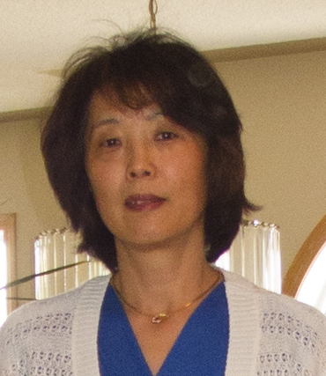
Danya Yang
Prasad L. Polavarapu

Slide 17
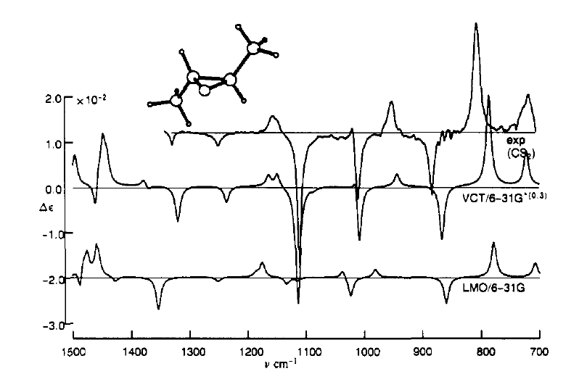

Slide 18
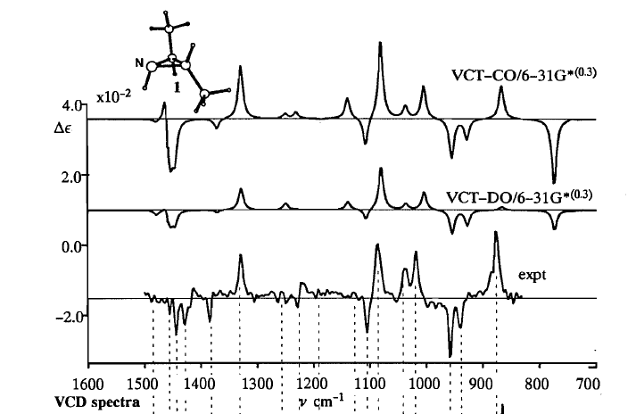
DFT force fields become available!

Slide 19
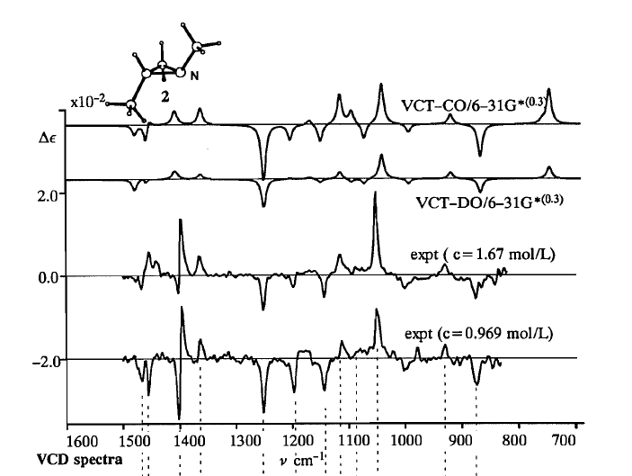

Slide 20
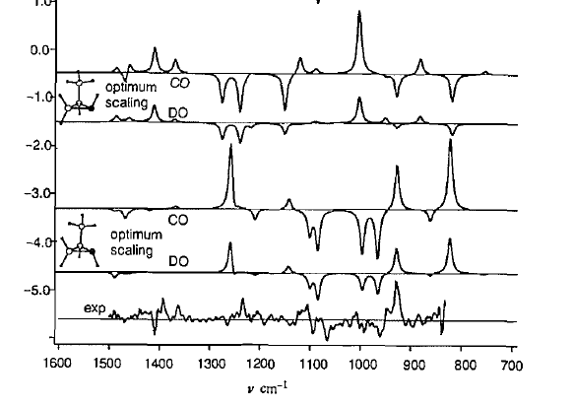
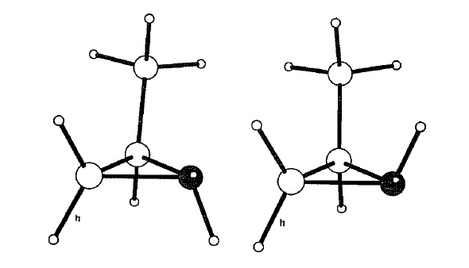

Slide 21
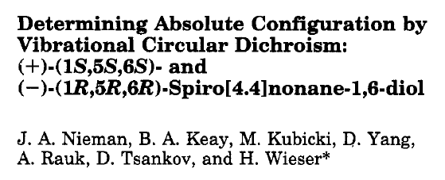
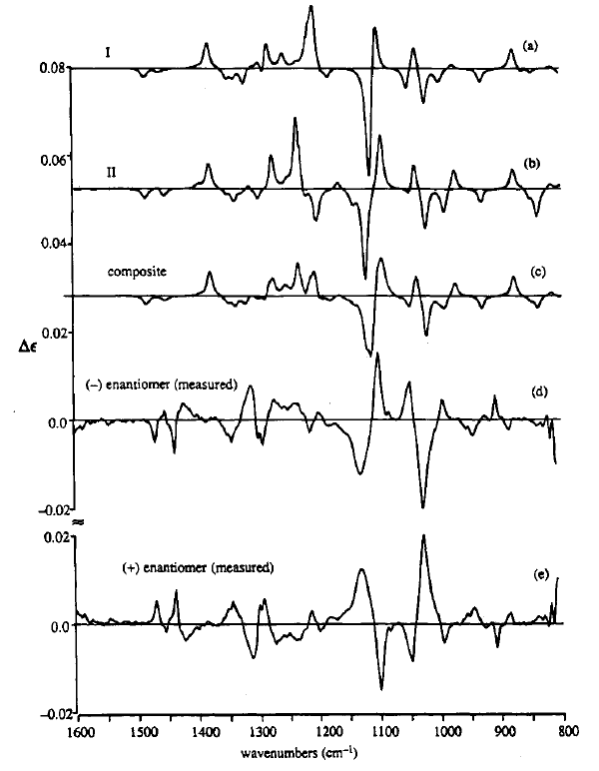
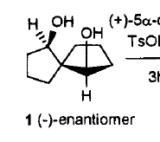
Danya Yang
2 conformations make up 86% of mixture

Slide 22
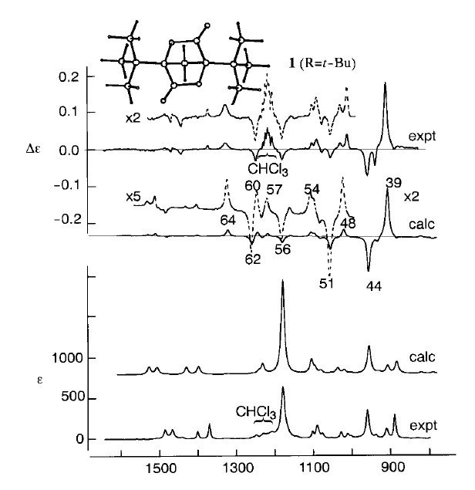
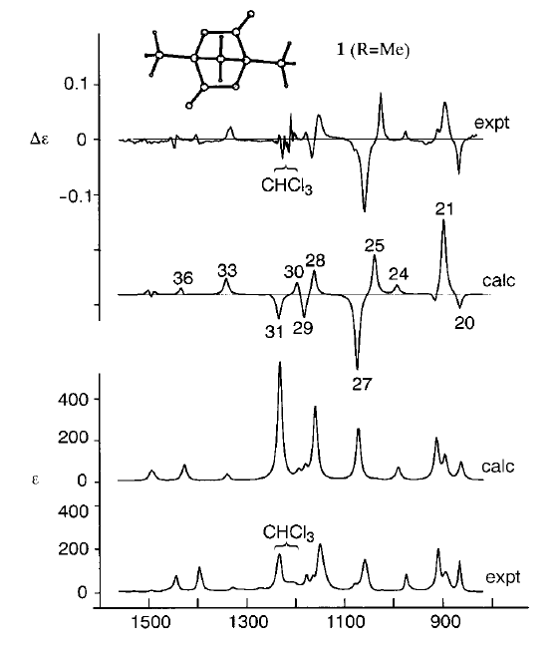

Slide 23
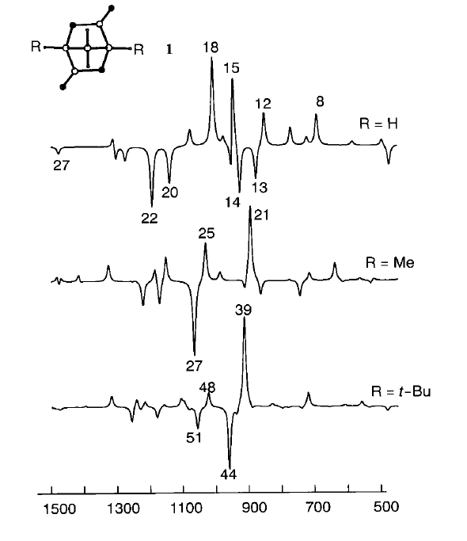
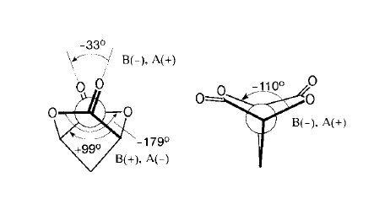

Slide 24
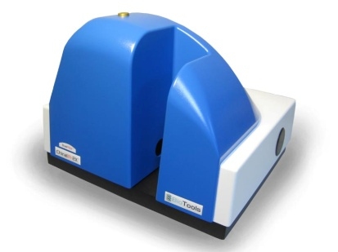
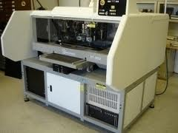
VCD today?
There are commercial instruments that make measurements easy:
ChiralIR from BioTools
PMA 50 from Bruker
Universal Instruments VCD Axial insertion machines
Excellent software to calculate VCD
Gaussian
ADF
CADPAC
Major Uses:
Protein secondary structure, optical purity, absolute chirality

Slide 25
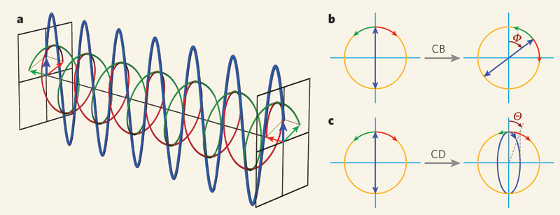
Questions?

