Slide 1
Optical Activity - What is it and how do we describe it theoretically?
Arvi Rauk
Professor Emeritus and Faculty Professor
Department of Chemistry, University of Calgary
rauk@ucalgary.ca
http://www.chem.ucalgary.ca/research/groups/rauk/

Slide 2
What is Optical Activity?
The ability of some substances to rotate the plane of polarization of plane polarized light
The differential absorption of right and left circularly polarized light
circularly polarized light?
plane polarized light?
plane of polarization?

Slide 3
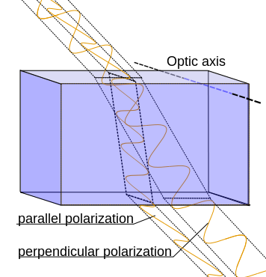
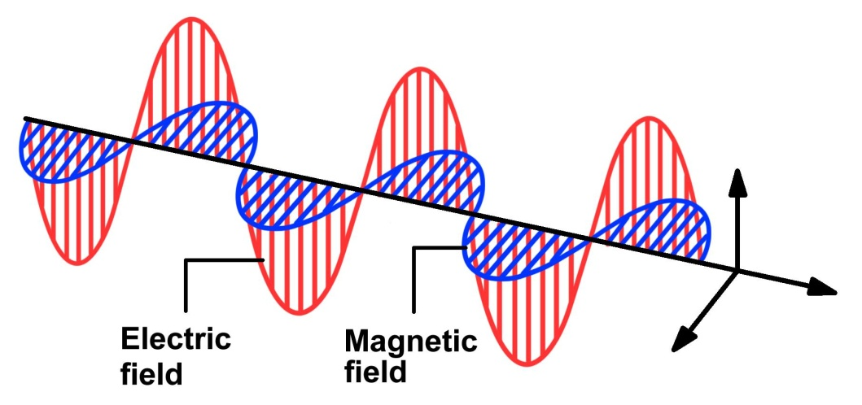
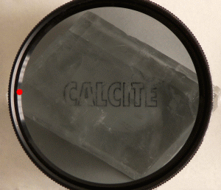
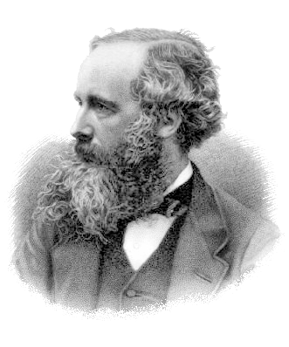
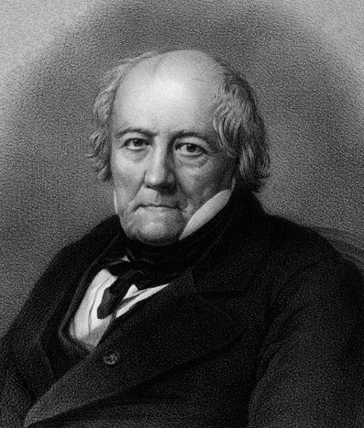
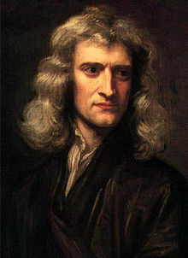
Polarized light
Birefringent materials
known since early 1700s
Iceland Spar
Birefringence: a calcite crystal seen through a polarizing filter
Isaac Newton
(1642-1727)
Jean-Baptiste Biot
(1774 – 1862)
James Clerk Maxwell
(1831 – 1879)

Slide 4
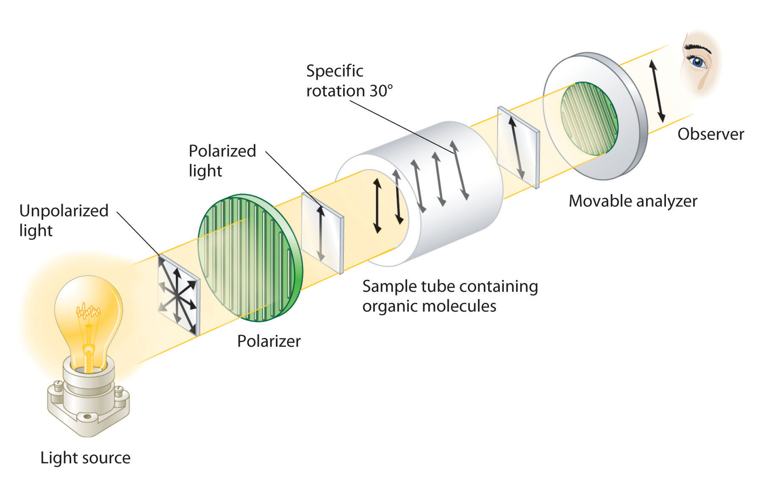
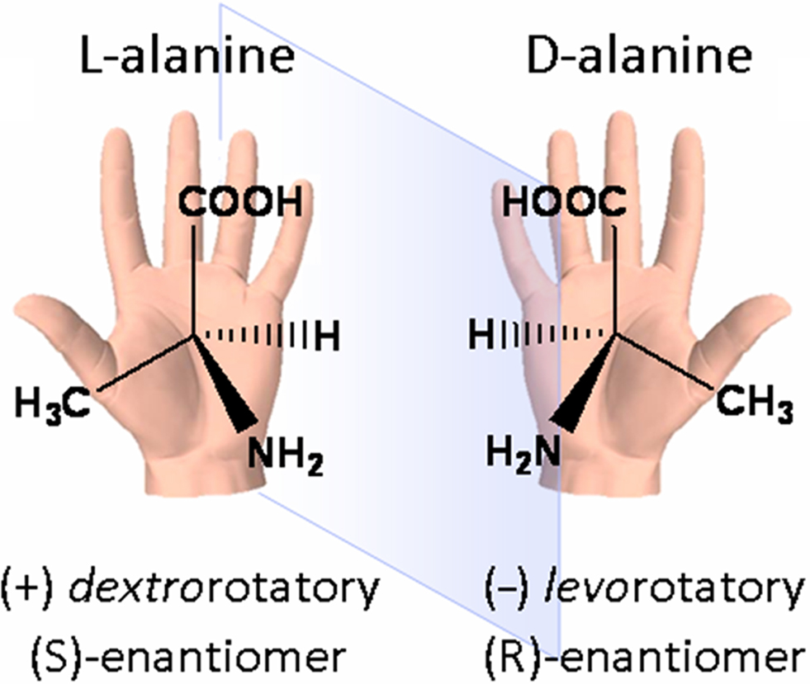
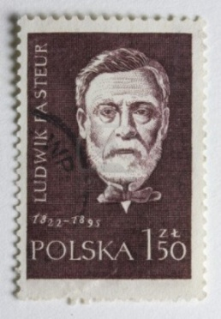
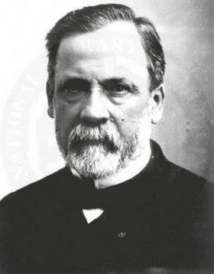
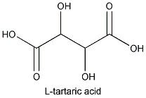
Polarimeter
1848 – Louis Pasteur separated (+)- and (-)-tartaric acid
→ molecular chirality
Louis Pasteur
(1822–1895)
L-(+)-tartaric acid: [α]_{D} = +12°
= specific rotation (1g/ml)
Temperature, concentration, solvent, and wavelength, must be specified

Slide 5
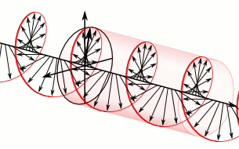
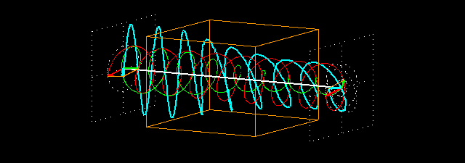
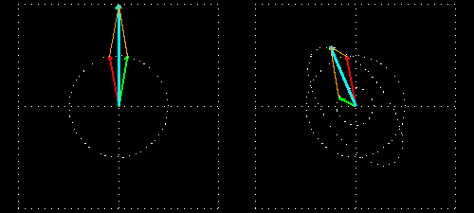
Plane and Circularly Polarized Light
n_{L} ≠ n_{R}
→ ORD
In
Out
ε_{L} ≠ ε_{R}
→ CD
András Szilágyi

Slide 6
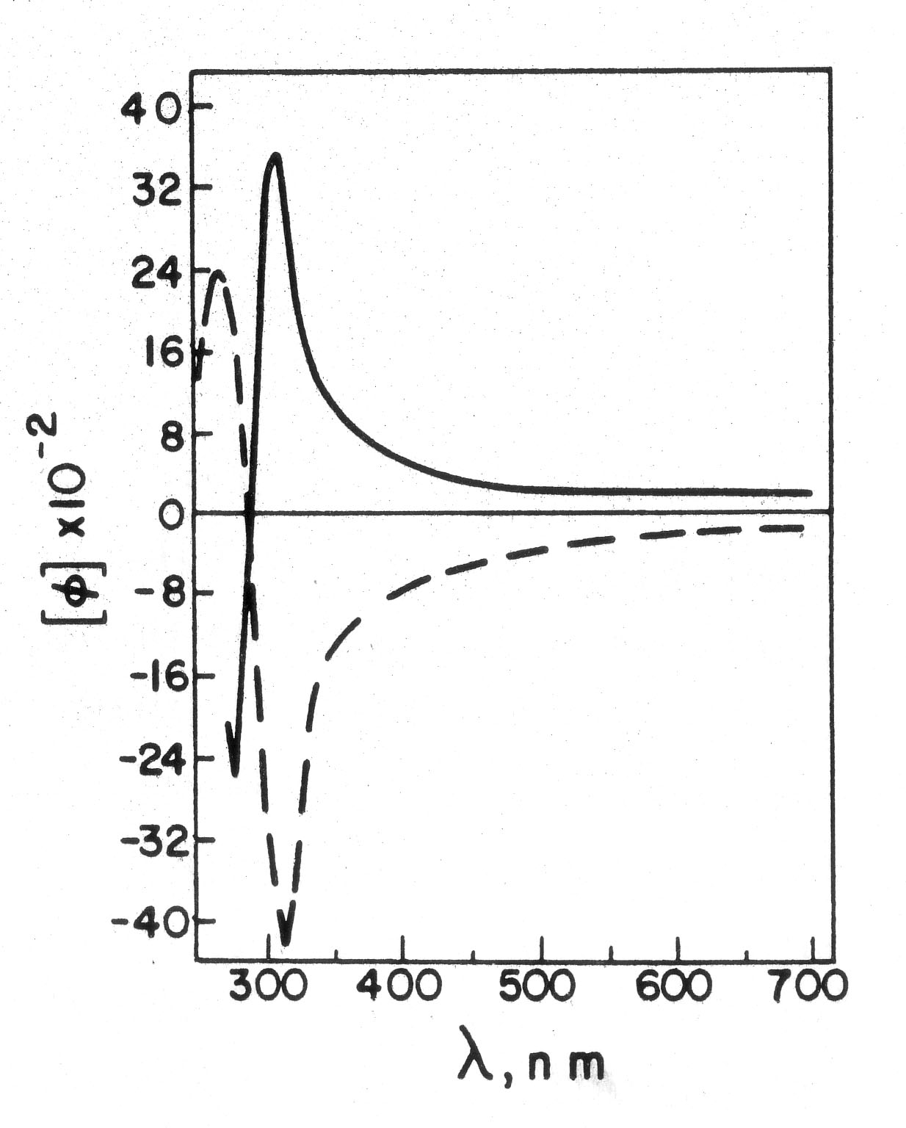
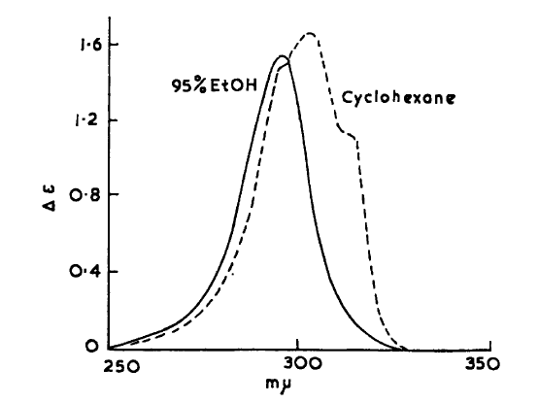
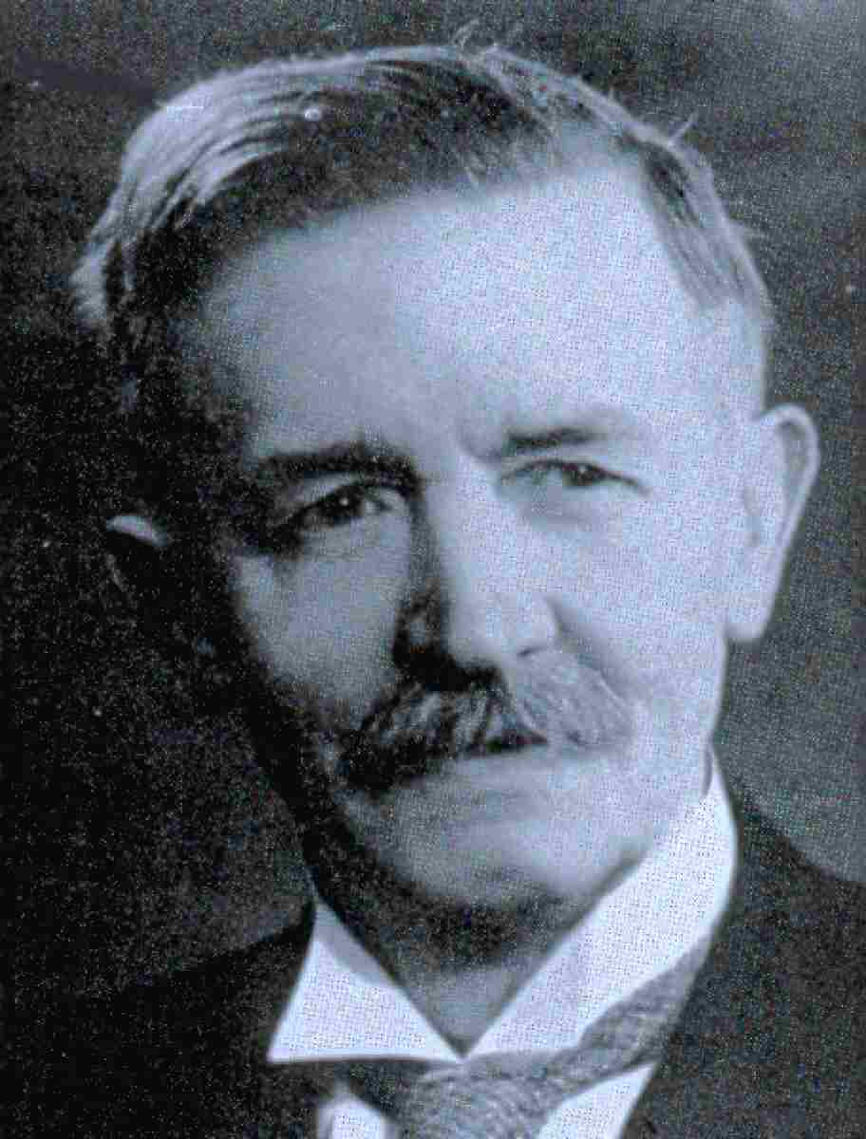
ORD
“D” 589 nm
CD
ε_{L} ≠ ε_{R}
n_{L} ≠ n_{R}
How to describe this behaviour theoretically?
Aimé Cotton
(1869-1951)

Slide 7
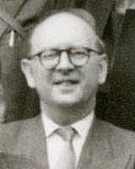
Optical Rotatory Dispersion (ORD)
β = -4πc/3h Σ_{n}[R_{0n}]/(ω_{0n}² – ω²)
where
[R_{0n}]^{r} = -i <Ψ₀|μ|Ψ_{n}><Ψ_{n}|m|Ψ₀>
Léon Rosenfeld
(1904 – 1974)
L. Rosenfeld, Z. Physik 52, 161 (1928)
Ψ₀, Ψ_{n} are ground and excited state wavefunctions
μ, m are electric and magnetic dipole transition moment operators
μ = μ^{e} + μ^{N} = - Σ_{i}er_{i} + Σ_{I}Z_{I}eR_{I}
m = m^{e} + m^{N} = - Σ_{i}(e/2mc) r_{i} × p_{i} + Σ_{I}(Z_{i}e/2M_{I}c)R_{I} × P_{I}
p_{i} = -iħ∇_{i}

Slide 8
?
[R_{0n}]^{r} = -i <Ψ₀|μ|Ψ_{n}><Ψ_{n}|m|Ψ₀> since 1928
L-(+)-tartaric acid: [α]_{D} = +12°
= specific rotation (1g/ml)

Slide 9
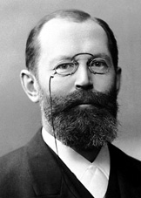
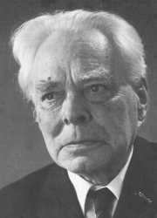
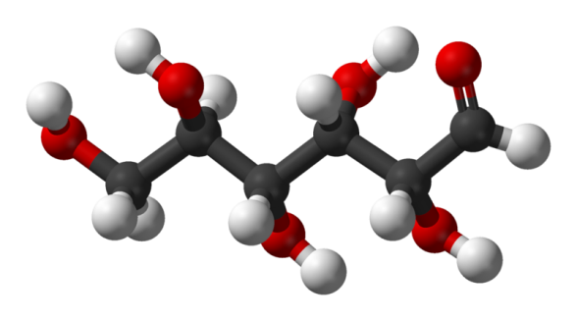
[R_{0n}]^{r} = -i <Ψ₀|μ|Ψ_{n}><Ψ_{n}|m|Ψ₀> since 1928
All naturally occuring amino acids are “L”
Herman Emil Fischer
(1852 – 1919)
Nobel Prize 1902
Johannes Martin Bijvoet
(1892 – 1980)
CH=O
CH=O
sodium rubidium tartrate (1951)
H
OH
HO
H
HO
H
or
H
OH
H
OH
HO
H
HO
H
(D)-(-)-Tartaric acid
H
OH
CH₂OH
CH₂OH
Fischer guessed right!
≈1890s
(D)-(+)-Glucose

Slide 10
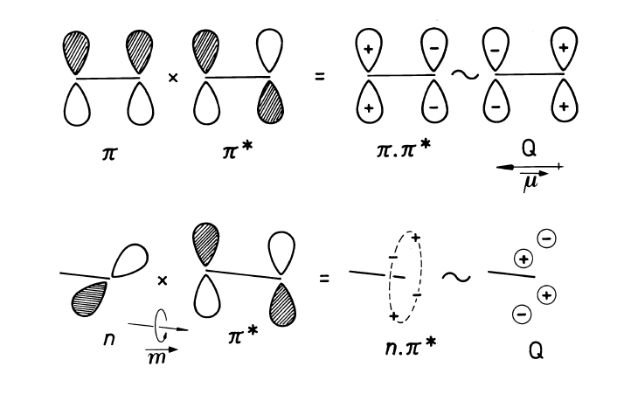
The Rosenfeld equation,
[R_{0n}]^{r} = -i <Ψ₀|μ|Ψ_{n}><Ψ_{n}|m|Ψ₀>
is so simple! Why did theoreticians fail?
Before computers (< 1980), the SEs “were too difficult to solve”
One solution...
Sector rules developed based on orbital nodal structures of chromophores

Slide 11
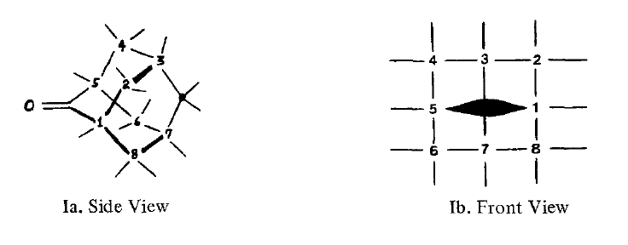
The carbonyl group
➔ Quadrant (or octant) rule
+
-
-
+
Other chromophores, e.g., the sulfide group

Slide 12
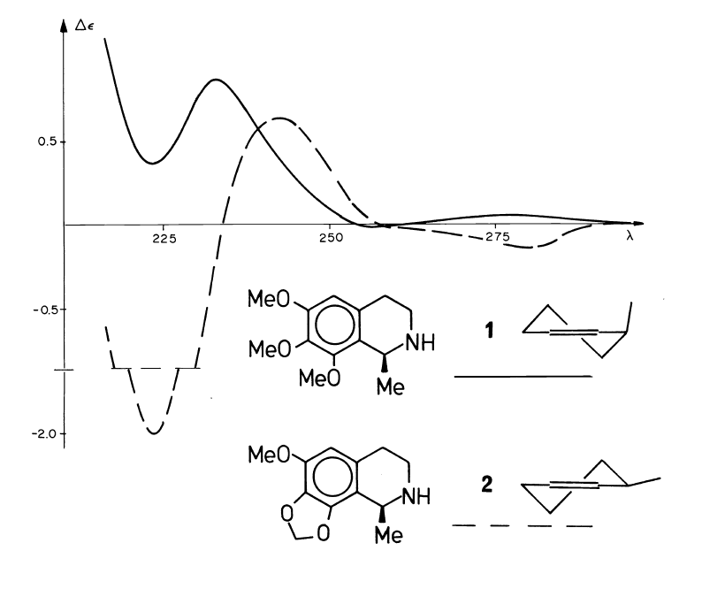
Sector rules too difficult and too unreliable in which to have confidence

Slide 13
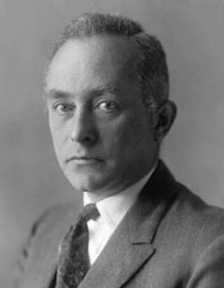
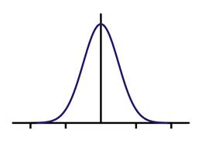
Rotational Strengths from Coupled Oscillator theory (1915)
H
H
C
μ₁
H
r₁₂
C
μ₂
C
H
H
C
μ₁, μ₂ are electric dipole transition moments of two degenerate electronic transitions, e.g., π → π*
H
D± ∝
|μ₁ ± μ₂|²
±
R± ∝
r₁₂•μ₁ × μ₂
±
Max Born
(1882 - 1970)

Slide 14
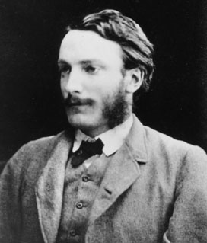
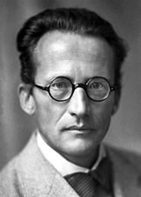
After computers (> 1980), the more reliable theories could treat Ψ₀ and Ψ_{n} more equally.
(Rayleigh and) Schrodinger had pointed the way in 1926 ...
John William Strutt
(1842-1919)
Ψ₀ = Φ_{HF} (correct to first order)
Ψ_{n} = Ψ_{n}⁰
+ Σ_{j} a_{nj} Φ_{j}⁰
a_{nj} = <Ψ_{n}⁰|H|Φ_{j}⁰>/(<Φ_{j}⁰|H|Φ_{j}⁰> - <Ψ_{n}⁰|H|Ψ_{n}⁰>)
[R_{0n}]^{r} = -i <Ψ₀|μ|Ψ_{n}><Ψ_{n}|m|Ψ₀>
Erwin Schrodinger
(1887-1961)
[R_{0n}]^{r} is origin-dependent for inexact wave functions

Slide 15
Length formulation
[R_{0n}]^{r} = -i <Ψ₀|μ|Ψ_{n}><Ψ_{n}|m|Ψ₀>
[R_{0n}]^{r} is origin-dependent for inexact wave functions
From commutator relationship of H and μ, for exact wave functions,
<Ψ₀|μ|Ψ_{n}> = <Ψ₀| |Ψ_{n}>/(E_{n} – E₀)
Velocity formulation
[R_{0n}] = -i<Ψ₀| |Ψ_{n}><Ψ_{n}|m|Ψ₀>/(E_{n} – E₀)
[R_{0n}] is not origin-dependent but requires accurate ΔE_{n0}

Slide 16
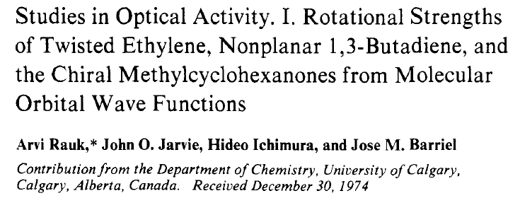
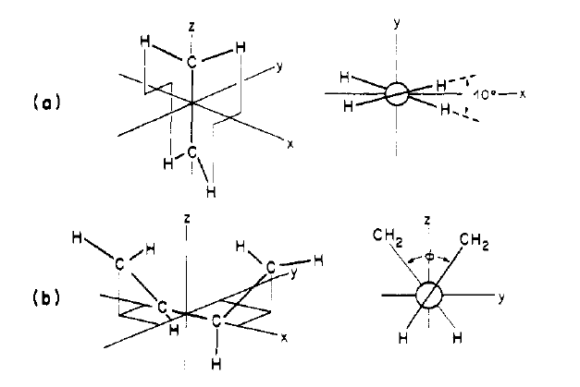
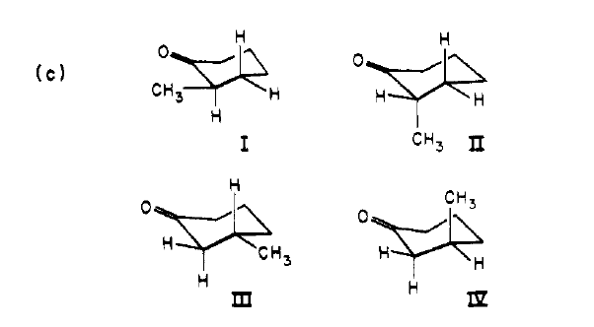
Jose M. Barriel
John O. Jarvie
J. Am. Chem. Soc. 1975, 97, 5656-5664.

Slide 17
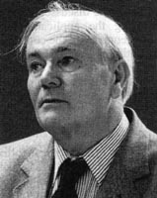
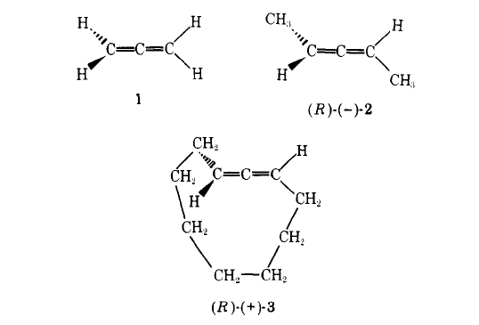
Alex F. Drake
(a.drake@kcl.ac.uk)
Stephen F. Mason
(1923 – 2007)

Slide 18
Achiral
(optically inactive?)
Same chirality but opposite rotations
(R)-(-)-2: CD spectrum decreases as temperature is lowered
(R)-(+)-3: CD spectrum increases as temperature is lowered
(R)-(-)-2: two (+)ve CEs near 220 nm
(R)-(+)-3: (+)ve CE and (-)ve CE near 220 nm

Slide 19
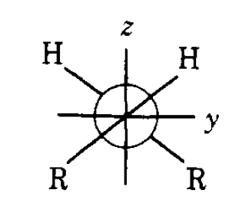
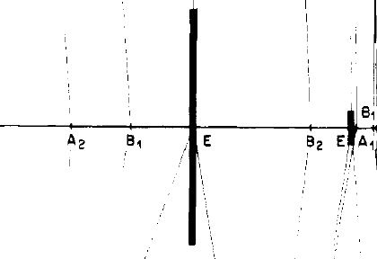
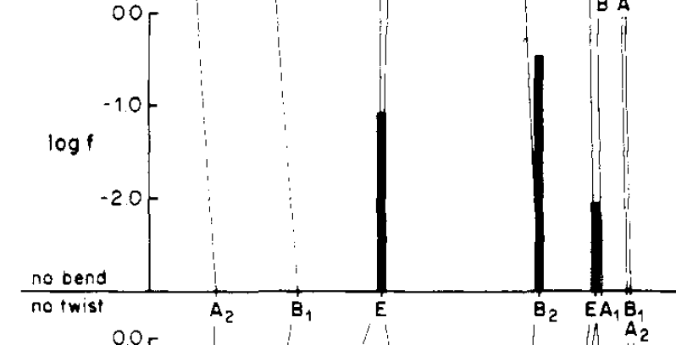
CD
Valence
π → π*
Valence
π → π*
Valence
π → π*
Rydberg
UV
π → 3s

Slide 20
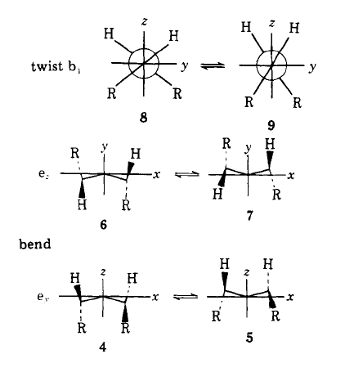
865 cm⁻¹
335 cm⁻¹

Slide 21
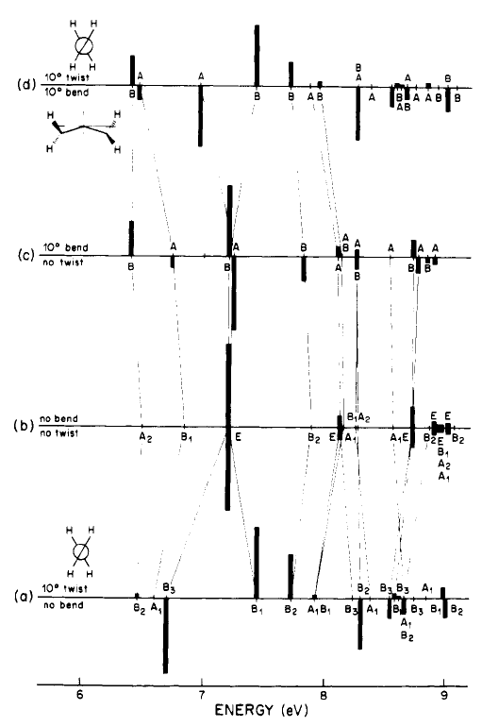

Slide 22
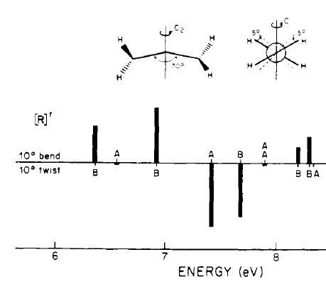
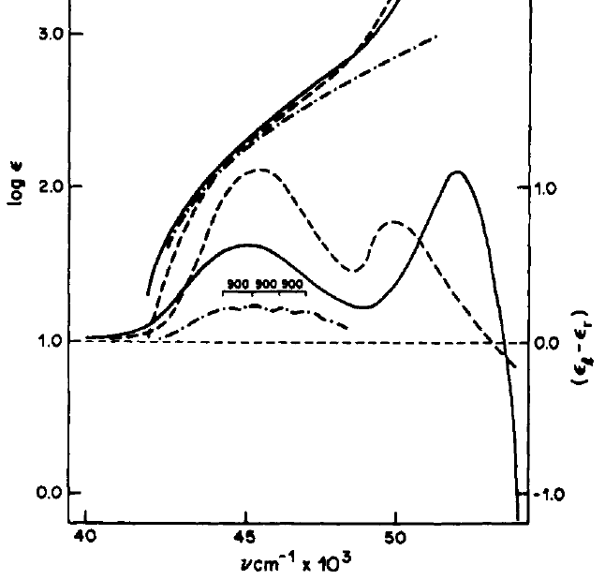
23°
CH₃
CH₃
gas
CH₃
CH₃
solution
23°
solution
-182°
-182°

Slide 23
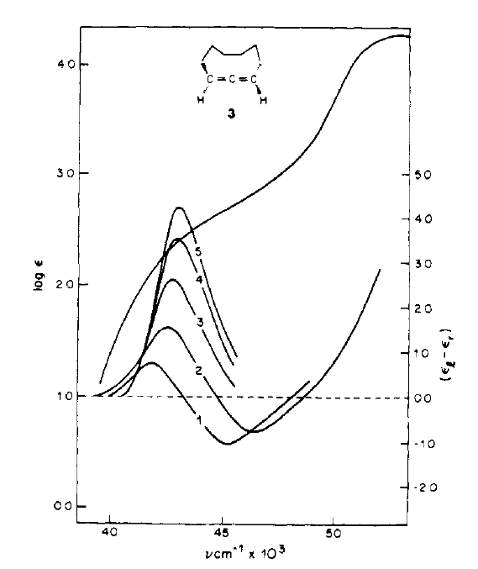
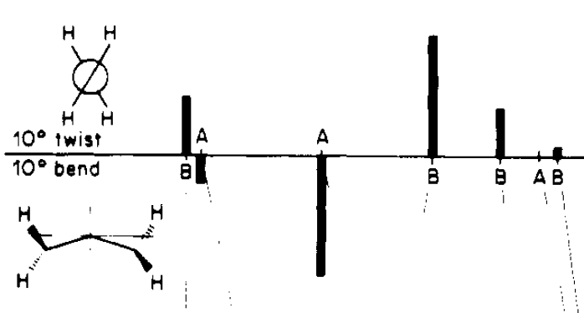
solution
-182°
-145°
-100°
Bend rigid
Twist sensitive to temperature
At low temperature, CD due to A bands disappears
20°
gas

Slide 24
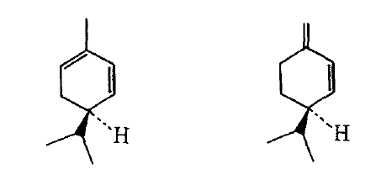
J. Comput. Chem., 1980, 1, 240-256
(-)-α-phellandrene
(-)-β-phellandrene
The puzzle:
The diene chromophore has a right-handed twist and should have a (+)ve CE for the lowest π – π* transition
Both have a (-)ve specific rotation
β-Phellandrene has a (+)ve CE near 260 nm but α-phellandrene has a (-)ve CE

Slide 25
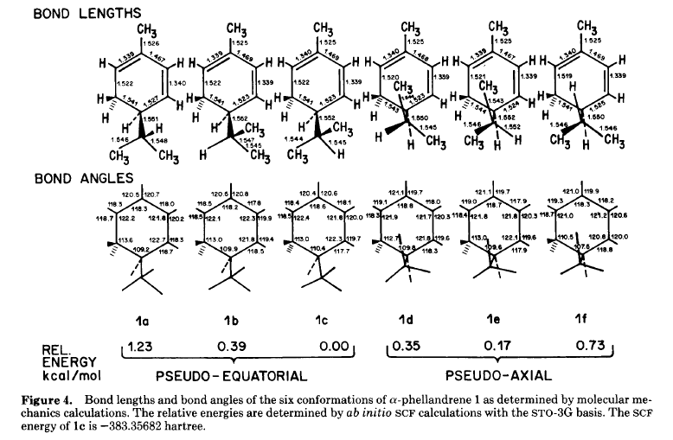

Slide 26
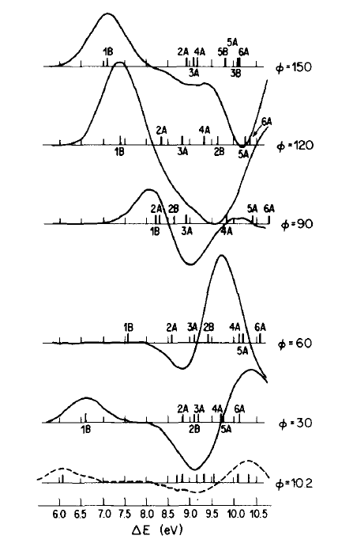
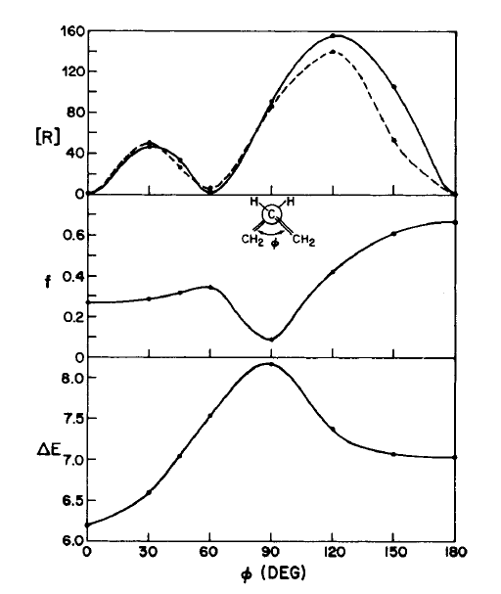
Right-handed twist
N → V (π₂ →π₃*)

Slide 27
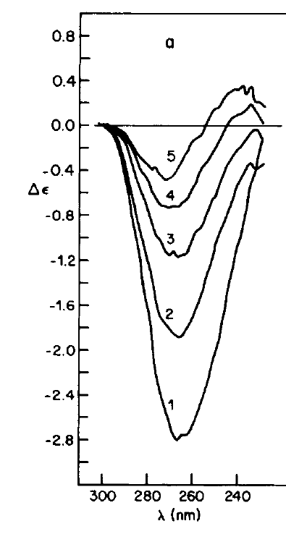
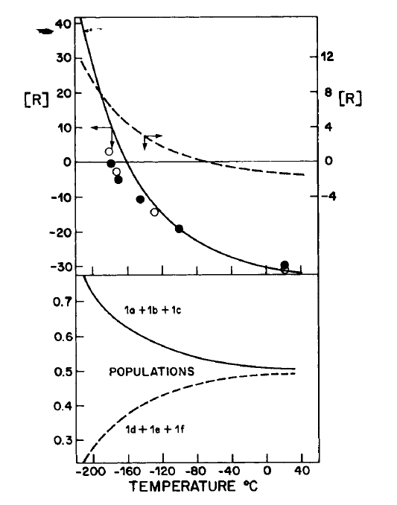
-178°
-170°
-144°
-100°
23°

Slide 28
Limitations of ECD practically and theoretically
Too few transitions in accessible spectral region
Transitions sum – if of opposite sign, they cancel
Transitions of small molecules are often in the far UV and difficult to measure
Transitions are complex and may involve many coupled chromophores
Excited states are complex and difficult to describe theoretically (TD and CI methods help)

Slide 29
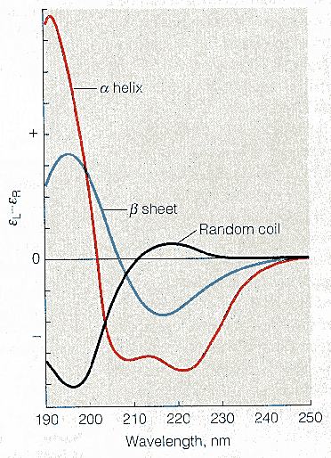
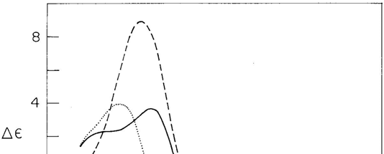
Major users of CD Today?
Biochemists for protein structure analysis
SELCON, CONTIN, CDSSTR
Lactate dehydrogenase
Cytochrome c
Papain
e.g., Papain: 27% helix; 14% β-sheet; 64% coil

Slide 30
Questions?

