Slide 1
Sabre: Sender-Anonymous Messaging with Fast Audits
Adithya Vadapalli¹, Kyle Storrier², and Ryan Henry²
¹University of Waterloo, adithya.vadapalli@uwaterloo.ca
²University of Calgary, {kyle.storrier, ryan.henry}@ucalgary.ca
Notes:
Hello, My name is Kyle Storrier, and I am here to present “Sabre: Sender-Anonymous Messaging with Fast Audits”

Slide 2
Outline
Introduction
Sabre-BB
  DPF verification protocol
Sabre-M
  Sabre-M mailbox security
Conclusion
Notes:
This presentation will be divided as follows:
We will first describe some introductory and background material
Then we will discuss the Sabre-BB system and its novel technique for DPF verification
We will then describe Sabre-M and its mailbox security protocol

Slide 3


Sender-Anonymous Messaging (SAM)
Sender-anonymous bulletin board model
Sender-anonymous mailbox model
Notes:
As its name suggests, sender-anonymous messaging (or SAM) protocols enable clients to anonymously send messages to one or more recipients.
In the literature, there are two main types of SAM protocols.
This first is the sender anonymous bulletin board model, in which clients broadcast messages to all readers. Much like an anonymous version of Twitter.
The second is the sender-anonymous mailbox model. This model is more like email or the secureDrop protocol. It works by having the recipients pre-register a mailbox with the system. The recipients can then tell potential senders the mailbox’s address, so that they can anonymously send messages to the mailbox.

Slide 4

Sabre
Sabre-BB in the bulletin board model
Sabre-M in the mailbox model
Improved verification protocols
Notes:
In this work, we propose Sabre, a versatile sender-anonymous messaging protocol that functions in both the bulletin board and mailbox models with significant performance improvements over prior works.

Slide 5
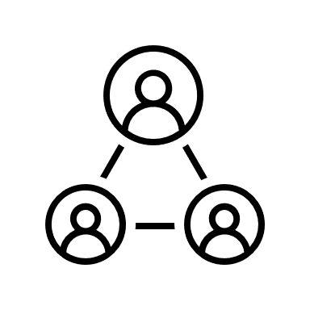
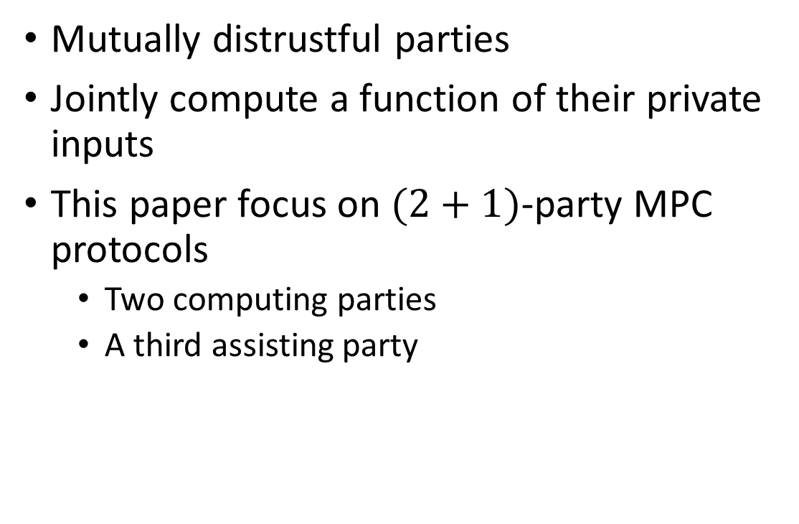
Secure Multiparty Computation (MPC)
Mutually distrustful parties
Jointly compute a function of their private inputs
This paper focus on $(2+1)$-party MPC protocols
  Two computing parties
  A third assisting party
Notes:
A key technique used in Sabre is secure multiparty computation (MPC)
We specifically focus on $(2+1)$-party MPC protocols
Two computing parties
A third assisting party
Sabre uses MPC for verifying DPF correctness

Slide 6

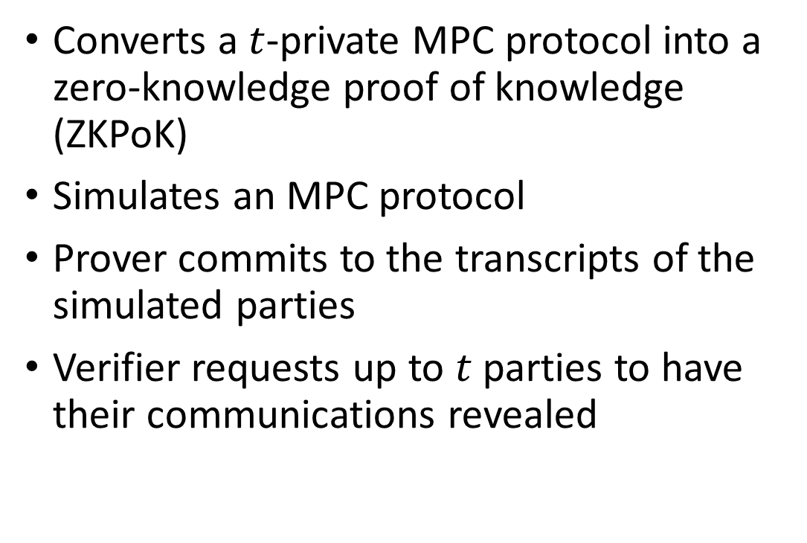
MPC-in-the-Head
Converts a $t$-private MPC protocol into a zero-knowledge proof of knowledge (ZKPoK)
Simulates an MPC protocol
Prover commits to the transcripts of the simulated parties
Verifier requests up to $t$ parties to have their communications revealed
Notes:
Converts an MPC protocol to a zero-knowledge proof of knowledge (ZKPoK)
Prover simulates an MPC protocol to verify the statement
Prover commits to the transcripts of the simulated parties
Verifier requests up to $t$ parties to have their communications revealed
Privacy requirements of MPC protocols ensures zero-knowledge property

Slide 7
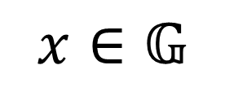
Additive Secret Sharing
$$x∈𝔾$$
Notes:
Secret sharing divides a secret value into two or more shares such that some minimum threshold number of shares must be combined in order to reveal the secret.
In our work, we use secret sharing schemes which divide a value into two shares where both shares are needed to reconstruct the secret.
The scheme used in our work is based on a simple idea. We have a secret value x which is an element of a group G
We then select one share to be a random value in G
The other share is then computed so that it makes the sum of the shares equal the secret x
If you are familiar with the concept of a one-time pad, we have essentially done that here with one share being the key and the other being the ciphertext.
This means that both of our shares are essentially random, hiding the secret value from any party who only knows one share.
These shares are then distributed to the relevant parties. Whenever these parties want, they can exchange their shares and reveal the secret by adding the two values together.

Slide 8

Additive Secret Sharing
$${\left[x\right]}_{0}∈_{R}𝔾$$
Notes:
Secret sharing divides a secret value into two or more shares such that some minimum threshold number of shares must be combined in order to reveal the secret.
In our work, we use secret sharing schemes which divide a value into two shares where both shares are needed to reconstruct the secret.
The scheme used in our work is based on a simple idea. We have a secret value x which is an element of a group G
We then select one share to be a random value in G
The other share is then computed so that it makes the sum of the shares equal the secret x
If you are familiar with the concept of a one-time pad, we have essentially done that here with one share being the key and the other being the ciphertext.
This means that both of our shares are essentially random, hiding the secret value from any party who only knows one share.
These shares are then distributed to the relevant parties. Whenever these parties want, they can exchange their shares and reveal the secret by adding the two values together.

Slide 9

Additive Secret Sharing
$${\left[x\right]}_{1}=x−{\left[x\right]}_{0}$$
Notes:
Secret sharing divides a secret value into two or more shares such that some minimum threshold number of shares must be combined in order to reveal the secret.
In our work, we use secret sharing schemes which divide a value into two shares where both shares are needed to reconstruct the secret.
The scheme used in our work is based on a simple idea. We have a secret value x which is an element of a group G
We then select one share to be a random value in G
The other share is then computed so that it makes the sum of the shares equal the secret x
If you are familiar with the concept of a one-time pad, we have essentially done that here with one share being the key and the other being the ciphertext.
This means that both of our shares are essentially random, hiding the secret value from any party who only knows one share.
These shares are then distributed to the relevant parties. Whenever these parties want, they can exchange their shares and reveal the secret by adding the two values together.

Slide 10

Additive Secret Sharing
$$x={\left[x\right]}_{1}+{\left[x\right]}_{0}$$
Notes:
Secret sharing divides a secret value into two or more shares such that some minimum threshold number of shares must be combined in order to reveal the secret.
In our work, we use secret sharing schemes which divide a value into two shares where both shares are needed to reconstruct the secret.
The scheme used in our work is based on a simple idea. We have a secret value x which is an element of a group G
We then select one share to be a random value in G
The other share is then computed so that it makes the sum of the shares equal the secret x
If you are familiar with the concept of a one-time pad, we have essentially done that here with one share being the key and the other being the ciphertext.
This means that both of our shares are essentially random, hiding the secret value from any party who only knows one share.
These shares are then distributed to the relevant parties. Whenever these parties want, they can exchange their shares and reveal the secret by adding the two values together.

Slide 11


Additive Secret Sharing
$$x={\left[x\right]}_{1}+{\left[x\right]}_{0}$$
$$y={\left[y\right]}_{1}+{\left[y\right]}_{0}$$
Notes:
Now, if two parties have additive shares of two different secrets x and y, the holders of the secrets can compute secret shares of x+y without needing to communicate or bring in a third party.
A share of x+y is simply a share of x + a share of y

Slide 12
Additive Secret Sharing
$$x+y=\left({\left[x\right]}_{1}+{\left[y\right]}_{1}\right)+\left({\left[x\right]}_{0}+{\left[y\right]}_{0}\right)$$
Notes:
Now, if two parties have additive shares of two different secrets x and y, the holders of the secrets can compute secret shares of x+y without needing to communicate or bring in a third party.
A share of x+y is simply a share of x + a share of y
Assuming that some multiplication-like operation even exists for this group, multiplication is more costly than addition.
If you are interested, I can explain more about how multiplication is performed during the questions and answers period.

Slide 13


Additive Secret Sharing over $ℤ_{2^{ℓ}}$
$ℤ_{2^{ℓ}}$ is the ring of integers modulo $2^{ℓ}$
Represented with $ℓ$-bit integers
Addition and multiplication are simply the corresponding operations modulo $2^{ℓ}$
Notes:
We generally use $ℤ_{2^{ℓ}}$ or $ℤ_{2}^{ℓ}$ as our $𝔾$
$ℤ_{2^{ℓ}}$ is the set of integers modulo $2^{ℓ}$
$𝔽_{2}^{ℓ}$ is the set of length $ℓ$ vectors of numbers modulo $2$
Both can be easily represented with $ℓ$-bit integers
In $ℤ_{2^{ℓ}}$ addition and multiplication are simply the corresponding operations modulo $2^{ℓ}$
In $𝔽_{2}^{ℓ}$ addition is bitwise XOR and multiplication is bitwise AND (note that this

Slide 14


Additive Secret Sharing over ${\left\{0, 1\right\}}^{ℓ}$
The set of length $ℓ$ bitstrings
Represented with $ℓ$-bit integers
For “addition” we use bitwise XOR
For “multiplication” we use bitwise AND
Notes:
We generally use $ℤ_{2^{ℓ}}$ or $ℤ_{2}^{ℓ}$ as our $𝔾$
$ℤ_{2^{ℓ}}$ is the set of integers modulo $2^{ℓ}$
$𝔽_{2}^{ℓ}$ is the set of length $ℓ$ vectors of numbers modulo $2$
Both can be easily represented with $ℓ$-bit integers
In $ℤ_{2^{ℓ}}$ addition and multiplication are simply the corresponding operations modulo $2^{ℓ}$
In $𝔽_{2}^{ℓ}$ addition is bitwise XOR and multiplication is bitwise AND (note that this

Slide 15

Additive Secret Sharing Databases
Secret Database
Server 1
Server 2
Notes:
In many privacy protecting systems, including sender-anonymous messaging systems, a database of secret information will be divided into secret shares
We can view the database as a vector

Slide 16
Additive Secret Sharing Databases
Share 1
Share 2
Server 1
Server 2
Notes:
Each element of the database can be secret shared to produce two vectors of secret shares of the database

Slide 17
Additive Secret Sharing Databases
Share 1
Share 2
Server 1
Server 2
Notes:
By giving one vector of shares to each server in the system, we can protect the privacy of the data in the database from the servers in the system (as long as the two servers do not collude).

Slide 18

Additive Secret Sharing Databases
Write $x$ at index $2$
Share 1
Share 2
Server 1
Server 2
Notes:
When we write into a secret shared database, we want to ensure that both the value being written and the location it is being written to remains private.

Slide 19

Additive Secret Sharing Databases
Write $x$ at index $2$
$$0$$
$$0$$
$$x$$
$$0$$
$$0$$
$$0$$
Share 1
Share 2
Server 1
Server 2
Notes:
We can represent our write request as a vector where all entries are zero except at the location where we want to write the value (in this case 2) which has the value we want to write (here x).

Slide 20




Additive Secret Sharing Databases
Write $x$ at index $2$
$${\left[0\right]}_{0}$$
$${\left[0\right]}_{0}$$
$${\left[x\right]}_{0}$$
$${\left[0\right]}_{0}$$
$${\left[0\right]}_{0}$$
$${\left[0\right]}_{0}$$
$${\left[0\right]}_{1}$$
$${\left[0\right]}_{1}$$
$${\left[x\right]}_{1}$$
$${\left[0\right]}_{1}$$
$${\left[0\right]}_{1}$$
$${\left[0\right]}_{1}$$
Share 1
Share 2
$${\left[0\right]}_{0}$$
$${\left[0\right]}_{0}$$
$${\left[0\right]}_{0}$$
$${\left[0\right]}_{0}$$
$${\left[0\right]}_{0}$$
$${\left[0\right]}_{0}$$
$${\left[0\right]}_{1}$$
$${\left[0\right]}_{1}$$
$${\left[0\right]}_{1}$$
$${\left[0\right]}_{1}$$
$${\left[0\right]}_{1}$$
$${\left[0\right]}_{1}$$
Server 1
Server 2
Notes:
We can then divide the write request vector into secret shares.
For this example, we will assume that the database was empty, meaning that each entry holds shares of zero.

Slide 21




Additive Secret Sharing Databases
Write $x$ at index $2$
Share 1
Share 2
$${\left[0\right]}_{0}$$
$${\left[0\right]}_{0}$$
$${\left[0\right]}_{0}$$
$${\left[0\right]}_{0}$$
$${\left[0\right]}_{0}$$
$${\left[0\right]}_{0}$$
$${\left[0\right]}_{0}$$
$${\left[0\right]}_{0}$$
$${\left[x\right]}_{0}$$
$${\left[0\right]}_{0}$$
$${\left[0\right]}_{0}$$
$${\left[0\right]}_{0}$$
$${\left[0\right]}_{1}$$
$${\left[0\right]}_{1}$$
$${\left[x\right]}_{1}$$
$${\left[0\right]}_{1}$$
$${\left[0\right]}_{1}$$
$${\left[0\right]}_{1}$$
$${\left[0\right]}_{1}$$
$${\left[0\right]}_{1}$$
$${\left[0\right]}_{1}$$
$${\left[0\right]}_{1}$$
$${\left[0\right]}_{1}$$
$${\left[0\right]}_{1}$$
$$+$$
$$+$$
Server 1
Server 2
Notes:
The write request shares can then be added to the database shares.

Slide 22


Additive Secret Sharing Databases
Write $x$ at index $2$
Share 1
Share 2
$${\left[0\right]}_{0}$$
$${\left[0\right]}_{0}$$
$${\left[x\right]}_{0}$$
$${\left[0\right]}_{0}$$
$${\left[0\right]}_{0}$$
$${\left[0\right]}_{0}$$
$${\left[0\right]}_{1}$$
$${\left[0\right]}_{1}$$
$${\left[x\right]}_{1}$$
$${\left[0\right]}_{1}$$
$${\left[0\right]}_{1}$$
$${\left[0\right]}_{1}$$
Server 1
Server 2
Notes:
Since we can add shares locally, this writes the desired data to the database.
While this allows us to privately write data to the database, I am sure you noticed that a write request requires us to send two vectors of the same size as the full database.
This problem will be addressed when we introduce distributed point functions.

Slide 23


Additive Secret Sharing Databases
Write $y$ at index $4$
$$0$$
$$0$$
$$0$$
$$0$$
$$y$$
$$0$$
Share 1
Share 2
$${\left[0\right]}_{0}$$
$${\left[0\right]}_{0}$$
$${\left[x\right]}_{0}$$
$${\left[0\right]}_{0}$$
$${\left[0\right]}_{0}$$
$${\left[0\right]}_{0}$$
$${\left[0\right]}_{1}$$
$${\left[0\right]}_{1}$$
$${\left[x\right]}_{1}$$
$${\left[0\right]}_{1}$$
$${\left[0\right]}_{1}$$
$${\left[0\right]}_{1}$$
Server 1
Server 2
Notes:
We can repeat this without any problem as long as no writes are attempted to locations that have already been written to (as this will corrupt the entry).

Slide 24


Additive Secret Sharing Databases
Write $y$ at index $4$
$${\left[0\right]}_{0}$$
$${\left[0\right]}_{0}$$
$${\left[0\right]}_{0}$$
$${\left[0\right]}_{0}$$
$${\left[y\right]}_{0}$$
$${\left[0\right]}_{0}$$
$${\left[0\right]}_{1}$$
$${\left[0\right]}_{1}$$
$${\left[0\right]}_{1}$$
$${\left[0\right]}_{1}$$
$${\left[y\right]}_{1}$$
$${\left[0\right]}_{1}$$
Share 1
Share 2
$${\left[0\right]}_{0}$$
$${\left[0\right]}_{0}$$
$${\left[x\right]}_{0}$$
$${\left[0\right]}_{0}$$
$${\left[0\right]}_{0}$$
$${\left[0\right]}_{0}$$
$${\left[0\right]}_{1}$$
$${\left[0\right]}_{1}$$
$${\left[x\right]}_{1}$$
$${\left[0\right]}_{1}$$
$${\left[0\right]}_{1}$$
$${\left[0\right]}_{1}$$
Server 1
Server 2

Slide 25


Additive Secret Sharing Databases
Write $y$ at index $4$
Share 1
Share 2
$${\left[0\right]}_{0}$$
$${\left[0\right]}_{0}$$
$${\left[x\right]}_{0}$$
$${\left[0\right]}_{0}$$
$${\left[0\right]}_{0}$$
$${\left[0\right]}_{0}$$
$${\left[0\right]}_{0}$$
$${\left[0\right]}_{0}$$
$${\left[0\right]}_{0}$$
$${\left[0\right]}_{0}$$
$${\left[y\right]}_{0}$$
$${\left[0\right]}_{0}$$
$${\left[0\right]}_{1}$$
$${\left[0\right]}_{1}$$
$${\left[0\right]}_{1}$$
$${\left[0\right]}_{1}$$
$${\left[y\right]}_{1}$$
$${\left[0\right]}_{1}$$
$${\left[0\right]}_{1}$$
$${\left[0\right]}_{1}$$
$${\left[x\right]}_{1}$$
$${\left[0\right]}_{1}$$
$${\left[0\right]}_{1}$$
$${\left[0\right]}_{1}$$
$$+$$
$$+$$
Server 1
Server 2
Notes:
Note that adding shares of zero to shares of our value x which is already in the database will simply result in the database containing a different secrete sharing of the same value x.

Slide 26


Additive Secret Sharing Databases
Share 1
Share 2
$${\left[0\right]}_{0}$$
$${\left[0\right]}_{0}$$
$${\left[x\right]}_{0}$$
$${\left[0\right]}_{0}$$
$${\left[y\right]}_{0}$$
$${\left[0\right]}_{0}$$
$${\left[0\right]}_{1}$$
$${\left[0\right]}_{1}$$
$${\left[x\right]}_{1}$$
$${\left[0\right]}_{1}$$
$${\left[y\right]}_{1}$$
$${\left[0\right]}_{1}$$
Server 1
Server 2
Notes:
This results in our database holding the written data in secret shared form

Slide 27
Additive Secret Sharing Databases
Reconstruct the database
Share 1
Share 2
$${\left[0\right]}_{0}$$
$${\left[0\right]}_{0}$$
$${\left[x\right]}_{0}$$
$${\left[0\right]}_{0}$$
$${\left[y\right]}_{0}$$
$${\left[0\right]}_{0}$$
$${\left[0\right]}_{1}$$
$${\left[0\right]}_{1}$$
$${\left[x\right]}_{1}$$
$${\left[0\right]}_{1}$$
$${\left[y\right]}_{1}$$
$${\left[0\right]}_{1}$$
Server 1
Server 2
Notes:
At some time in the future, we may want to reveal the value of the database.
This is an important component of Sabre and other sender-anonymous messaging systems.

Slide 28



Additive Secret Sharing Databases
Reconstruct the database
$${\left[0\right]}_{0}$$
$${\left[0\right]}_{0}$$
$${\left[x\right]}_{0}$$
$${\left[0\right]}_{0}$$
$${\left[y\right]}_{0}$$
$${\left[0\right]}_{0}$$
$${\left[0\right]}_{1}$$
$${\left[0\right]}_{1}$$
$${\left[x\right]}_{1}$$
$${\left[0\right]}_{1}$$
$${\left[y\right]}_{1}$$
$${\left[0\right]}_{1}$$
$$+$$
Server 1
Server 2
Notes:
To do this, the two servers simply reveal their secret shares of the database, and the shares are added together to reconstruct each entry.

Slide 29

Additive Secret Sharing Databases
Reconstruct the database
$$0$$
$$0$$
$$x$$
$$0$$
$$y$$
$$0$$
Server 1
Server 2
Notes:
This reveals the data in the database.

Slide 30
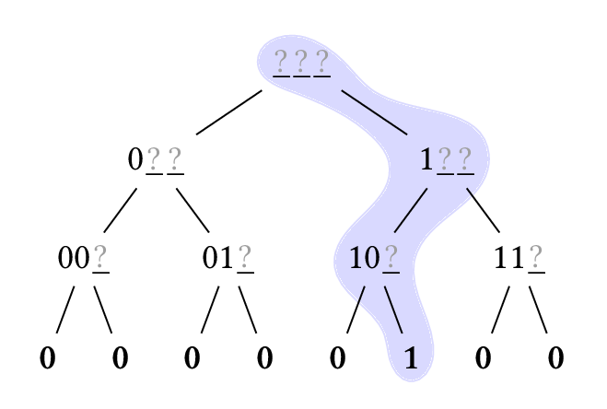
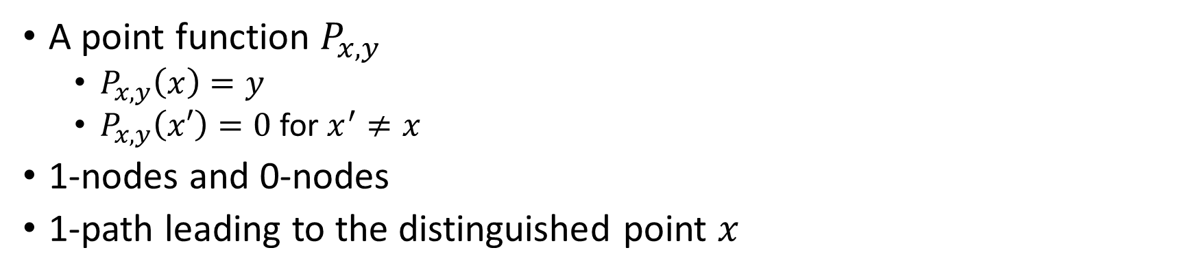
Point Functions
A point function $P_{x,y}$
  $P_{x,y}\left(x\right)=y$
  $P_{x,y}\left(x′\right)=0$ for $x^{′}≠x$
1-nodes and 0-nodes
1-path leading to the distinguished point $x$
Notes:
We propose a novel characterization of a point function tree as being made up of 1-nodes and 0-nodes
We can use the 1-path to determine whether a given DPF tree is well-formed simply by traversing from the root to the leaf 1-node which requires work logarithmic in the number of leaves rather than linear in the number of leaves.
This is the key to the efficiency of our DPF verification protocol

Slide 31
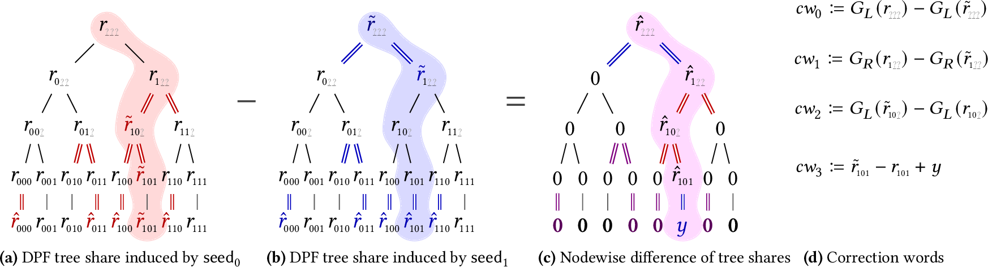
Distributed Point Functions (DPFs)
Elette Boyle, Niv Gilboa, and Yuval Ishai. Function secret sharing: Improvements and extensions. In Proceedings of CCS 2016, pages 1292–1303, Vienna, Austria (Oct. 2016).
Notes:
Divide a point function into secret shares
Boyle, Gilboa, and Ishai developed DPFs with key size logarithmic in the domain size
Use length-doubling PRGs to generate the point function tree
The DPF share is evaluated in the same way as the normal point function tree (with an added layer after what would be the leaf node in the point function).
The vectors of leaf nodes of the two trees form an additive secret sharing of the vector which has 0 at all locations except location x where it has value y.
Adding this to an additive secret shared database can be used for private database writing.
Thus, a DPF allows us to privately write data to a secret shared database while only sending data logarithmic in the size of the database being written to.

Slide 32
Distributed Point Functions (DPFs)
Elette Boyle, Niv Gilboa, and Yuval Ishai. Function secret sharing: Improvements and extensions. In Proceedings of CCS 2016, pages 1292–1303, Vienna, Austria (Oct. 2016).
Notes:
In order to produce the desired output values at the leaf nodes, specially crafted correction words are added at each level.
These corrections are designed so that for each 0-node that is the child of a 1-node, the correction will make that node equal between the two DPF trees.
Since the subtree rooted at that 0-node is deterministically generated by a PRG from the value of that 0-node, we know that the subtree rooted at that 0-node will be the same between the two DPF trees.
This will result in the combined value from the leaves having a value of 0, as required for a point function.
At the final level a special correction is added to make the distinguished point have the desired value of $y$.

Slide 33
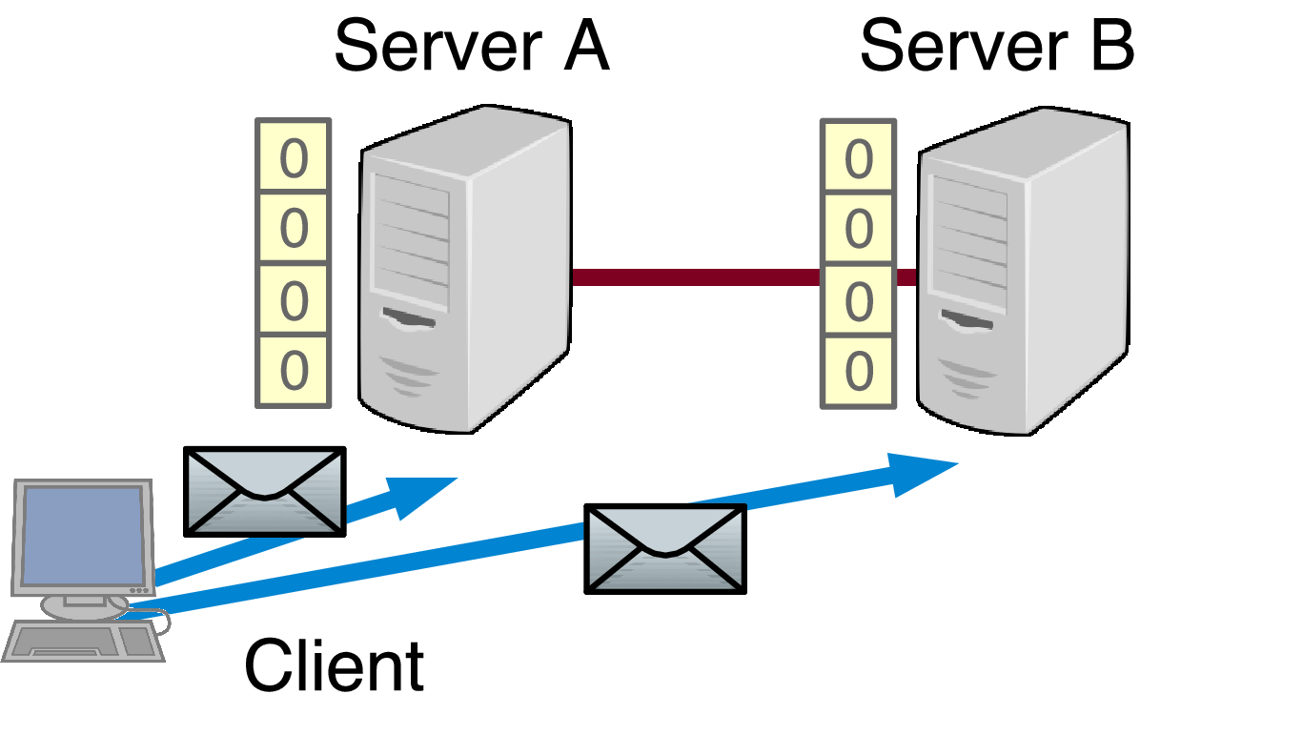
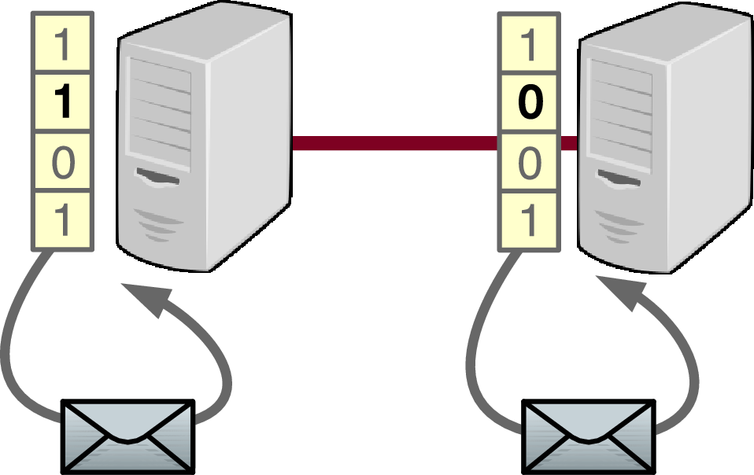
Riposte
Sender-anonymous bulletin board model
Uses DPFs to write to randomly selected buckets
Henry Corrigan-Gibbs, Dan Boneh, and David Mazières. Riposte: An anonymous messaging system handling millions of users. In Proceedings of IEEE S&P 2015, pages 321–338, San Jose, CA, USA (May 2015).
Notes:
Messages are stored in a database of additive secret shares held by the two servers.
If keys that do not correspond to a valid DPF are used, the database would be corrupted.
To counter this Riposte needs to verify the DPF keys are well formed.
Uses square root n size DPFs due to restrictions on its verification systems.

Slide 34
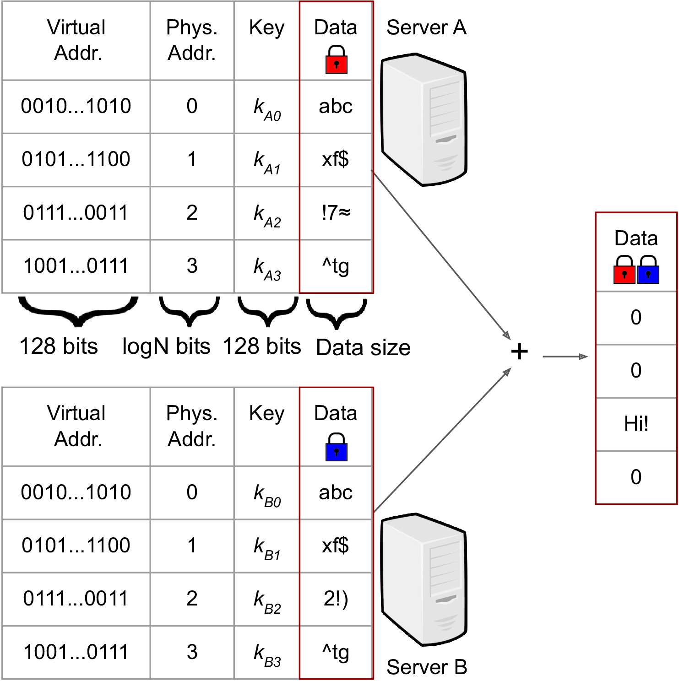
Express
Sender-anonymous mailbox model
Uses DPFs to write to pre-registered mailbox addresses
Saba Eskandarian, Henry Corrigan-Gibbs, Matei Zaharia, and Dan Boneh. Express: Lowering the cost of metadata-hiding communication with cryptographic privacy. In Proceedings of USENIX Security 2021, Vancouver, BC, Canada (Aug. 2021).
Notes:
Uses logarithmic size DPFs with large (they said 128-bit) inputs. These large addresses map to the smaller “physical mailbox” addresses in order to prevent attackers from writing to a mailbox they are not supposed to.

Slide 35

Sabre-BB
Uses DPFs for writing like Riposte
Uses logarithmic size DPFs
Improved DPF verification

Slide 36
DPF Verification MPC Protocol
Traverse the 1-path of the DPF tree to the distinguished point
Notes:
We can walk through part of this protocol to see how it works.

Slide 37

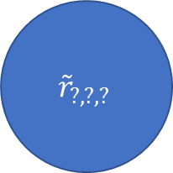
DPF Verification MPC Protocol
Seeds
$$r_{?,?,?}$$
$${\tilde{r}}_{?,?,?}$$
Notes:
First, we have the seeds for the two trees. If this is the initial level of the tree, part 0 has one seed and party 1 has the other. If it is a later layer, both parties hold secret shares of both seeds.

Slide 38
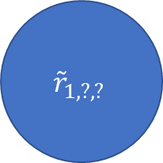
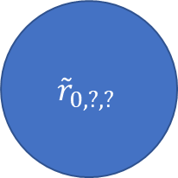
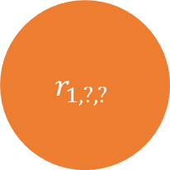
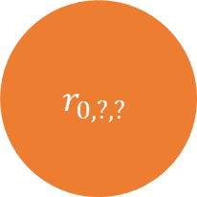
DPF Verification MPC Protocol
$$r_{?,?,?}$$
$${\tilde{r}}_{?,?,?}$$
$$r_{0,?,?}$$
$$r_{1,?,?}$$
$${\tilde{r}}_{0,?,?}$$
$${\tilde{r}}_{1,?,?}$$
Notes:
Then we use the correction words and the PRG to expand both seeds. If this is the first layer, the parties evaluate the PRG and apply the corrections locally and then secret share the two child nodes. Otherwise, the computation is done by using MPC to obliviously evaluate the PRG and apply corrections. Either way, the two sets of child nodes held as secret shares by both parties.

Slide 39
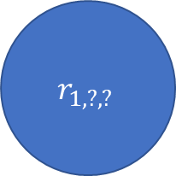
DPF Verification MPC Protocol
$$r_{?,?,?}$$
$${\tilde{r}}_{?,?,?}$$
$$r_{0,?,?}$$
$$r_{1,?,?}$$
$${\tilde{r}}_{0,?,?}$$
$$r_{1,?,?}$$
1-Node
0-Node
1-Node
0-Node
Notes:
In this case, we will assume the 1-node is on the left. Thus, the two right children are equal.

Slide 40
DPF Verification MPC Protocol
$$r_{?,?,?}$$
$${\tilde{r}}_{?,?,?}$$
$$r_{1,?,?}$$
$$r_{0,?,?}$$
$$r_{1,?,?}$$
$${\tilde{r}}_{0,?,?}$$
0-Node
1-Node
0-Node
1-Node
Notes:
We can then use MPC operations to obliviously flip the child nodes, so that, no matter which side the 1-node is on, the flip makes the 0-node be on the left and the 1-node be on the right. The flip is performed using secret shares of the alleged distinguished point of the DPF.

Slide 41
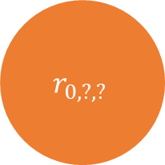
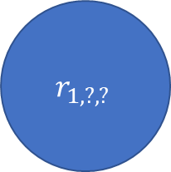
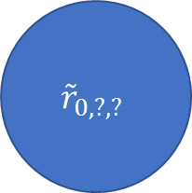
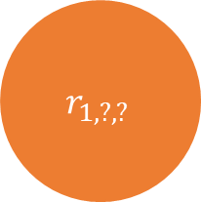
DPF Verification MPC Protocol
0-Node
1-Node
$$r_{1,?,?}$$
$$r_{1,?,?}$$
$$r_{0,?,?}$$
$${\tilde{r}}_{0,?,?}$$
Notes:
Now, we can take the child nodes.

Slide 42
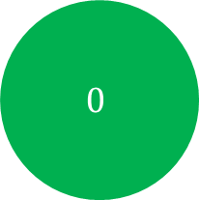

DPF Verification MPC Protocol
0-Node
1-Node
$$r_{1,?,?}$$
$$0$$
$$r_{1,?,?}$$
$$r_{0,?,?}$$
$${\tilde{r}}_{0,?,?}$$
Notes:
We can then assert that the values for the 0-nodes combine to produce zero as we discussed earlier.

Slide 43

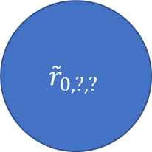
DPF Verification MPC Protocol
New Seeds
$$r_{0,?,?}$$
$${\tilde{r}}_{0,?,?}$$
Notes:
If the 0-node is correct, we can then use the values from the 1-nodes as the seeds for the next layer of the two DPF trees. This process is repeated until we reach the leaf nodes.

Slide 44
Multi-Verifier MPC-in-the-Head
DPF verification protocol can be converted to a ZKPoK using MPC-in-the-head
The Sabre servers already have DPF keys
  They cannot see the simulated party with the other key
Different servers verify different simulated parties
Two vs three verifier versions
Notes:
DPF verification protocol can be converted to a ZKPoK using MPC-in-the-head
In Sabre’s verification protocol the parties start with DPF keys
This means that server $i$ cannot see DPF key $i$ from simulated party $i$
We can have different servers verify different simulated parties
Two verifiers requires repetition to reduce cheating probability
Three verifiers can verify all parties with one repetition
It is also possible to have three servers directly run the

Slide 45
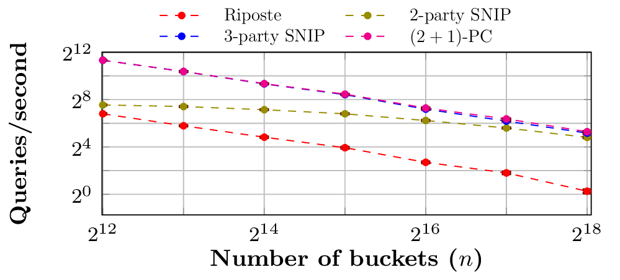
Sabre-BB Experimental Analysis
Notes:
This plot shows the number of queries per second processed by each of the three Sabre-BB implementations and by Riposte
You can see that all three Sabre-BB implementations outperform Riposte due to the logarithmic cost of Sabre’s verification protocol as opposed to Riposte’s linear cost protocol
In particular, the three party MPC and ZKP versions of Sabre-BB outperform the two-verifier proof since the three party protocols do not need to perform the cut and choose
As the number of buckets grows, the cost of the DPF verification in Sabre is overshadowed by the cost of the actual write.
Note that this is a log-scale plot, so these differences in performance are significant

Slide 46

Sabre-M
Uses the same DPF verification protocol as Sabre-BB
Novel mailbox address verification protocol
Notes:
In Sabre-M, mailbox addresses are a combination $\left(i, {\text{addr}}_{i}\right)$ where ${\text{addr}}_{i}=F(\tilde{k}, i)$ for a long-term key $\tilde{k}$ and a PRF $F$

Slide 47
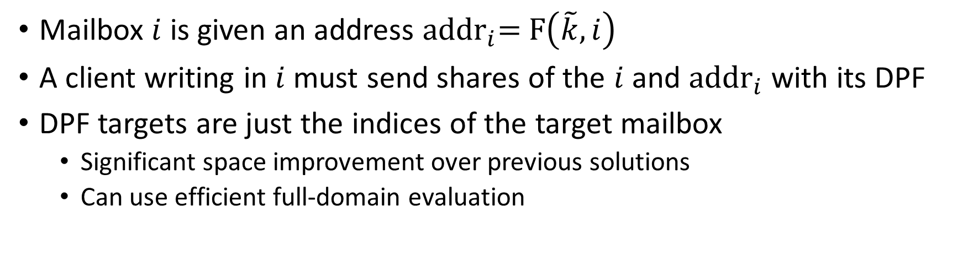
Sabre-M Addresses
Mailbox $i$ is given an address ${\text{addr}}_{i}\text{= }\text{F}\left(\tilde{k}, i\right)$
A client writing in $i$ must send shares of the $i$ and ${\text{addr}}_{i}$ with its DPF
DPF targets are just the indices of the target mailbox
  Significant space improvement over previous solutions
  Can use efficient full-domain evaluation

Slide 48

PRF Mailbox Verification
Each server has received shares ${\left[i\right]}_{b}$ and ${\left[{\text{addr}}_{i}^{′}\right]}_{b}$
The servers use MPC to compute ${\text{addr}}_{i}\text{= }\text{F}\left(\tilde{k}, i\right)$
The servers compute ${\text{addr}}_{i}−{\text{addr}}_{i}^{′}$
The result should be zero
Notes:
Unlike prior solutions, this verification protocol has constant complexity and it is performed before the DPF is evaluated, making this verification more secure against denial of service attacks.

Slide 49
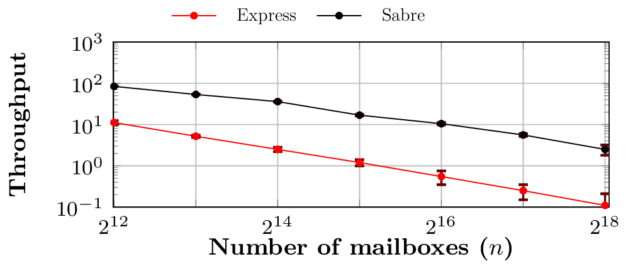
Sabre-M Experimental Analysis
Notes:
This log-scale plot shows the significantly higher throughput achieved by Sabre-M in comparison to Express.

Slide 50
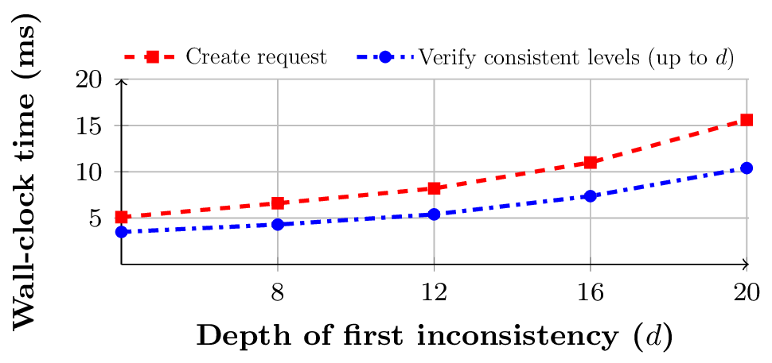
Sabre Denial of Service Resistance
Notes:
In this graph, we see the time required for a client to generate a random malformed request in red and the time to verify the request in blue.
This shows that our implementation of Sabre is able to verify a DPF and detect inconsistencies faster than a malicious client can sample the necessary randomness to generate a malformed request.
As a result, an attacker performing a denial of service attack against an instance of Sabre must apply even more computing resources than the servers running Sabre in order to stop Sabre.

Slide 51
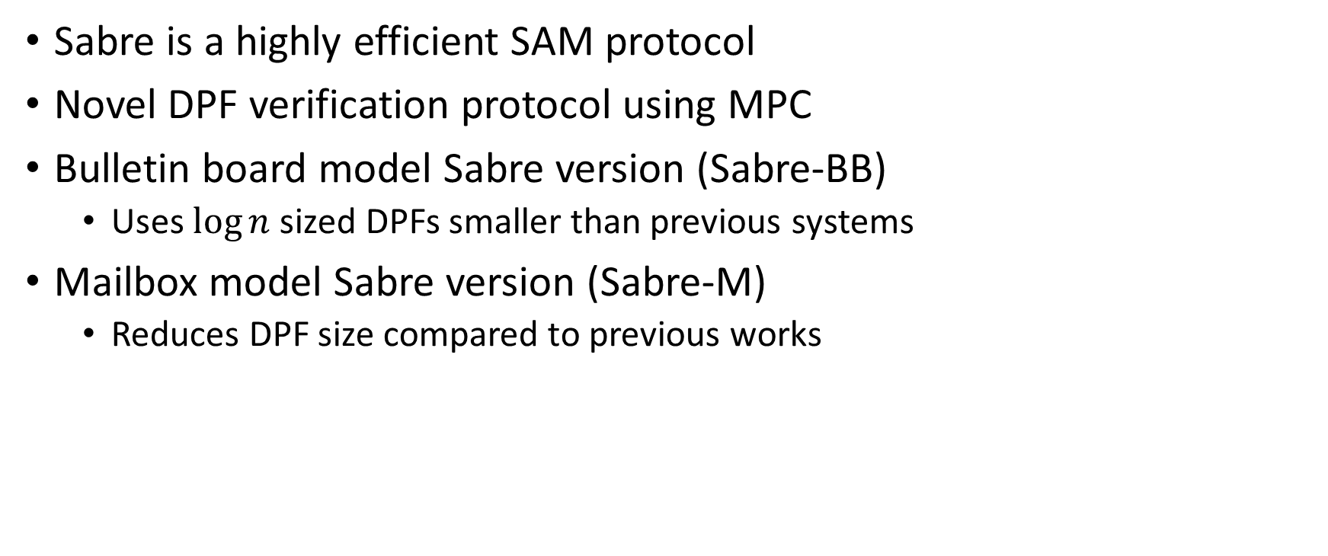
Conclusion
Sabre is a highly efficient SAM protocol
Novel DPF verification protocol using MPC
Bulletin board model Sabre version (Sabre-BB)
  Uses $\log{n}$ sized DPFs smaller than previous systems
Mailbox model Sabre version (Sabre-M)
  Reduces DPF size compared to previous works
Notes:
Sabre is a highly efficient SAM protocol
Innovative DPF verification protocol using MPC
Bulletin board model Sabre version (Sabre-BB)
Replaces $\sqrt{n}$ size DPFs from Riposte with $\log{n}$ sized DPFs
Faster audit protocols
Mailbox model Sabre version (Sabre-M)
Smaller DPFs than Express
Rejects bad queries without expanding them

Slide 52
References
[1] Henry Corrigan-Gibbs, Dan Boneh, and David Mazières. Riposte: An anonymous messaging system handling millions of users. In Proceedings of IEEE S&P 2015, pages 321–338, San Jose, CA, USA (May 2015).
[2] Saba Eskandarian, Henry Corrigan-Gibbs, Matei Zaharia, and Dan Boneh. Express: Lowering the cost of metadata-hiding communication with cryptographic privacy. In Proceedings of USENIX Security 2021, Vancouver, BC, Canada (Aug. 2021).
[3] Elette Boyle, Niv Gilboa, and Yuval Ishai. Function secret sharing: Improvements and extensions. In Proceedings of CCS 2016, pages 1292–1303, Vienna, Austria (Oct. 2016).

Slide 53
Questions?

