Slide 1
Fides: A System for Verifiable Computation Using Smart Contracts
Mahmudun Nabi,
University of Calgary, Alberta, Canada
April 1, 2022

Slide 2
Outline
Backgrounds
Blockchain
Ethereum and smart contract
Outsourcing computation
Refereed Delegation of Computation (RDoC)
Verifiable Computation using Smart Contracts
Our Work
Committed CRR (cmCRR) protocol
Fides
Conclusion

Slide 3
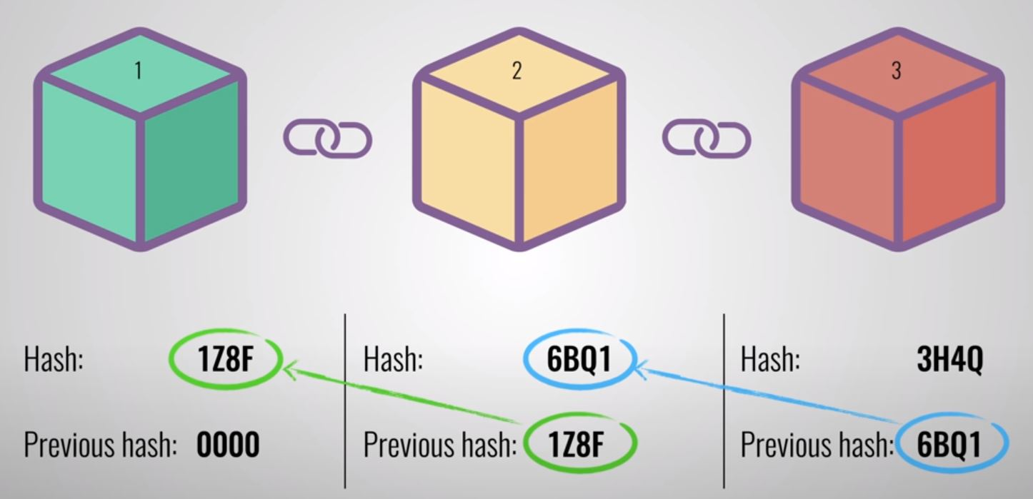
Blockchain Basics
Key Components of Blockchain:
Node
Transaction
Block
Consensus
- Full node
- Mining node (aka miner)
- Lightweight node
- A cryptographically signed
piece of instruction that is generated
by a node and submitted to the blockchain.
- Transaction data is permanently
recorded in files called blocks.
- To add a new block to the blockchain,
all participating nodes must come to a
common agreement (also called consensus).
Forming blockchain: by chaining blocks
Key Characteristics:
Decentralization
Anonymity
Transparency
Immutability
Figure: Example of forming blockchain

Slide 4

Ethereum
Ethereum: An open source, decentralized computing platform
Enables users to develop smart contracts and decentralized applications (DApps).
Key terms
Peer-to-peer network of computers
Accounts
externally owned accounts (EOA)
contract accounts
Consensus algorithm
Ethereum Virtual Machine (EVM)
Smart contract
Gas
Digital currency: Ether

Slide 5
Smart contracts
Executable code
stored on the Ethereum blockchain
Bytecode
Instruction set for execution inside EVM
Code Execution
triggered by the transactions added to the blockchain
Gas
Unit of Execution
Gas limit
Max. amount of gas a transaction or block may consume
Solidity
Language for Ethereum smart contract
Properties
Correctness
Transparency
Immutability

Slide 6
Outsourcing computation using Smart Contract

Slide 7
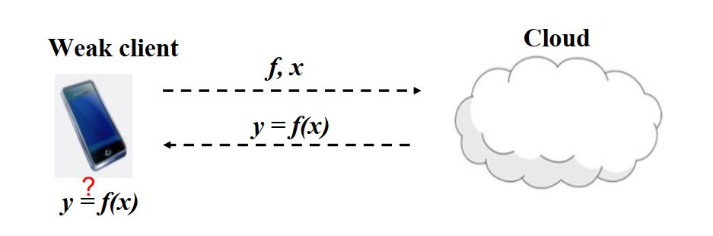
Outsourcing Computation
Verifiable outsourcing: Efficiently verify the correctness of a computation result that is provided by the cloud.

Slide 8
Verifiable Outsourcing (Existing approaches against malicious adversary)
Using cryptography:
Probabilistic checkable proofs [Kil92, Mic00]
Homomorphic Encryption [GGP10, CKV10, AIK10]
Expensive computation, inflexible
Outsourcing by replication:
Outsource the computation to a number of clouds.
Select a solution that is generated by the majority of the clouds as the correct solution.
Verifiable outsourcing using two clouds (Canetti, Rothblum and Riva [CRR11])
[Kil92] Joe Kilian. A note on efficient zero-knowledge proofs and arguments (extended abstract). STOC, 92
[Mic00] Silvio Micali. Computationally sound proofs. SIAM Journal on Computing, 2000.
[GGP10] Gennaro, R., Gentry C., and Parno B. Non-interactive verifiable computing: outsourcing computation to untrusted workers, CRYPTO’10.
[CKV10] Chung K.M., Kalai Y., and Vadhan S. Improved delegation of computation using fully homomorphic encryption, CRYPT’10
[AIK10] Applebaum B., Ishai Y., and Kushilevitz E.: From secrecy to soundness: efficient verification via secure computation. ICALP’10
[CRR11] Canetti, R., Riva, B., & Rothblum, G. N.: Practical delegation of computation using multiple servers, CCS’11

Slide 9
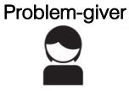
CRR (Canetti, Rothblum and Riva, CCS’11) ^{[1]}
Refereed Delegation of Computation (RDoC)
Cloud 1
y₁ = f(x)
f, x
f, x
?
y₂ = f(x)
Cloud 2
y₁ = y₂
y₁ = y₂
Correct answer- Accept
Strength:
Provable security
Weakness:
Client is trusted
y₁ = y₂
Play refereed game - Identify malicious cloud
binary-search
verify-reduced-step
[1] Canetti, R., Riva, B., & Rothblum, G. N.: “Practical delegation of computation using multiple servers”, CCS’11

Slide 10
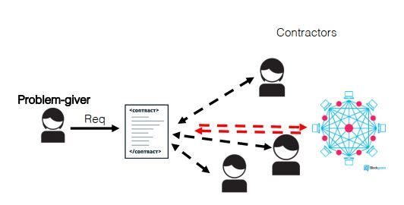
Smart contract as TTP
Goals:
Guarantee correctness
Manage interaction between parties
Managing the payments
Avizheh et al. (ACM CCSW’19) ^{[2]}
“Verifiable Computation using Smart Contracts ”
[2] Avizheh, S., Nabi, M., Safavi-Naini, R., Venkateswarlu K, M.: “Verifiable computation using smart contracts”, CCSW’19

Slide 11

scCRR^{[2]} Verifiable Computation using Smart Contracts
Cloud 1
y₁ = f(x)
Request computation
f, x
Collect result
f, x
y₂ = f(x)
Cloud 2
Verify result
Assumptions:
Client is untrusted.
One of the clouds is malicious and the other is rational.
Problem:
Copy Attack
[2] Avizheh, S., Nabi, M., Safavi-Naini, R., Venkateswarlu K, M.: “Verifiable computation using smart contracts”, CCSW’19

Slide 12
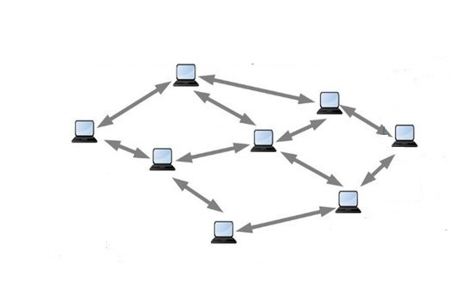
Copy Attack
f(x)
EVM
EVM
EVM
EVM
EVM
Cloud 1’s result
1. Cloud 1 sends f(x) to smart contract.
f(x)
EVM
Cloud 2’s result
Cloud 1
f(x)
EVM
f(x)
f(x)
EVM
Cloud 2
2. Cloud 2 sees f(x); copies f(x) and sends as its result it to the network.
3. All Ethereum nodes see two identical values from two clouds.
The result is accepted as correct.

Slide 13
Our Work

Slide 14
Our Contribution
Committed CRR (cmCRR) protocol
Outline of our SC-aided RDoC scheme using two servers
Security and privacy analysis
Fides
Proof of concept implementation of cmCRR
Evaluations

Slide 15
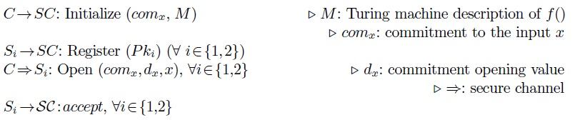
Committed CRR (cmCRR) Protocol
Client $C$ has function $f$ and input $x$, servers $S_{1}$ and $S_{2}$ receive $f$ and $x$, and compute $f(x)$and return output $y_{1}$ and $y_{2}$ to referee contract $SC$.
Phase 1:
Initialization:
- Computation initialization and server registration

Slide 16
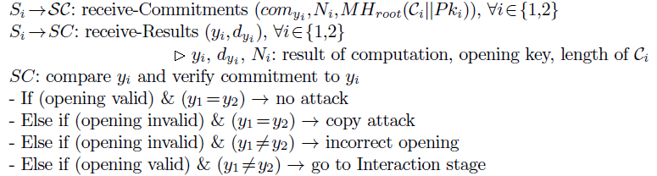
cmCRR Protocol (cont..)
Phase 2:
Computation:
Execution and result comparison

Slide 17
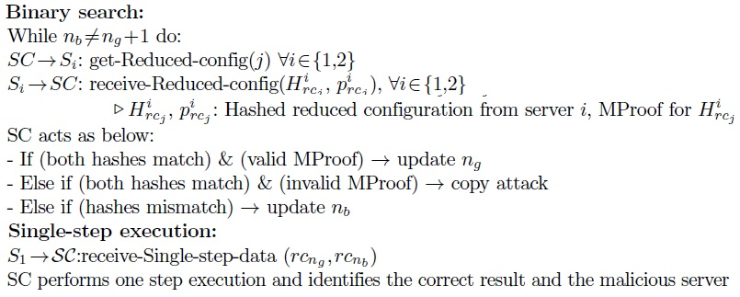
cmCRR Protocol (cont..)
Phase 3:
Dispute Resolution:
- Binary search and single-step execution

Slide 18
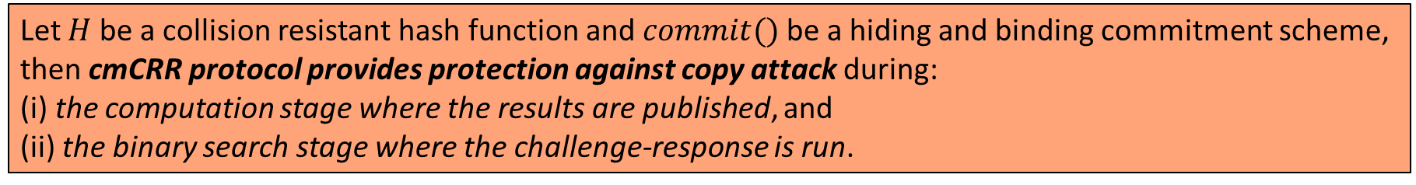
Security and Privacy
Security
Correctness
Soundness
Copy Detection
Theorem:
Let $H$ be a collision resistant hash function and $commit()$be a hiding and binding commitment scheme, then cmCRR protocol provides protection against copy attack during:
(i) the computation stage where the results are published, and
(ii) the binary search stage where the challenge-response is run.
Privacy
Input privacy

Slide 19
Implementation

Slide 20
Proof-of-concept implementation
Fides
Implements cmCRR Protocol
Follows Ethereum execution model
Actors:
Client
Two Servers
Referee
Challenges and Design Choices
Single-step execution on Ethereum network
Solidity language for delegated program
Private EVM execution by servers
Deterministic execution of delegated program
Exclude non-deterministic EVM instructions

Slide 21
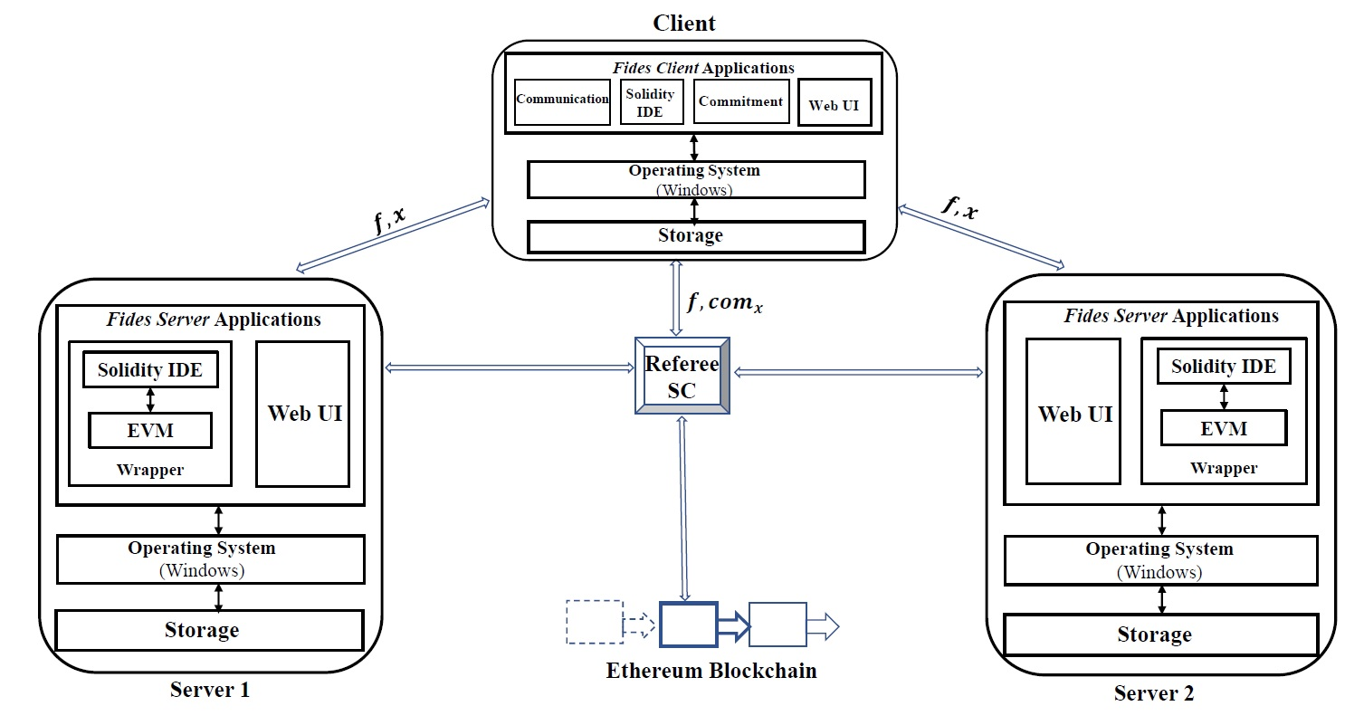
Fides Overview
Functions:
Client functions
Server functions
Referee SC
Smart contract development:
Language: Solidity
Compiler: Remix
Blockchain setup:
Ganache
Figure: Overview of Fides

Slide 22
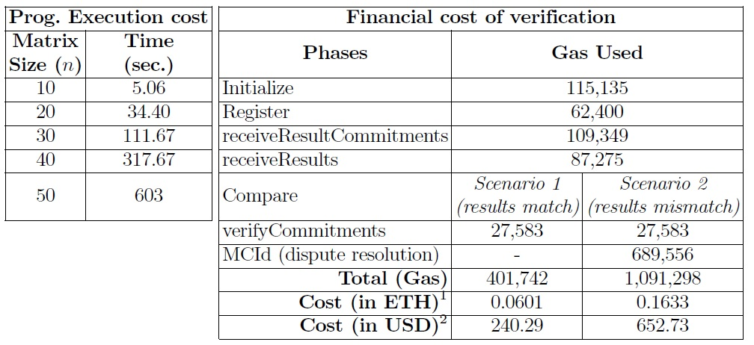
Evaluation
Goals:
measure the execution cost of the delegated program by a server.
measure the financial cost of verification by the referee contract on Ethereum network
Table: Cost analysis of Fides.
Left side: program execution cost (in time) inside EVM by each server for different matrix sizes.
Right side: financial cost of executing the referee contract on the Ethereum network.

Slide 23
Concluding remarks
Fides: SC-aided RDoC system for Verifiable Computation
Smart contract as a Referee
cmCRR protocol with protect against copy attack
Proof-of-concept implementation

Slide 24
Publication
Mahmudun Nabi, Sepideh Avizheh, and Reihaneh Safavi-Naini. "Fides: A System for Verifiable Computation Using Smart Contracts." In 6th Workshop on Trusted Smart Contracts (WTSC) in Association with Financial Cryptography (FC) conference, 2022.

Slide 25
Thank you!

