Slide 1

Violence on Campus
Prevention & Response

Slide 2
Active threat defined
An active threat can be defined as:
A person whose immediate activity can cause death and/or serious injury
An active threat can involve a firearm or another weapon
An active shooter is an active threat

Slide 3

UC Emergency app
The UC Alertus Emergency app delivers alerts and updates that can save lives and prevent injury. The app is one part of the university’s emergency management plan and a big part of creating a safe and healthy living and learning environment for everyone on campus. For more information and to get the app today, visit https://www.ucalgary.ca/risk/emergency-management/emergency-communication/mobile-app.
Download UC Alertus Emergency App

Slide 4
Being prepared to respond
Important considerations:
Most incidents are over within minutes
They are unpredictable and evolve quickly
Everyone must know what to do
You must scan, assess and act quickly
Your actions will influence others

Slide 5
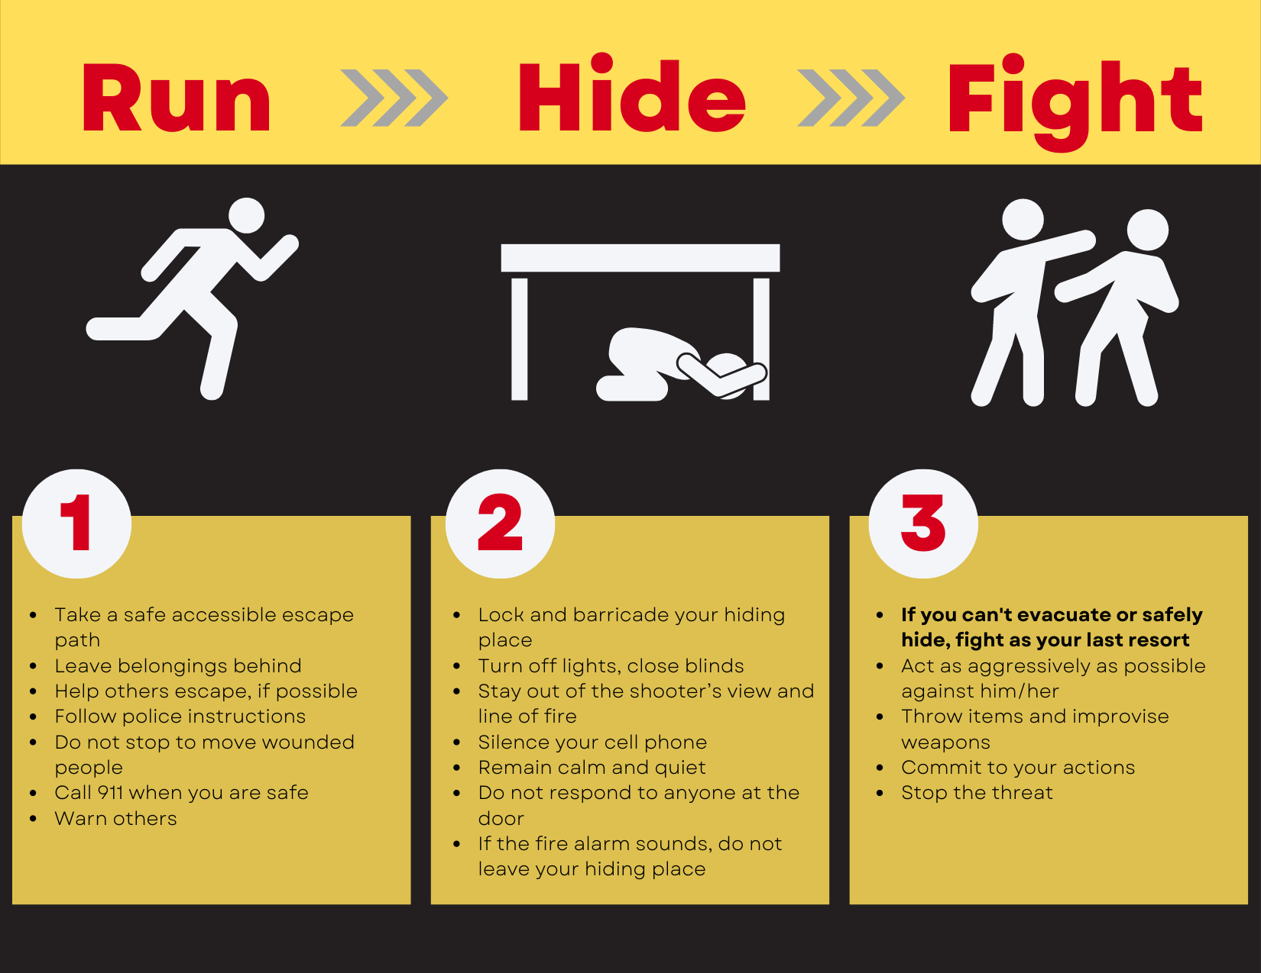
Active threat response

Slide 6
RUN
    RUN
    Take a safe accessible escape path
    Leave belongings behind
    Help others escape, if possible
    Follow police instructions
    Do not stop to move wounded people
    Call 911 when you are safe
    Warn others

Slide 7
HIDE
    HIDE
    Lock and barricade your hiding place
    Turn off lights, close blinds
    Stay out of the shooter’s view and line of fire
    Silence your cell phone
    Remain calm and quiet
    Do not respond to anyone at the door
    If the fire alarm sounds, do not leave your hiding place

Slide 8
FIGHT
FIGHT
As a last resort, fight for your life.
    If you can’t evacuate or safely hide, fight as your last resort
    Act as aggressively as possible against him/her
    Throw items and improvise weapons
    Commit to your actions
    Stop the threat

Slide 9
Understand police response
Upon arrival, the initial police responders will:
Locate the threat
Stop the threat
Pass by victims
Secure the scene
Initial police responders will not:
Render medical assistance to victims
Answer question

Slide 10
How to respond when police arrive
How to respond:
Remain calm
Follow the direction of the police
Put down any items in your hands
Keep hands visible at all times
Avoid quick movements
Be patient – clearing the area could take a long time

Slide 11
After the event
What you should know post event:
Entire area will be treated as a crime scene
After evacuating you will be directed to or taken to a holding area for:
  medical care
  counseling
  interviewing

Slide 12
Summary
You should always:
Be aware of your surroundings
Plan ahead/share your plan
Report concerns or incidents

Slide 13
Reporting concerns or incidents
  Report when you see behavior or actions that are:
  Acting intimidating, threatening or angry
  Showing escalating panic or severe anxiety
  Disconnecting from reality – bizarre or irrational behavior
  Expressing despair or hopelessness
  Planning/sharing about getting revenge

Slide 14
Everyone on campus holds the responsibility for keeping all of us safe. If you are concerned about someone's behavior, please call Campus Security at 220-5333.
Campus Security will ensure that you are connected to the right resources.

Slide 15
Support resources
Wellness Centre - MacEwan Student Centre room 370
403.210.9355 press option 2 for counselling
sar@ucalgary.ca
8:30 a.m. - 4:30 p.m. Monday to Friday
Distress Centre – 403.266.4357 – www.distresscentre.com
LifeWorks – Employee & Family Assistance – 1.877.207.8833
City of Calgary – dial 211 to access a wide range of services
24 Hours x 7 Days Support

Slide 16
Questions
For any questions or concerns regarding this presentation, or any other matter regarding emergency management, please feel free to contact emergencymgmt@ucalgary.ca.

