Slide 1
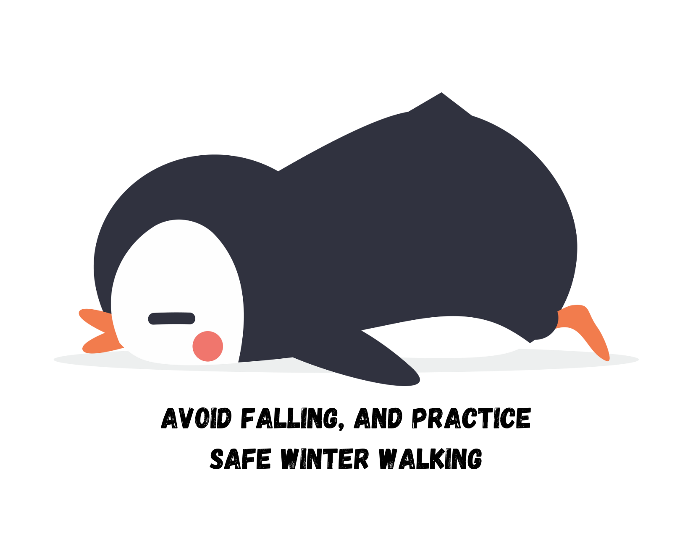
Slips, trips, and falls
Keep yourself and others safe this season

Slide 2
It’s that time of year again!
Reduce risk and potential injuries by being prepared and aware of your surroundings
Avoid slippery areas
Choose well-lit walkways and wear appropriate footwear
Walk slowly and deliberately
Give yourself extra time to get to your destination
Put your phone away!

Slide 3
Safe winter walking tips
Do the penguin shuffle: point your feet outward like a penguin, take short, shuffle-like steps, keep your arms at your side and out of your pockets, concentrate on keeping your balance, watch where you’re stepping and go slowly
Test potentially slick areas by tapping your foot on them
Keep your eyes on where you’re going
Step – don’t jump – from vehicles and equipment

Slide 4
Report unsafe conditions, injuries or near misses
Help make the university safer and prevent injuries. If you notice unsafe conditions on campus, report it to Campus Security
If you’re involved in an incident or near miss, work with your manager to submit an OARS report

