Slide 1
Active Assailant

Slide 2
Summary
October 25, there was an emergency incident on our main campus – an active assailant.
An individual with a knife confronted a student in Science Theatres and frightened many others.
This was a serious and real incident that was a threat to the safety of our campus community.
Campus Security responded quickly to the threat to protect students, faculty and staff.
Campus was given an all-clear at 9:24 pm when it was confirmed the armed individual had left the university on LRT.
There was a confusing initial public response by Calgary Police Service, who at first indicated that there was no actual evidence of an emergency/incident.
Perpetrator was arrested on morning of October 27^{th,} as a result of evidence provided by UCalgary Campus Security.

Slide 3
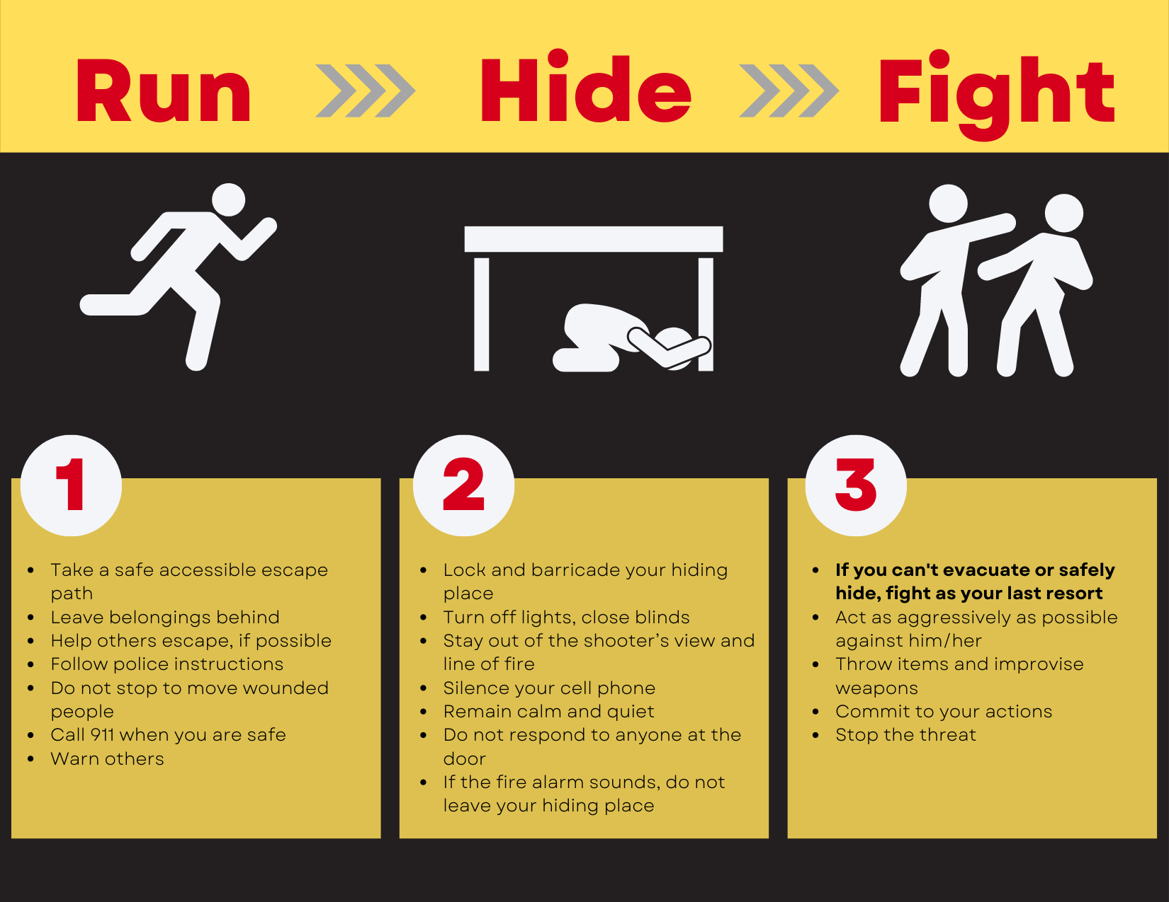
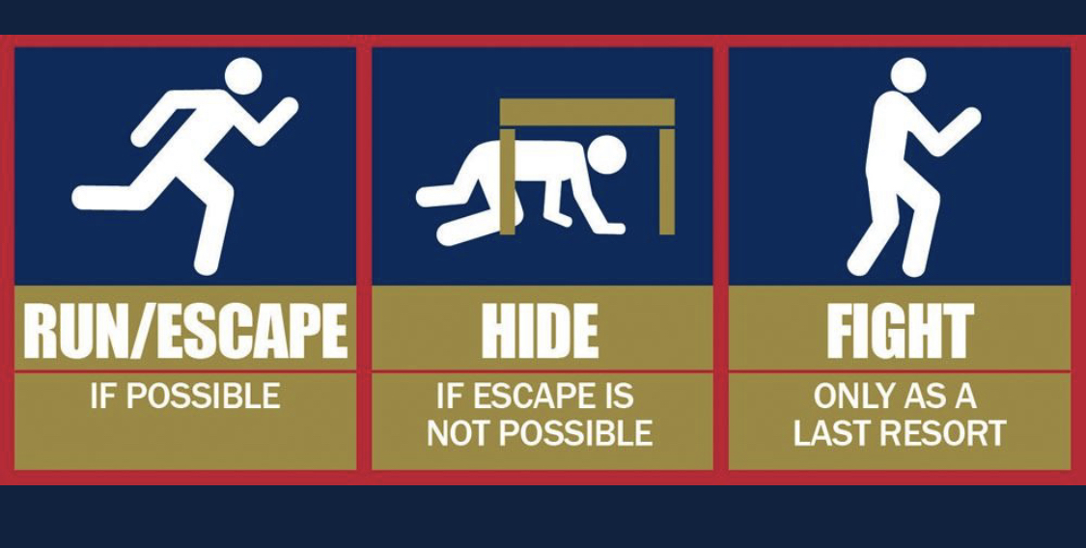
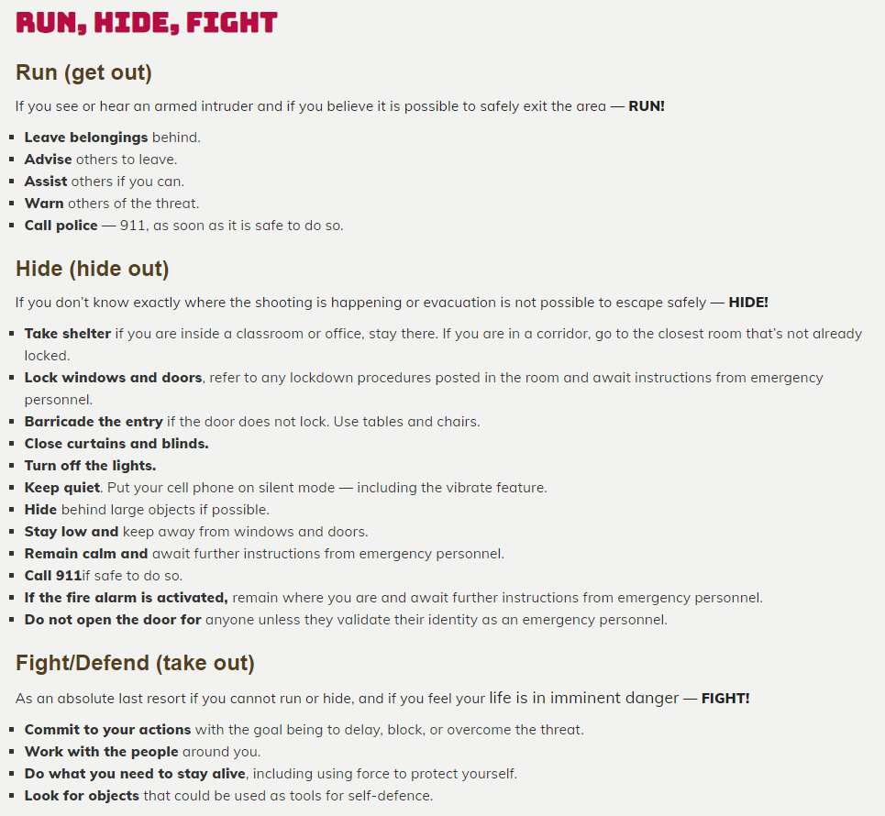
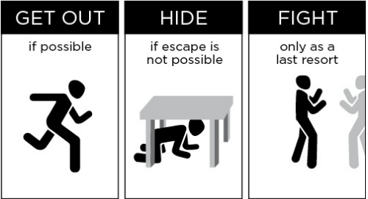
Active Assailant training/practices
UCalgary has well established training and procedures on active assailants which are on our website. https://www.ucalgary.ca/risk/emergency-management/plans-procedures/reacting-active-assailant
Run, Hide, Fight is the standard phrase in active assailant training in North America, which includes organizations such as the FBI, UBC, and the University of Waterloo.
UCalgary
FBI
UBC
University of Waterloo

Slide 4
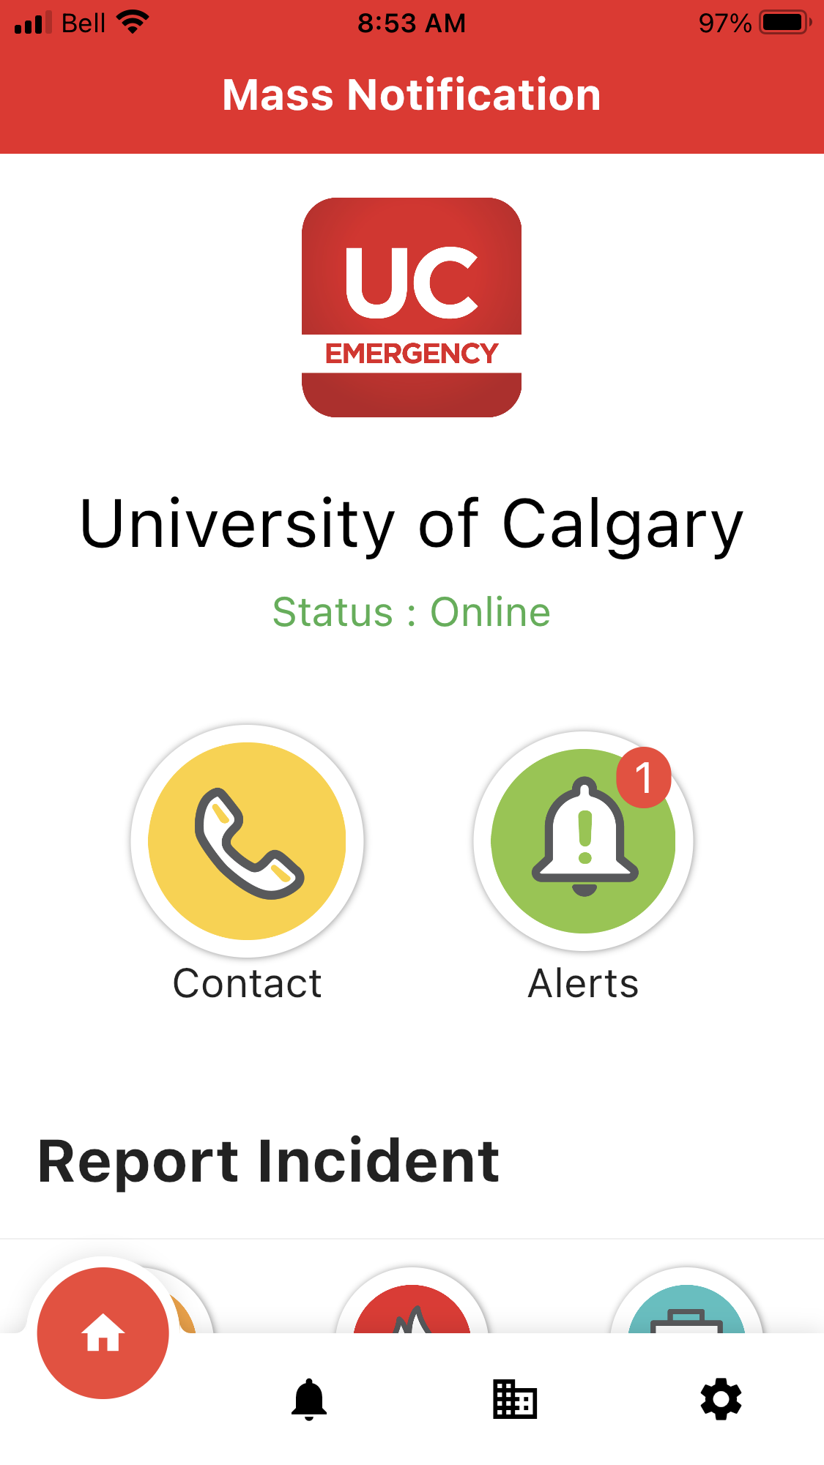
Many have still not downloaded Alertus
Please download the Alertus App, to be notified of any UCalgary emergency situations
https://www.ucalgary.ca/risk/emergency-management/emergency-communication/uc-emergency-mobile

Slide 5

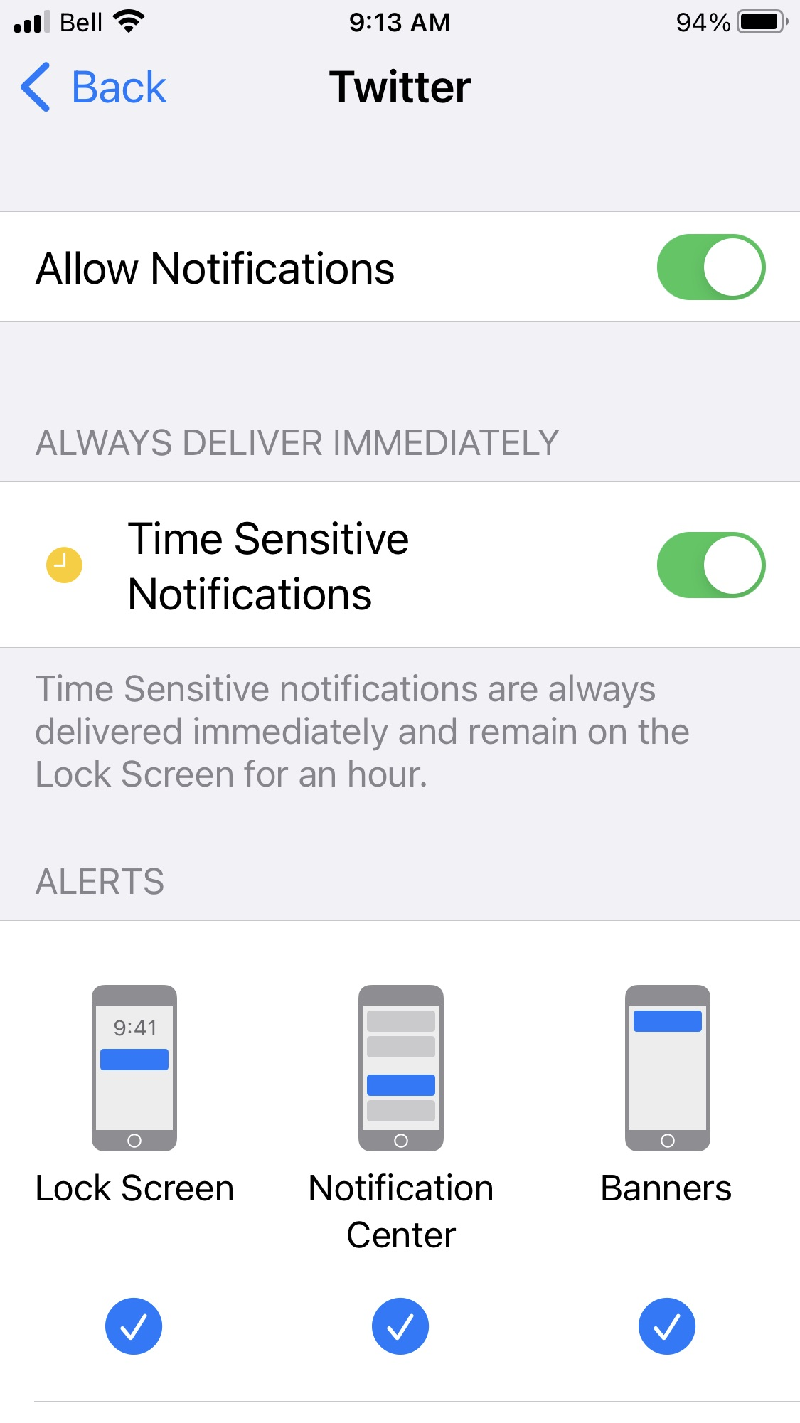
Use Social Media channels as a backup

