Slide 1
Coffee Corner: Sustainable Coffee Breaks
Sustainability Moment

Slide 2
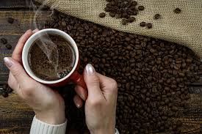
Coffee: The Problem
Coffee is grown in tropical and subtropical areas that are home to different levels of biodiversity, and increasing demands for coffee have been leading to deforestation
Using a single serve coffee machine draws 3 times more energy than drip coffee, adding around $60 to the annual electricity bill
Unfair wages and forced labour is rampant in the coffee production industry
Every year, Canadians buy and use 1.5 billion disposable coffee pods, which is more than enough to circle the globe
Notes:
“How Much Energy Does My Coffee Maker Use?” The Light Lab, June 23, 2019. https://www.firstchoicepower.com/the-light-lab/energy-education/how-much-energy-does-my-coffee-maker-use/.

Slide 3
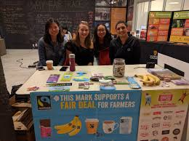
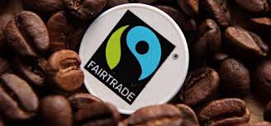
Fairtrade
Buy Fairtrade Canada certified tea, coffee, sugar, and chocolate for your office
By choosing Fairtrade, you are supporting workers and marginalized farmers get fair wages, which they invest back into their communities
UCalgary was awarded Fairtrade Campus of the Year for 2018
Notes:
UCalgary is a Fairtrade campus. All campus caterers, and the dining center carry fairtrade certified tea and coffee. In addition, Starbucks and Good Earth also serves Fairtrade coffee, and campus members can buy Fairtrade chocolates at the Stor.

Slide 4
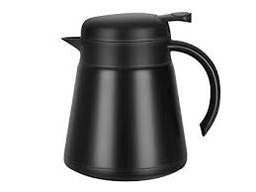
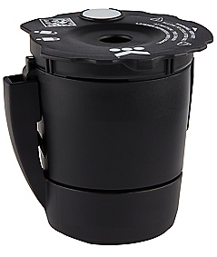
What kind of coffee machine is right for us?
Large offices (40+):
ENERGY STAR ™ certified commercial coffee machine
Smaller offices:
Drip coffee machine w/ auto shutoff and insulated carafe
If you already have a Keurig…
Use compostable or reusable pods only.
Notes:
Energy Star certified products are highly energy efficient, which help cut down maintenance costs
Drip coffee machines brew fresher coffee compared to coffee pod machines
The coffee in coffee pods can go stale by the time it is ground, neatly portioned, vacuum-sealed and shipped to consumers
Fun facts about coffee pods - Drip coffee machines are usually cheaper to purchase than coffee pod machines. On average, bulk ground coffee also lasts longer and is much less expensive than coffee pods. - Drip coffee tastes better! It is more likely to be fresh and has more moisture than pod coffee, which can go stale by the time it is ground, neatly portioned, vacuum-sealed in pods and shipped to consumers. - Coffee pod machines’ moist, dark inner reservoirs are an ideal environment for mold and bacterial growth. Unless you thoroughly drain, disassemble, clean and scale your machine on a regular basis, it may be home to mold, bacteria, yeast and even algae. (These organisms can also grow in drip coffee machines – but drip machines are usually much easier to clean!)

Slide 5
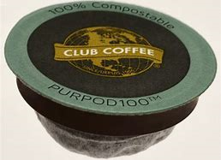
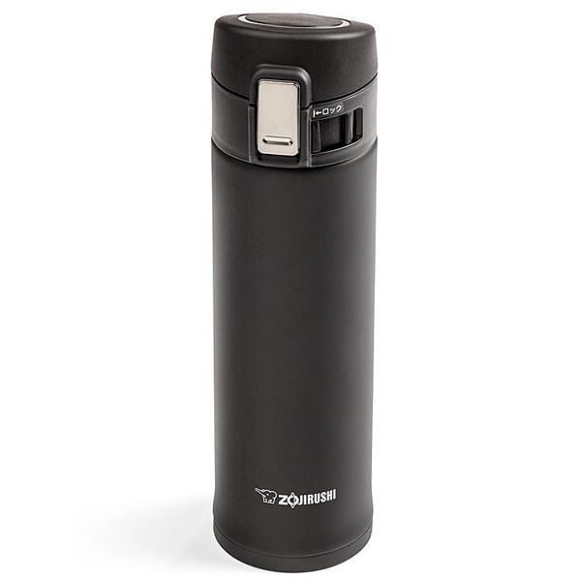
Already have a Coffee Pod Machine?
If you are using a coffee pod machine, switch to compostable or reusable pods Use re-usable cups and tumblers over single-use cups
Did you know-
The moist, dark inner reservoirs of Coffee pods are an ideal environment for mold and bacterial growth
Notes:
Rob Ferguson, “MPP wants to ban non-compostable coffee pods,” Toronto Star, Nov. 1, 2017, https://www.thestar.com/news/queenspark/2017/11/01/mpp-wants-to-ban-non-compostable-coffee-pods.html.

