Slide 1
Governance of Science and Technology through an Ability Studies Lens
Dr. Gregor Wolbring and Lucy Diep
Community Rehabilitation and Disability Studies
University of Calgary,
Second Annual Conference on Governance of
Emerging Technologies: Law, Policy, and Ethics,
USA, May 26-29, 2014
gwolbrin[at]ucalgary.ca
©Gregor Wolbring
/

Slide 2







My Students
The Wolb Pack
A Collaborative Interdisciplinary Student Research Team
http://www.crds.org/research/faculty/Gregor_Wolbring.shtml

Slide 3

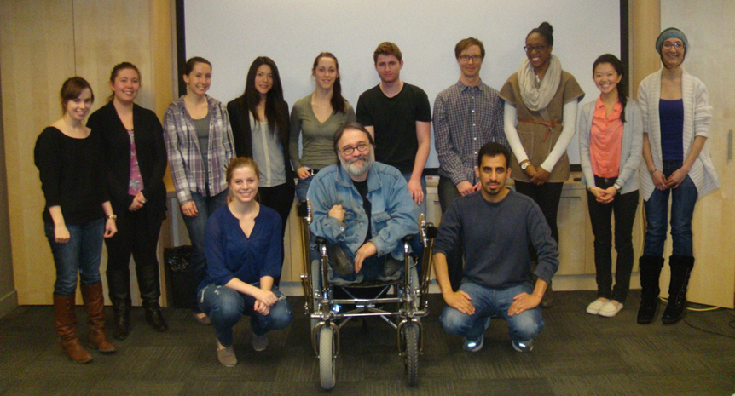
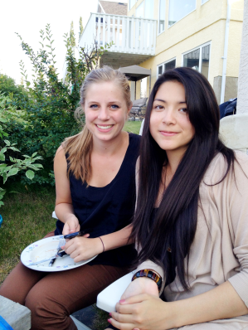
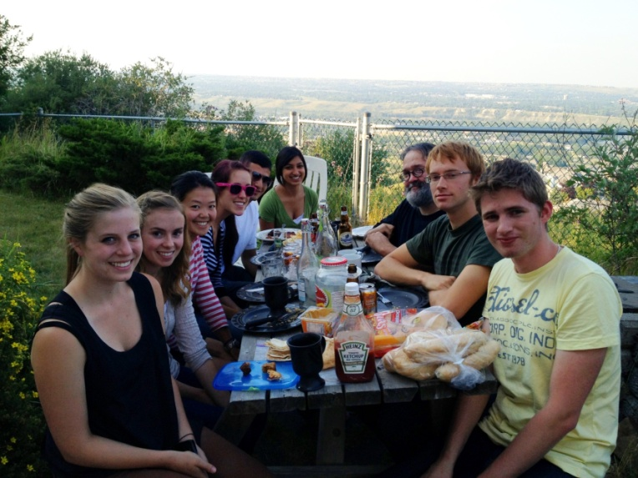
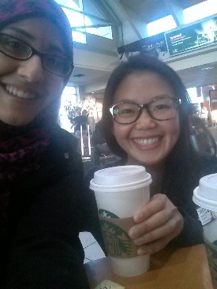
Present Group
Dr. Gregor Wolbring
Dr. Jesse Hendrikse
Bushra Abdullah
Rosemarie Breton
Emily Cha
Lily Choii
Jennifer Cheung
Lucy Diep
Emily Hutcheon
Kelsey Lucek
Rachel Mackay
Angelica Martin
Kalie Mosig
Jacqueline Noga
Anuya Pai
Maharaj R
Eniola Salami
Kassi Shave
Melanie Valkey
Sophya Yumakulov
The Pack
ALUMNI
Natalie Ball
Alshaba Billawala
Dana De Bok
Jenna Galloway
Verlyn Leopatra
Brian Litke
Sonum Panesar
Theresa Rybchinski
Camlila Sanchez
Kayla Schill
Jeremy Tynedal

Slide 4
Ability Studies: Investigates the cultural dynamic of
Ability expectation (want) and Ableism (need)
The Pack
Ability Studies

Slide 5
The Pack
Ability Studies
Within it, it allows to investigate eco-ability expectations and eco-ableism that focuses on ecological dynamics of human-human; human-animal and human-environment relationships.
Ability Studies allows for the study of multiple subject formations, social relationships, and lived experiences based on diverse ability expectations and the actions linked to such expectations.
It encourages the study of how legal, ethical/moral, biological, cultural and social constructs are exhibiting ability expectations and how such ability expectations and the actions they trigger leads to an ability based and ability justified understanding of oneself, one’s body and one’s relationship with others of one’s species, other species and one’s environment.
Ability studies can be used in inter-, trans- and intra- disciplinarily ways to generate policies and advance the relationship between humans, animals and their environment.
Notes:
Gregor Wolbring (2012) Expanding Ableism: Taking down the Ghettoization of Impact of Disability Studies Scholars Societies 2: 3. 75 83

Slide 6
The Pack
Ability Studies
Ethics and Ability
expectations
Ethics codes, theories and principles are intended to help society to deal with emerging issues such as the governance of scientific and technological advancements.
They are linked intricately to abilities needed to make a given ethics code, theory or principles operational
A given ethics theory, code or principle privileges certain abilities and as such its uptake correlates with the privileging certain ability expectations.
Privileging certain ability expectations were and are one trigger for the development of ethics theories, codes and principles;
Notes:
Wolbring, Gregor (2012) Ethical Theories and Discourses through an Ability Expectations and Ableism Lens: The Case of Enhancement and Global Regulation Asian Bioethics Review Volume 4, Issue 4,pp. 293-309 | DOI: 10.1353/asb.2012.0033

Slide 7
Governance of S&T through an Ability Studies lens:
The Pack
Ability Studies
Ethics and Ability
expectations
Governance

Slide 8
The Pack
Ability Studies
Ethics and Ability
expectations
Governance
Question: What is the impact of a given S&T on Ability inequality and Ability Equality?
Ability inequality is a descriptive term denoting any uneven distribution of access to and protection from abilities generated through human interventions, right or wrong (modified from Cozzens ).
Ability inequality is a descriptive term denoting any uneven judgment of abilities intrinsic to biological structures such as the human body, right or wrong modified from Cozzens ) .
Ability inequity is a normative term denoting an unjust or unfair distribution of access to and protection from abilities generated through human interventions (modified from Cozzens).
Ability inequity is a normative term denoting an unjust or unfair judgment of abilities intrinsic to biological structures such as the human body (modified from Cozzens).

Slide 9
The Pack
Ability Studies
Ethics and Ability
expectations
Governance
Question: What is the impact of any given S&T on Ability Security?
Ability security means that one is able to live a decent life with whatever set of abilities one has, and that one will not be forced to have a prescribed set of abilities to live a secure life (e.g. even if one doesn’t have the ability to walk, he or she should be able to secure employment).
Example: According to the US bureau of labor statistics January 2014 the employment to population ratio for disabled people age 16-64 years is 25.5% for men with disabilities and 22.8% for women with disabilities These numbers included people who look for work but cannot find work and people who do not look for work. The equivalent numbers for so called non-impaired people are 75.3% for men with disabilities and 65.7% for women
http://www.bls.gov/news.release/empsit.t06.htm

Slide 10
The Pack
Ability Studies
Ethics and Ability
expectations
Governance
Question: What is the impact of a given S&T on Self-Identity security?
Self-identity security could be seen as a subset of personal security and means that one is accepted with one’s set of abilities and that one should not be forced (physically or by circumstance) to accept a perception of oneself one does not agree with (e.g. one is not expected to have the ability to walk or is seen as a “deficient product” if one cannot walk).
If we for example look at the academic literature of social robotics or brain machine/brain computer interfaces the language is nearly exclusive following a medical understanding of disabled people and the purpose of restoration.
The narrative is not indicating the ability expectation of decreasing the social discrimination ability diverse people experience
Now disability can also be reshaped in ability studies language so the social discrimination can also be rephrased in ability studies language namely disabled people are ability expectation oppressed people. And people with disabilities are people that are oppressed by ability expectations and experiencing ability expectation oppression is a form of disability.

Slide 11
The Pack
Ability Studies
Ethics and Ability
expectations
Governance
Question: Which ability expectations drive a given S&T
A 2006 Association for the Advancement of Science workshop looked into the dynamic of human enhancement and concluded that the following ability desires are the main drivers for human enhancements: 1) to keep one’s local and global competitive advantage; 2) to live securely; and 3) to maintain one’s quality of life and one’s consumer life-style.

Slide 12
The Pack
Ability Studies
Ethics and Ability
expectations
Governance
Question: Which ability expectations drive a given S&T and its governance?

Slide 13
The Pack
Ability Studies
Ethics and Ability
expectations
Governance
Question what ability expectation does S&T support?
Democratizing Nano versus Nano for furthering democracy
To better connect science and democracy, there must be a way for society to guide the developments of science. Pirtle 2006
To better allow for democracy to decide what good science should achieve, a serious and proactive
assessment of the possible implications of scientific work is needed in order to make informed, democratic
decisions (2). Pirtle 2006
“The first focus of converging technologies should be on the benefits to individuals and society in general. Good indicators of success are the quality of life, health, safety, and how humanely and democratically the benefits are distributed. Application of democratic principles for equal opportunity, access to information, knowledge and development are other challenges. This report is based on scientific evidence and underlines the need to respect the human condition, democracy, and serving human needs. Optimizing societal interactions, R&D policies and risk governance for the converging new technologies can enhance economic competitiveness and democratization.” (Roco 2008)

Slide 14
The Pack
Ability Studies
Ethics and Ability
expectations
Governance
Question:
Which S&T products have been influential so far in supporting abilities seen as essential for Democracy?
Which S&T products could be influential in supporting abilities seen as essential for Democracy?
Which S&T products have been detrimental so far in regards to abilities seen as essential for Democracy?
Which S&T products could be detrimental in regards to abilities seen as essential for Democracy?

Slide 15
The Pack
Ability Studies
Ethics and Ability
expectations
Governance
Does a given S&T product decrease, increases or maintains existing levels of Ability privileges?
Does a given S&T generate new Ability Privileges? If Yes for whom?

Slide 16
The Pack
Ability Studies
Ethics and Ability
expectations
Governance
Governance/ Anticipatory governance assume many abilities of the stakeholders
Keywords | EBSCO (all)(abstract) | Scopus (title, abstract, keyword) | Science direct (title, abstract, keyword) | Web of Science (topic) | Google Scholar
Social work | 156,908 | 33786 | 871 | 17422 | 1,480,000
+”social robot | 0 | 0 | 0 | 0 | 27/5 relevant
+brain machine interface | 0 | 0 | 0 | 0 | 12/0 relevant
+brain computer interface | 1 | 0 | 0 | 0 | 55/1 relevant
+human enhancement | 0 | 0 | 0 | 0 | 0 relevant
+Neuro/cognitive enhancement | 0/3 | 0/7 | 0/0 | 0/2 | 27(0relevant)/
+Technology governance/governance of technology | 0/0 | 0/0 | 0/0 | 0/0 | 91/6 but none relevant

Slide 17
The Pack
Ability Studies
Ethics and Ability
expectations
Governance
Vision of purpose of social work education
facilitating the transaction between individuals and their environments for purposes of problem solving (Parsons, 1991)
empowerment (Parsons, 1991)
to promote recovery, restore individual, family and community well- being, enhance development of each individual's power and control over his or her life and advance principles of social justice (McGarry, 2014)
addressing need in the light of people’s lived experience (Cox, 2002);
“to advocate for, and/or with people changes in those policies and structural conditions that maintain people in marginalized dispossessed and vulnerable positions”(Rock, 2013) ;
to enhance people's well-being (Knauth, 2014);
to increase betterment of living conditions of a client, a family, or a community (Soydan, 2011);
Understand the mechanisms of oppression and discrimination. (Qatar University Social work program, 2014)
Apply strategies of advocacy and social change to advance social justice (Qatar University Social work program, 2014) .

Slide 18
The Pack
Ability Studies
Ethics and Ability
expectations
Governance
Conclusion
Conversation between Alex D and Paul Denton
Paul Denton: If you want to even out the social order, you have to change the nature of power itself. Right? And what creates power? Wealth, physical strength, legislation — maybe — but none of those is the root principle of power.
Alex D: I’m listening.
Paul Denton: Ability is the ideal that drives the modern state. It's a synonym for one's worth, one's social reach, one's "election," in the Biblical sense, and it's the ideal that needs to be changed if people are to begin living as equals.
Alex D: And you think you can equalise humanity with biomodification?
Paul Denton: The commodification of ability — tuition, of course, but, increasingly, genetic treatments, cybernetic protocols, now biomods — has had the side effect of creating a self-perpetuating aristocracy in all advanced societies. When ability becomes a public resource, what will distinguish people will be what they do with it. Intention. Dedication. Integrity. The qualities we would choose as the bedrock of the social order. (Deus Ex: Invisible War)
Notes:
Wolbring (2008) "Is there an end to out-able? Is there an end to the rat race for abilities?" http://journal.media-culture.org.au/index.php/mcjournal/article/viewArticle/57 for Journal: Media and Culture, Volume 11, Issue 3, July. 2008

Slide 19
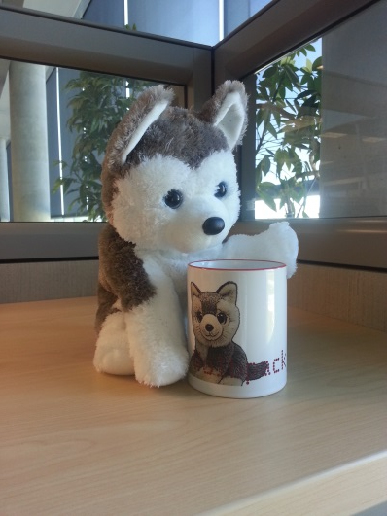
Your turn
Any questions?

