Slide 1


Imagery of Disabled People within Social Robotics Research
Sophya Yumakulov, BHSc, syumakul@ucalgary.ca
Gregor Wolbring, PhD, gwolbin@ucalgary.ca

Slide 2
Project Overview
Purpose: to explore the portrayal of people with disabilities within social robotics literature
Method: Literature review
Databases: ScienceDirect, Compendex, IEEE, Communication Abstracts, Scopus, OVID, EBSCO, Academic One File, Web of Science, and JSTOR
Number of articles reviewed: 171
Notes:
The purpose of our project was to look at how people with disabilities were portrayed in social robotics research and what implications that could have.
This project was a literature review of social robotics research
Used these databases from the University of Calgary

Slide 3
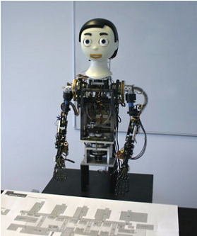
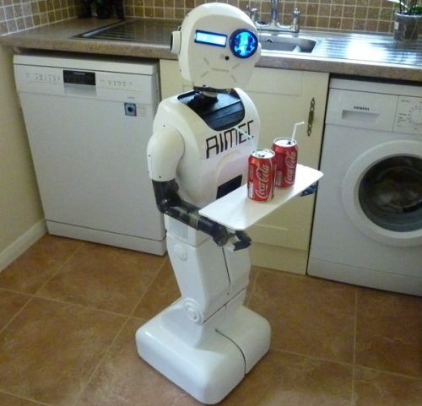
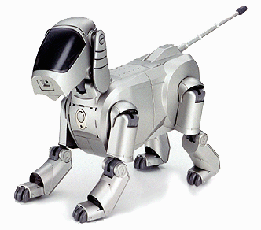
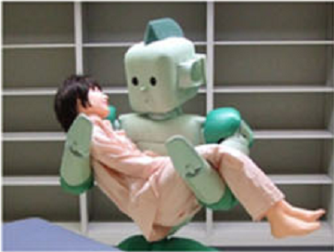
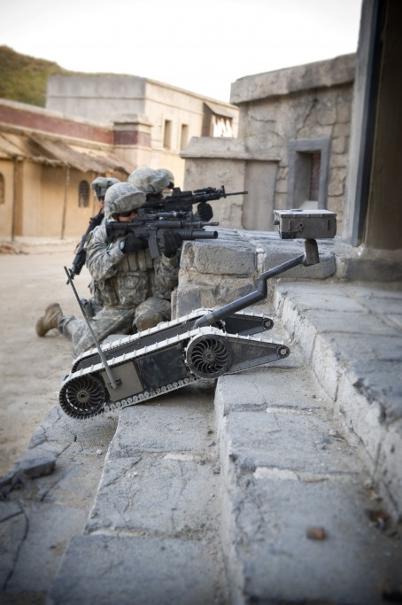
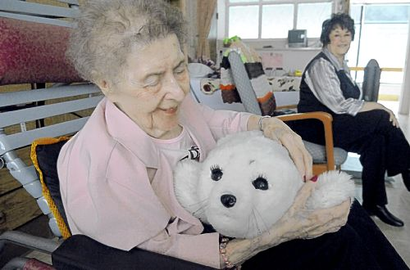
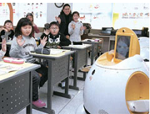
Overview of social robotics research
Notes:
Social robotics is the science of creating complex machines, or robots, that can interact with people and with each other autonomously
Developments of social robots span all industries and sectors, and nearly all aspects of life.
Main areas of social robotics development include military, household, industrial, companionship, and healthcare – I will focus on healthcare applications here.

Slide 4
Top publishing countries:
Notes:
Robotics research has increased exponentially over the years. These are the top publishing countries, as you can see, Canada is well on its way to being a good contributor to the research. One of our own researchers of the u of c, Dr. Tanya Beran, is doing work on child interactions with robots

Slide 5
Social robotics and healthcare
Keyword | Number of articles
Health | 60
Healthcare | 19
Patient | 40
Elderly | 47
Disability | 30
Autism | 28
Stroke | 9
Rehabilitation | 21
Notes:
There are a number of healthcare applications being developed and tested. They include receptionists, blood pressure-taking robots, patient moving, patient bathing, eldercare, people with disabilities.
The other focus is on people with disabilities
- Autism and other intellectual disabilities, stroke rehab, elderly

Slide 6
Imagery of disabled people
Medical perspective and ability-deficit orientation
Ability-charged definitions and terms:
Ex. children with autism have “deficits in theory of mind”, or “functional limitations”
Results in “fixing” framework for robotics applications
Notes:
Most articles about applications for people with ability differences used a medical perspective
– medical definitions and ability charged terms – emphasizing the ability deficiencies of people with disabilities.
- Taking autism as an example, researchers focus on what autistic children can’t do (make eye contact, social interaction, understanding/recognizing emotion) – and then propose that a ROBOT can help to fix these things
- treatments, diagnosis, therapy
- Ability charged terms

Slide 7
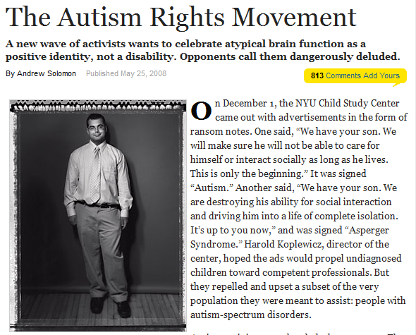
Implications
What about the alternative view?
Neurodiversity
Need for inclusion of alternative views of disability and the solutions that social robotics can offer
Notes:
This dominant medical narrative is not the only way to see things – neurodiversity – accept people as they are and not try to change them
but this perspective is not included in social robotics research so far,
- and there is a distortion of the views of what the problems are that people with disabilties are facing, and therefore what solutions social robotics can offer
The views and perspectives active in this research now will dictate where it will go! Right now the focus is on medical aspects of disability, the fixing framework, and as far as we can see, there is limited involvement of people with disabilities for these applications.
Inclusion of people with disabilities in this work is lacking, and this research is happening on a global scale, and in the long run, the question will become – where is the funding going? For what solutions, and what problems, and really, who is deciding?
The health and well-being of people with disabilities seems to be the priority of this research, but the very people who could potentially benefit from robotics applications, (and who have a diversity of views on what social robots can do for them), seem to not be included, judging by the very one-sided aims and perspectives that this research has taken so far
This is something that is lacking, but because this is a new area, still growing, and developing, there is certainly room for change, room for inclusion.

Slide 8


Acknowledgements
Dr. Gregor Wolbring
SSHRC
University of Calgary
We acknowledge the support of the Wolb-Pack

