Slide 1
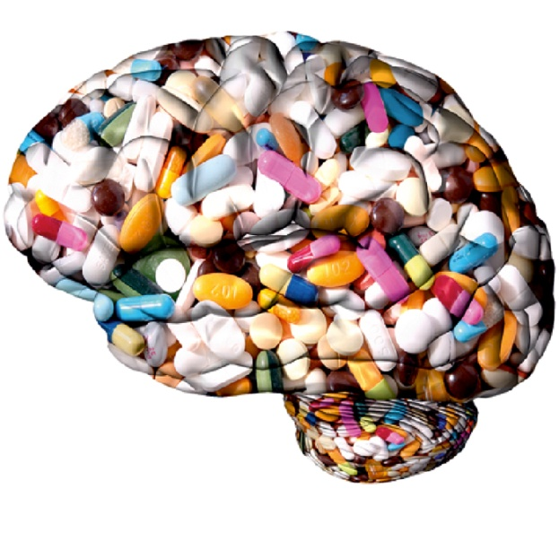
Neuroenhancement Beyond the Normal: A Topic for Disability Studies
Natalie Ball; Gregor Wolbring
Department of Health Sciences, Faculty of Medicine, University of Calgary
neball@ucalgary.ca
Image: http://www.gehirn-und-geist.de/alias/dachzeile/gehirn-geist-das-memorandum/1008082

Slide 2

Neuroenhancement
Rehabilitation and restoration intended for those who perform below what is seen as typical for humans to bring them to a ‘normal’ level [1-3]
Enhancement is intended to bring users above ‘normal’
Example: healthy users consuming pharmaceuticals intended for those with cognitive deficits
In the future: artificial hippocampus, genetic modifications, synthetic biology
Prototype of an artificial hippocampus.
Image from: http://hplusmagazine.com/2009/03/18/artificial-hippocampus/
Notes:
Just to ensure everyone’s on the same page, I want to provide a definition of neuroenhancement. This term is used in different contexts throughout the literature, but the definition of neuroenhancement that I employ for this project is that neuroenhancement is the use of techniques to bring the consumer above what is considered to be ‘normal’ in terms of cognitive capabilities. Therefore, neuroenhancement doesn’t fall within the realm of treatment or rehabilitation—often, neuroenhancement may be used by people without any existing cognitive deficit whatsoever.
What we’re seeing currently is university students using Ritalin to improve their academic performance, despite not having ADHD.
In the future, this may mean genetic manipulation to improve intelligence, brain implants that improve memory, and so forth.
The picture that I have here is a prototype of an artificial hippocampus, with two little nodules attached to the base. Though this technology is still in development, the idea here would be to implant this into your skull and use the electrical signals that occur within your brain to interpret stimuli and act as a repository and storage for memories.

Slide 3
Neuroenhancement a recognized issue—many feel we should be allowed to take neuroenhancers, and 6.9% of college students in the United States already report doing so [3-5]
Changing ability expectations!
Notes:
Where are neuroenhancements at now? As I’ve already noted, the use of prescription drugs by healthy individuals is being reported within universities.
With the constantly burgeoning pharmaceutical industry, the potential is there that more and more drugs that are being developed for Alzheimer’s, schizophrenia and the like will be used for the purposes of enhancement.
The purpose of this project was to examine the extent to which neuroenhancements are visible within various sources.

Slide 4
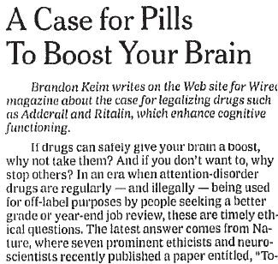
Visibility—Newspapers
 | New York Times (1995-2011) | Globe and Mail (1995-2011) | Canadian Newsstand (1995-2011)
Cognitive enhancement | 7 | 0 | 34
Cognitive enhancers | 5 | 0 | 50
Smart Drugs | 15 | 3 | 237
Neuroenhancement | 0 | 0 | 0
Memory enhancers | 7 | 0 | 86
[6,7]
Notes:
Moving onto the results, this is some of what we found when looking through newspapers. We looked through the New York Times, the Globe and Mail, and the Canadian Newsstand (which is a compilation of multiple Canadian daily and weekly newspapers), all from 1995 to 2011.
I have a table up here, but just so everyone can grasp it I’ll read out the highlights.
The phrase “cognitive enhancement” appeared 7 times in the NYT, 0 times in GM, and 34 times in the Canadian Newsstand. However, it’s important to remember that cognitive enhancement is a type of therapy.
The term neuroenhancement didn’t show up in any of the three sources.
‘Smart drugs’ was the most common neuroenhancing term that we found in the three sources—15 times in the New York Times, 3 times in the Globe and Mail, and 237 times within Canadian newsstand.
This table is just a snapshot of what we looked for in the newspapers. The actual academic terms—cognitive enhancement, neuroenhancement—are not used often in newspapers. This may mean that these topics aren’t deemed as newsworthy, or it may be that different terms are being utilized. For example, the phrase “smart drugs” fared a little better; however, even this appeared only three times in a sixteen year period in the Globe and Mail.
When we are looking at actual drugs, there was high visibility with Ritalin, Dexedrine, Adderall, amphetamines, caffeine, and nicotine. This may indicate that there is a greater discussion of the use of specific drugs for neuroenhancement—Patridge et al. found that, indeed, the effects of so-called ‘smart drugs’ have been exaggerated within the news. Overwhelmingly, these articles mentioned the benefits of such drugs, and it appears that there has been little discussion of the overall practice and ethics of neuroenhancements—only side effects and cognitive benefits of specific drugs.

Slide 5

Visibility—Organizations
Six organizations discussed enhancements. Only one gave guidance.
Almost 1800 organization had no mention whatsoever.
None mentioned enhancement in Canada
Notes:
After obtaining two lists of over 1800 organizations within Canada and the United States, we found that only six (all American) discussed neuro or cognitive enhancements in a non-therapeutic sense.
The only organization that actually provided any guidance with respect to enhancements was the American Academy of Neurology.
This illustrates that currently, neuroenhancement is not seen as a salient issue within most professional organizations in North America.

Slide 6
Visibility—Government Websites
Canada—no mention of neuro/cognitive enhancement whatsoever.
United States—15500 hits for “cognitive enhancement” (mostly referring to therapy); 164 for neuroenhancement
Notes:
With respect to government websites, the Canadian government has nothing linked on their website discussing cognitive enhancement or neuroenhancement.
Cognitive enhancement was a major key phrase, but looking through some of the results, it’s clear that for the most part, these hits are referring to cognitive enhancement therapy, which is rehabilitative.
The United States government website links to a number of academic papers on neuroenhancement in the non-rehabilitative sense, as well as clinical trials for neuroenhancement in a restorative or rehabilitative sense.

Slide 7

Visibility—Academic Literature
Literature breakdown
Skewed distribution of output from different countries
Clinical Trials
Understanding of neuroenhancement as restorative
Theses
21 in North America—1 from Canada, 20 from United States
Grants
Notes:
Recent and current clinical trials are using the term neuroenhancement; however, it’s being used in the restorative and rehabilitative sense, meaning that they are using neuroenhancement as a treatment or a way of mitigating illness or differing abilities.
In terms of grants, projects on enhancement have been awarded funding. There have been recent projects addressing the concept of identity when enhancements are introduced, stakeholder and public perspectives on methylphenidate (Ritalin), and a few different projects exploring the philosophy and ethics of neuroenhancement.

Slide 8
Visibility—Academic Literature
Country | “Cognitive Enhancement” (n=706) | Neuroenhancement (n=118)
United States | 299 | 26
United Kingdom | 70 | 10
Germany | 31 | 40
Canada | 33 | 8
Spain | 22 | 1
Australia | 17 | 7
Brazil | 15 | 2
Netherlands | 14 | 3
India | 13 | 1
Origin of primary author for academic articles in Google Scholar using the terms ‘cognitive enhancement’ and ‘neuroenhancement’ (search conducted from 2011- on Oct. 5, 2011).
Notes:
Here I have a breakdown of cognitive and neuroenhancement discourse from 2011 based on the origin of the primary author, to see where the literature on neuroenhancement is coming from.
We recognized when we completed this part of the project that these numbers certainly may be skewed because they are English terms. However, a great deal of abstracts from non-English speaking countries will publish an abstract in English. Because Google Scholar picks up abstracts, this can serve as a preliminary idea of which countries are producing what in terms of the neuroenhancement debate.
The most mention of cognitive enhancement was overwhelmingly from the United States with 299 articles originating from the United States. Next was the UK with 70, then Canada with 33 and Germany with 30.
When using the term neuroenhancement, which we found to be more likely to capture a non-therapeutic form cognitive improvement than the phrase ‘cognitive enhancement’, Germany produced the most articles with 40, followed by the United States with 26, United Kingdom with 10, and Canada with 8.
These are just the top countries in terms of output related to neuroenhancement and cognitive enhancement; what we found was that there were a few countries (the United States, Germany and the UK) putting out the bulk of the academic literature. Many countries had only published one or two articles on the topic of neuroenhancement, or none at all—we found this was especially true in less industrialized countries.

Slide 9
Discussion
Low overall visibility, especially pronounced in Canada
Could mean lack of consideration of the benefits and potential dangers of neuroenhancement
Lack of clinical trials [8]
Implications for disabled people
New concept of ‘normal’
Doubly disabled?
Availability
Visibility in developing countries low
Notes:
Ultimately, we found that the overall visibility of neuroenhancement was low, particularly when comparing Canada and the United States
According to Forlini and Racine, despite few clinical trials on neuroenhancing drugs and the results of those trials showing that such drugs have little effect on healthy individuals, many discussions about neuroenhancements are in favour of such drugs or devices, with the media often exaggerating the effects of these so-called ‘smart drugs.’
If the academic world and the media are leaning towards the use of neuroenhancements, why aren’t the government and professional organizations engaging in the debate? There are no reports from the Canadian government on the topic, and very few from the United States.
As such, there is very little guidance to the general public with respect to how neuroenhancements should be approached.
Finally, of course, I want to discuss the possible implications for people with disabilities.
Neuroenhancements (and human enhancements more generally) may be only available to those who can afford them, meaning that many people with disabilities will be unable to procure them—if they even want to enhance themselves at all, though there may be increasing pressure to do so.
This is especially salient within developing countries and countries with more pronounced income inequality, and these were the countries that were not found to be involved in the discussion of neuroenhancements.
Despite that neuroenhancements are currently in the development stage, such technologies have the potential to shift what is considered to be ‘normal’ or ‘expected’ of people.
In turn, there is the danger that people with disabilities could be ‘doubly disabled,’ whereby they would face further marginalization than they already do. There are the non-disabled and the disabled, but with the increasing advent of human enhancements, there may be another group added to the top of the hierarchy—the enhanced.

Slide 10
Conclusion
Greater public engagement, discussion of neuroenhancement
More realistic discussions of neuroenhancements
Consideration of neuroenhancement within disability studies
Greater exploration of possible impacts, current thoughts on neuroenhancement within the disabled community
Notes:
We need to continue the discussion of neuroenhancements, particularly as new technologies are being developed, and facilitate both discussions that are realistic based on the current products and discussion that grapples with potential future problems.
More data on neuroenhancements are needed with respect to public opinions, people’s moral stance on enhancements, and rigorous estimates of use.
Finally, I would argue that neuroenhancement should become a topic for consideration within disability studies.
Neuroenhancements bring with them the potential to further disable people with impairments, and it should be explored how disabled people and their caregivers view enhancements.
Next year, I’m hoping to complete my undergraduate honours thesis interviewing parents of disabled and non-disabled children to see what their thoughts and views are on enhancing their children. I’m hoping to see if there are any qualitative interviews between parents of disabled children and parents of non-disabled children.

Slide 11
THANK YOU!
Thanks to my peer group (the Wolb-pack), SSHRC and all of you for listening!

Slide 12
References
[1] Boorse C. Health as a Theoretical Concept. Philosophy of Science 1977. 44(4):542-73. Available from: URL: http://www.jstor.org/stable/186939
[2] Griffiths EH. Rehabilitation. Br Med J 1940. 2(4163):536-7. Available from: URL: http://www.bmj.com/content/2/4163/535.3.full.pdf?sid=cecff254-3e3b-4001-adbb-839c7322a47b
[3] Stucki G, Cieza A, Melvin J. The international classification of functioning, disability and health: A unifying model for the conceptual description of the rehabilitation strategy. Journal of Rehabilitation Medicine 2007. 39(4):279-85.
[4] Maher, B., Poll results: look who's doping. Nature, 2008. 452: p. 674-675.
[5] McCabe, S.E., et al. Non medical use of prescription stimulants among US college students: prevalence and correlates from a national survey. Addiction, 2005. 100(1): p. 96-106.
[6] Keim B. A case for pills to boost your brain. The New York Times. 2008 Dec. 14: WK3.
[7] Patridge B.J., Bell S.K., Lucke J.C,. Yeates S., Hall W.D. Smart drugs “as common as coffee”: Media hype about neuroenhancement. PloS One 2011;. 6(11): e28416.
[8] Racine E, Forlini C. Expectations regarding cognitive enhancement create substantial challenges. Journal of Medical Ethics 2009.35(8):469-70.

